Slide 1
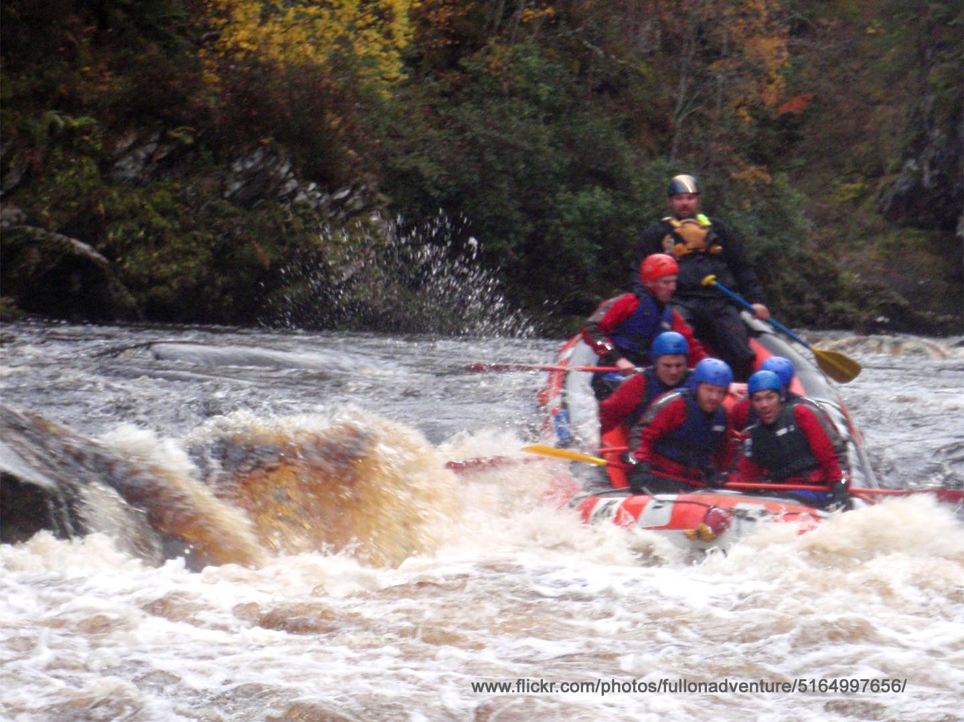
Surviving and Thriving in the IEP Accreditation Process
^{Joe McVeigh}
^{Bruce Rindler}
^{January 20, 2017}
^{EnglishUSA, Monterey}

Slide 2
Getting
started

Slide 3
Activity 1: Your experiences

Slide 4
Activity 1: Your experiences
What experience have you had with accreditation?
What are you concerned about ?

Slide 5
Getting people on board

Slide 6
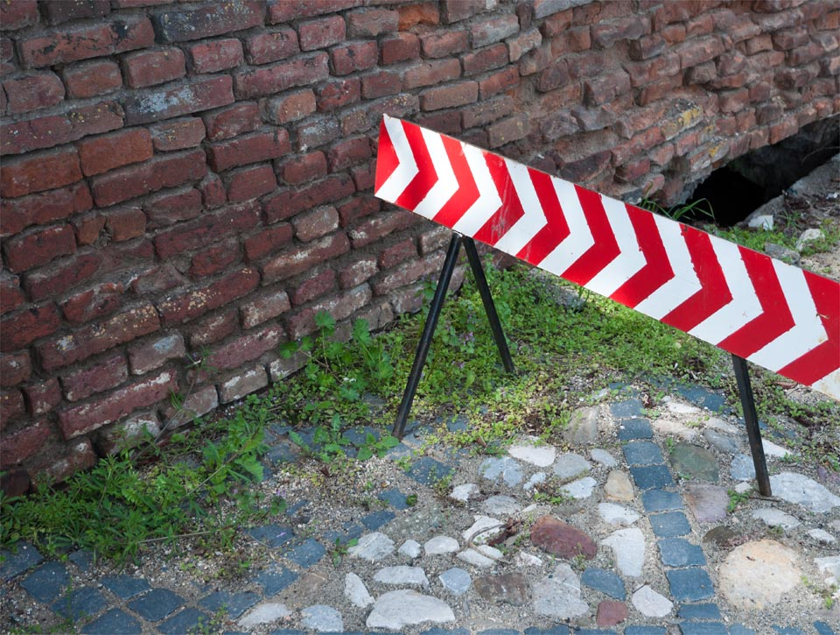
Activity 2:
Overcoming
obstacles

Slide 7
Activity 2:
What challenges do you
have at your institution?
How might you
overcome them?

Slide 8
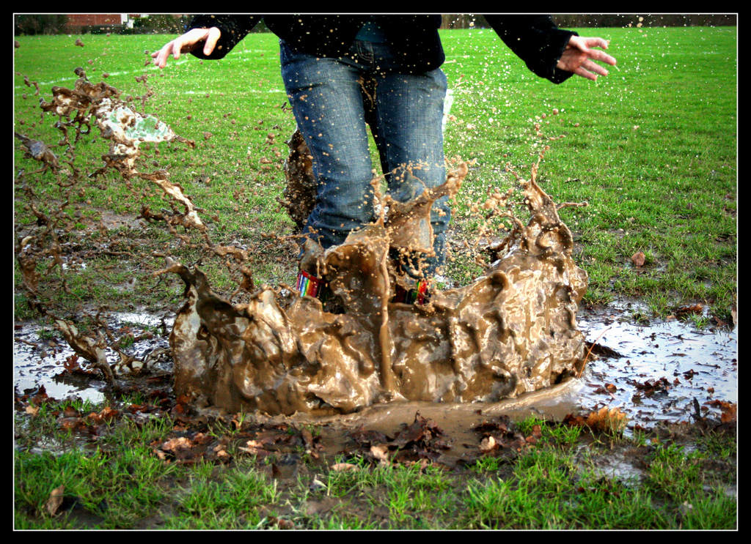
Making it
work

Slide 9
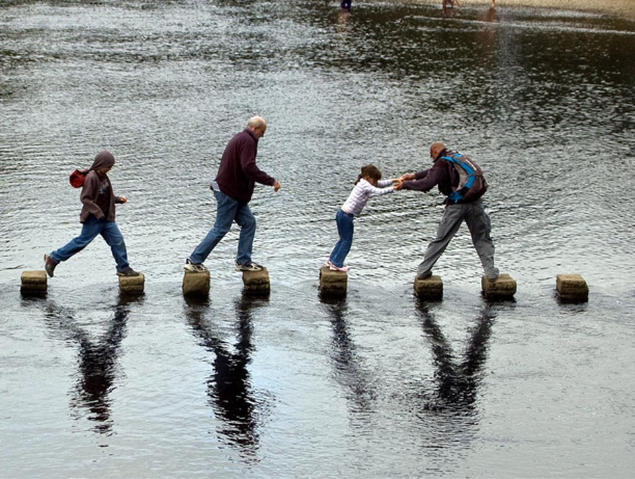
Project management

Slide 10
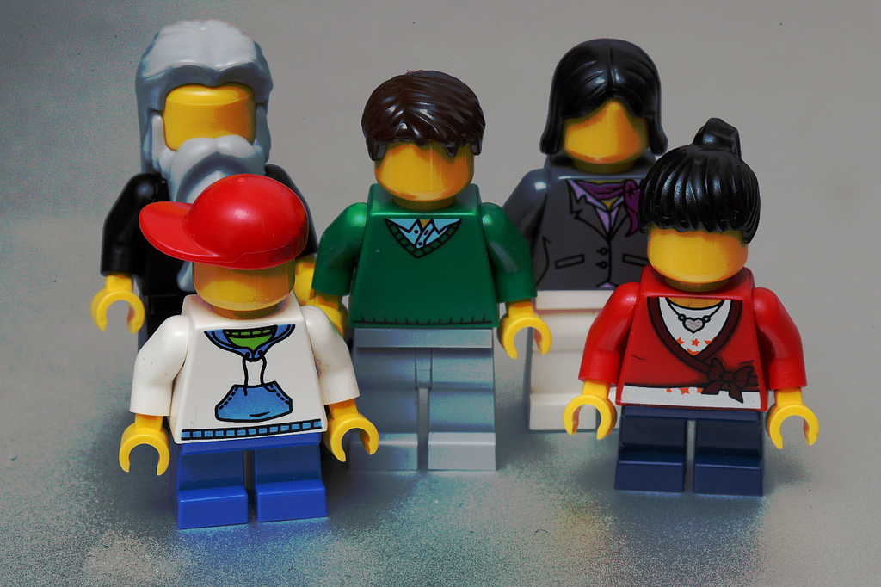
Who is doing what?

Slide 11
Planning

Slide 12
Time manage-ment

Slide 13
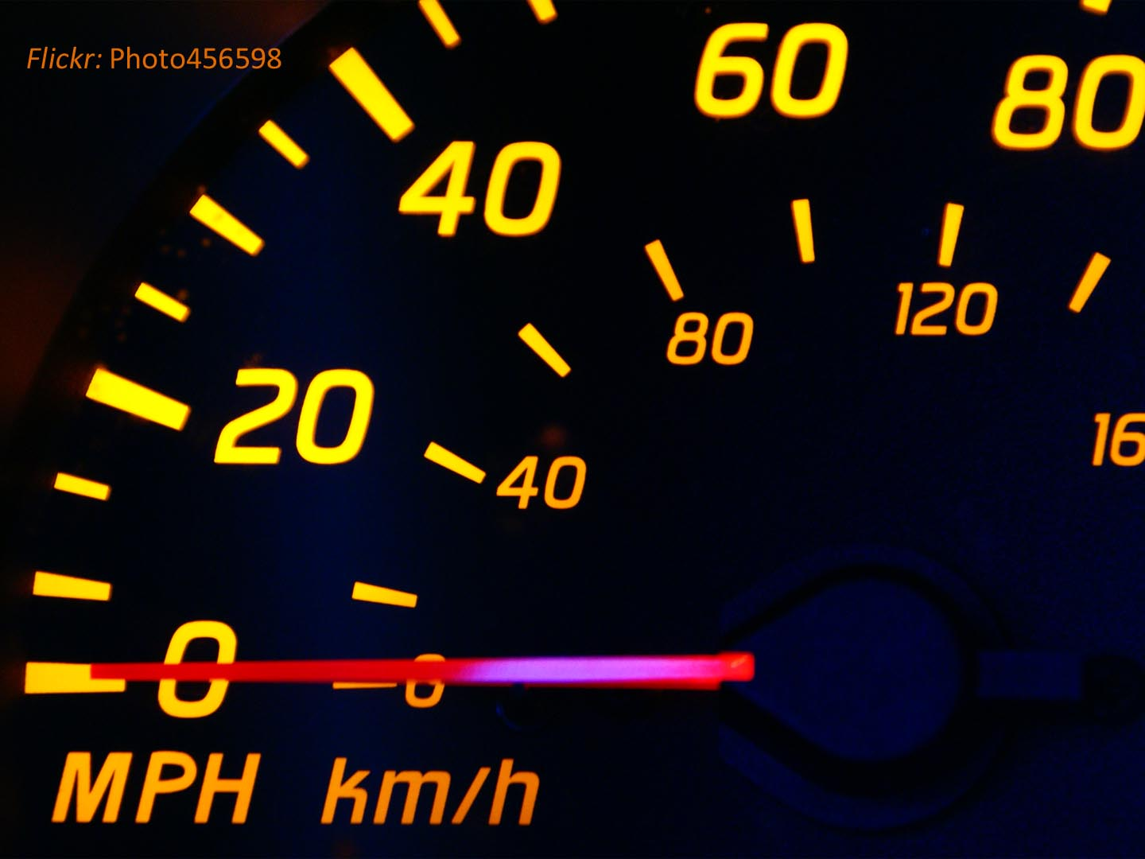

Slide 14
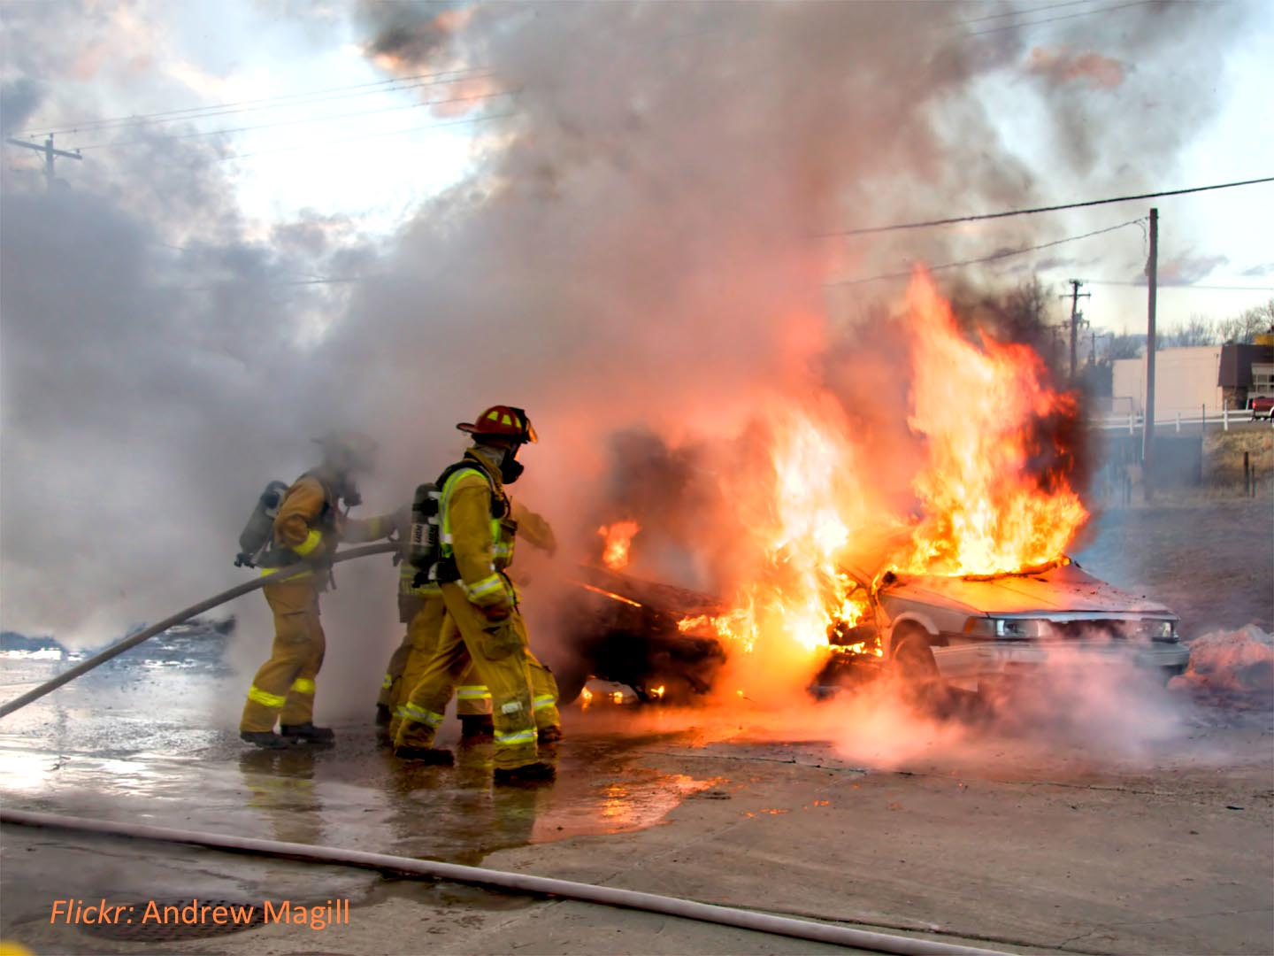

Slide 15
Nuts and bolts

Slide 16
Activity 3:
Understanding
the standards

Slide 17
Understanding the Standards
CEA
ACCET
CEA Standards for English Language Programs and Institutions
-Provides a context for each of the 11 standard areas and a discussion of the intent of each of the 44 individual standards.
- Available on CEA web site
Self-study Template
Identifies required responses for each of the standards
Available after CEA Accreditation Workshop
Standards for Accreditation
- Document #2
Analytic Self-Evaluation Report – ESOL (Word Doc)
- Document #3.4
English for Speakers of Other Languages (ESOL) Template
- Document #3.ESOL
- All documents available at ACCET web site

Slide 18
Activity 3:
With a partner
complete the activity on your
handout.

Slide 19
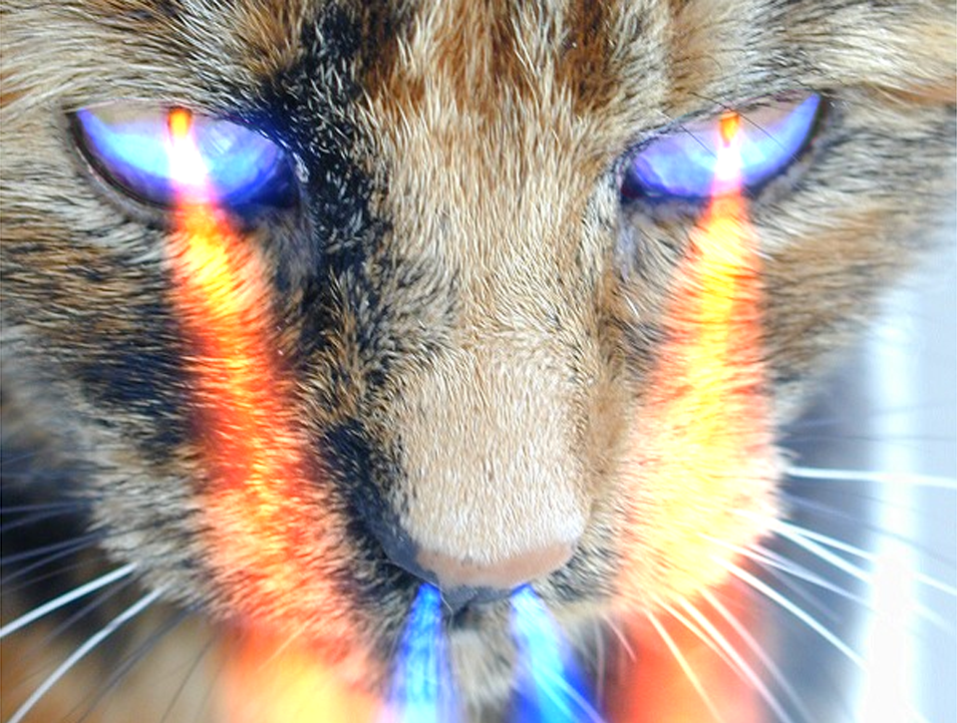
Looking more
closely at the
standards

Slide 20
Writing up the self-study or ASER

Slide 21
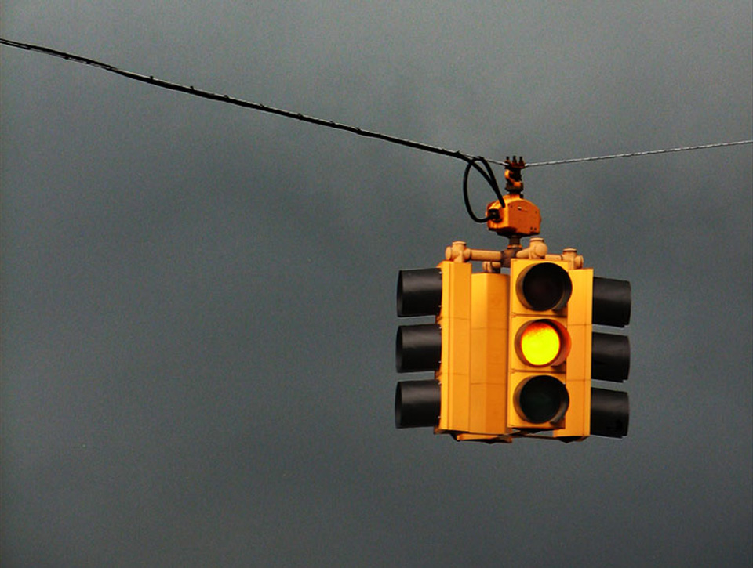
Caution !

Slide 22
The site visit and role of the visiting review team

Slide 23
Celebrate
success !

Slide 24
Questions &
Discussion

Slide 25
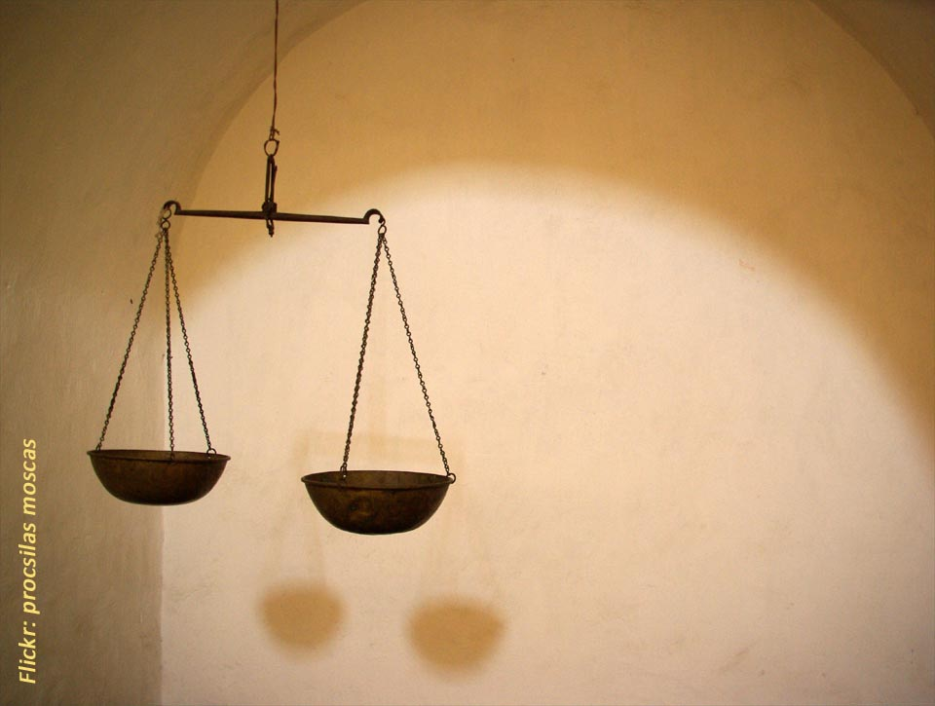
Please take a moment to evaluate the session

Slide 26
Thank you !
joe@joemcveigh.org
brindler@bu.edu
www.joemcveigh.org/resources

Slide 28
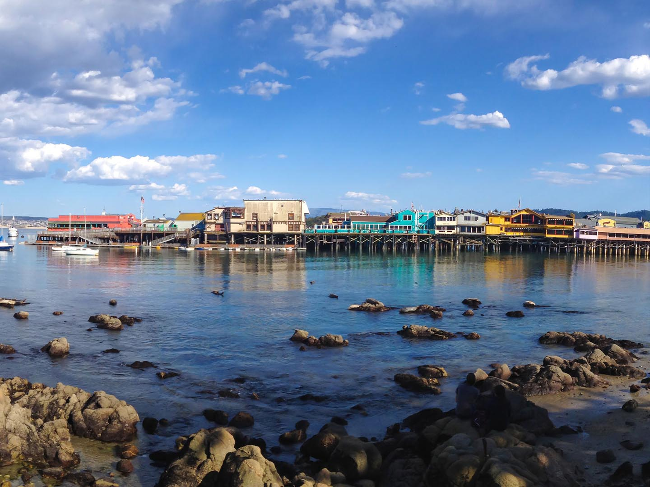
Thank you !
brindler@bu.edu
joe@joemcveigh.org
www.joemcveigh.org/resources

