Slide 1
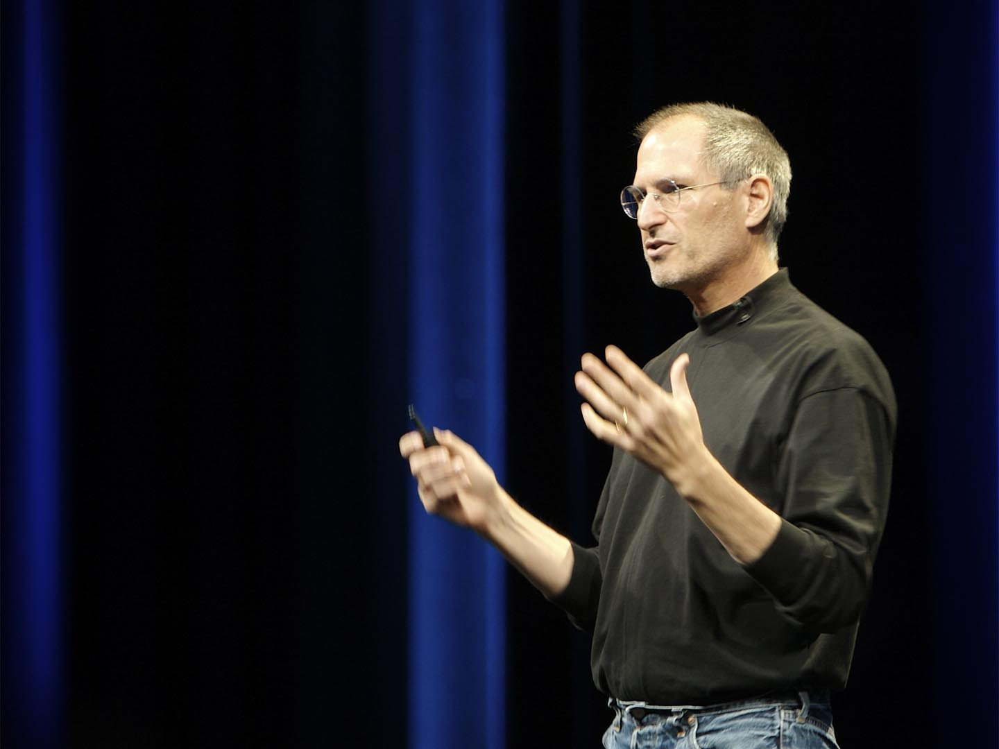
Effective Oral Presentations
Joe McVeigh
Higher College of Technology
Muscat, Sultanate of Oman
5 March 2012

Slide 2
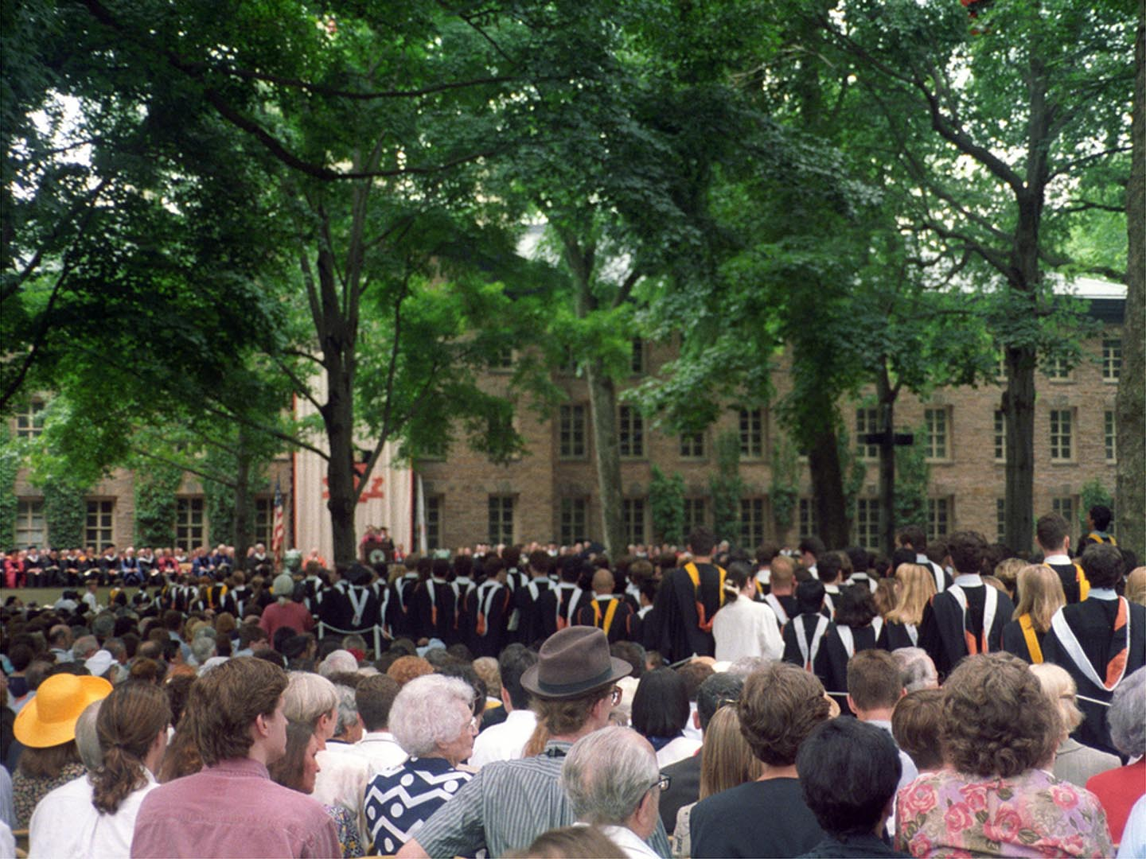

Slide 3
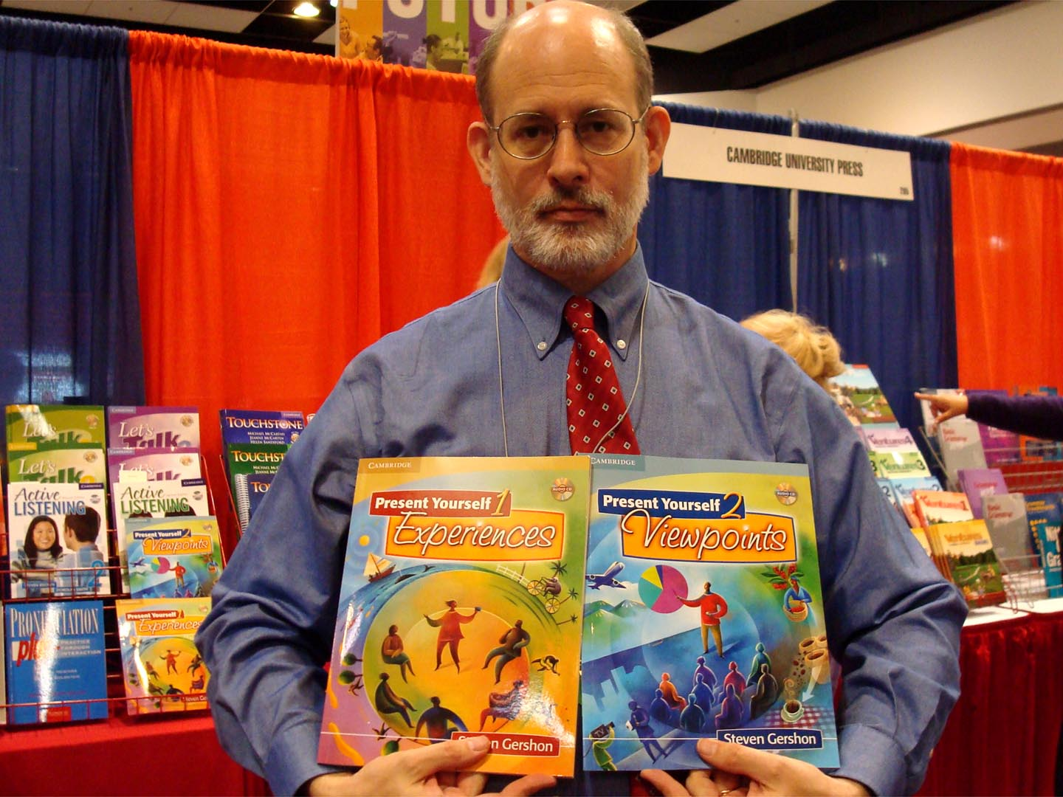

Slide 4
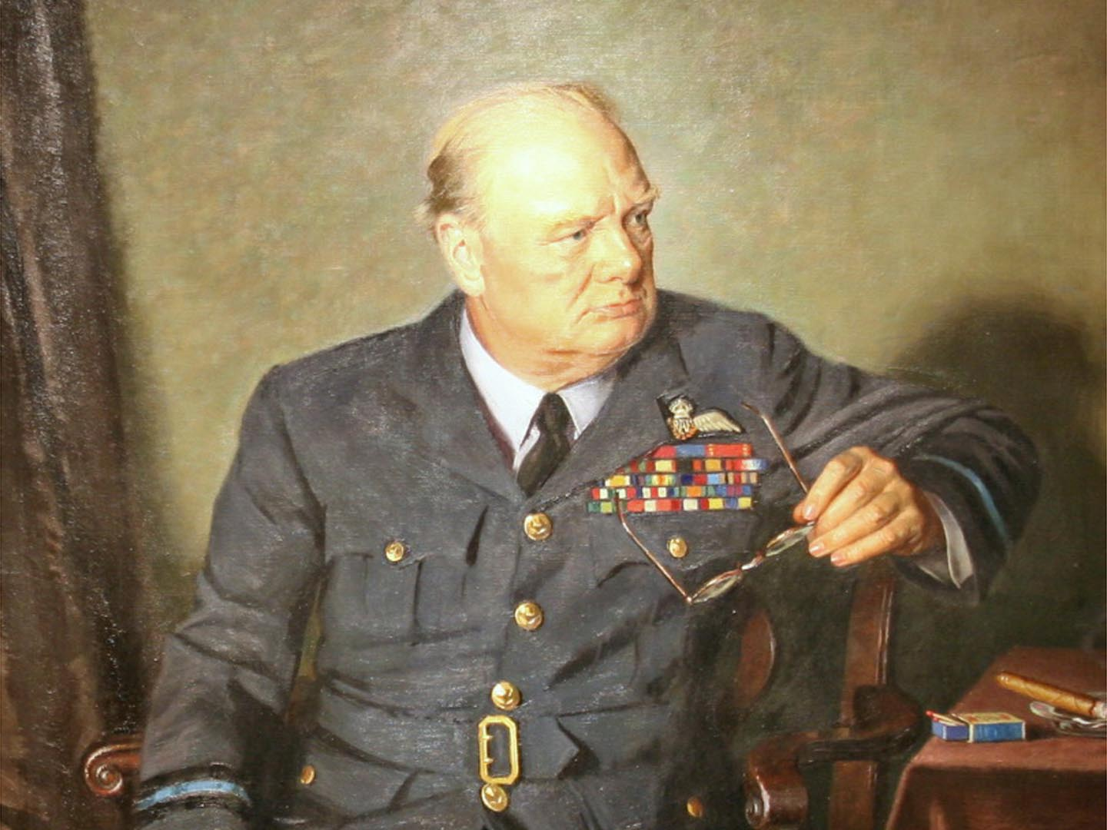
Characteristics of good speakers

Slide 5
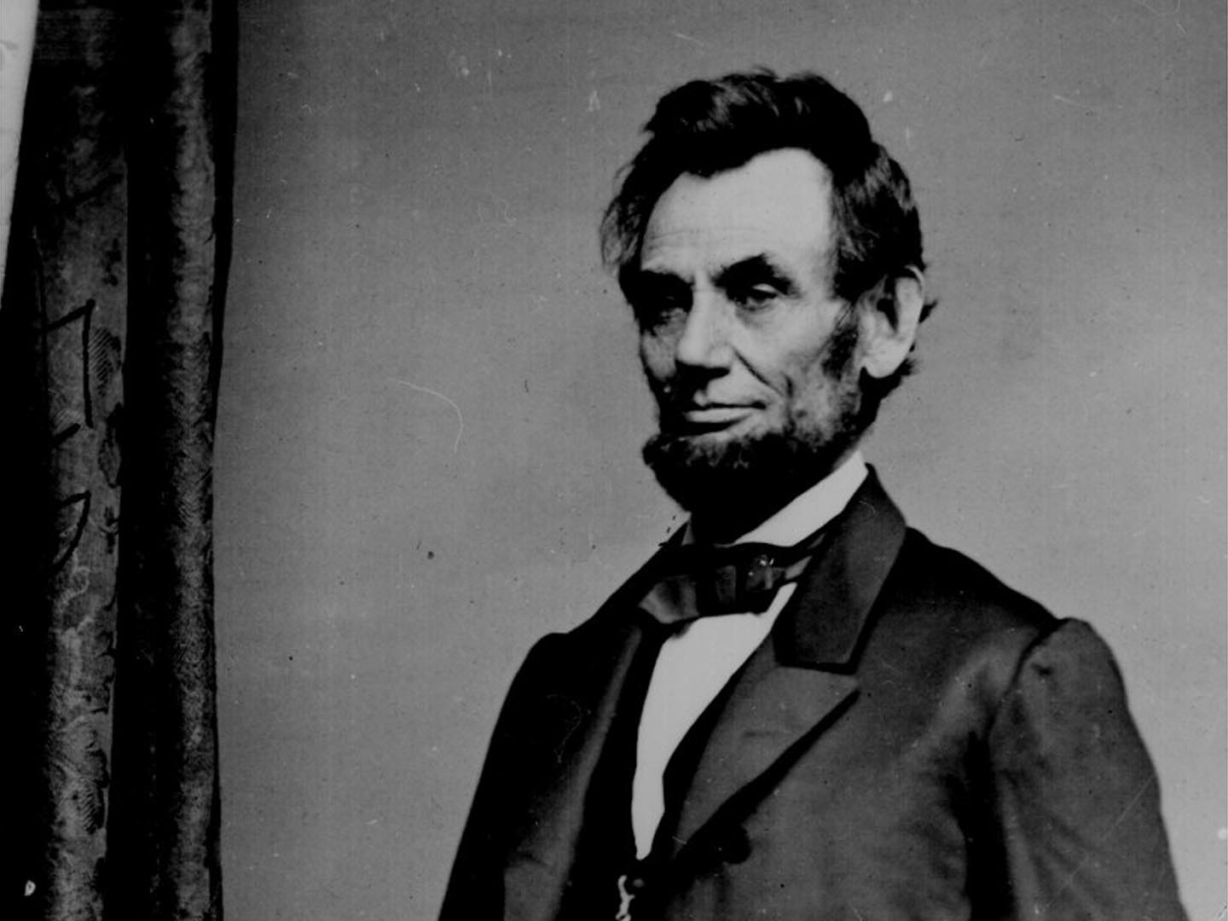

Slide 6
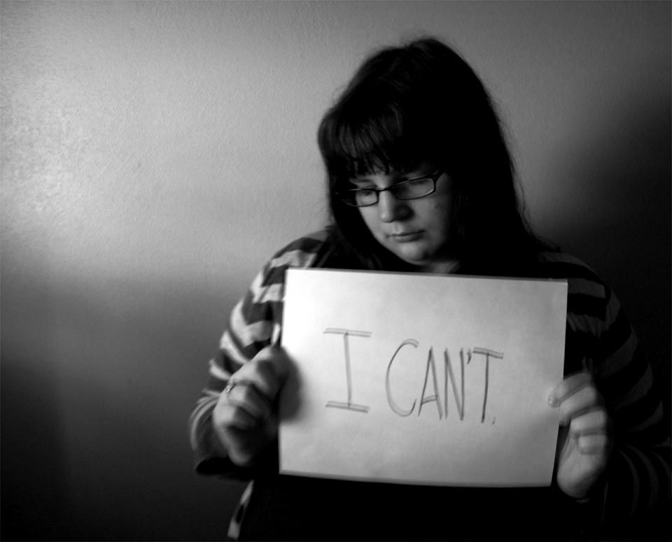
What do they want to do that they can’t do?

Slide 7
Delivery – language and verbal issues including pronunciation
Visuals – PowerPoint, etc.
Nonverbal communication
Preparation, content, structure clarity

Slide 8
What do you need to know to help them?

Slide 9
Controlled to less controlled activities

Slide 10
Barriers and obstacles

Slide 11
Preparation

Slide 13
Writing things down

Slide 14
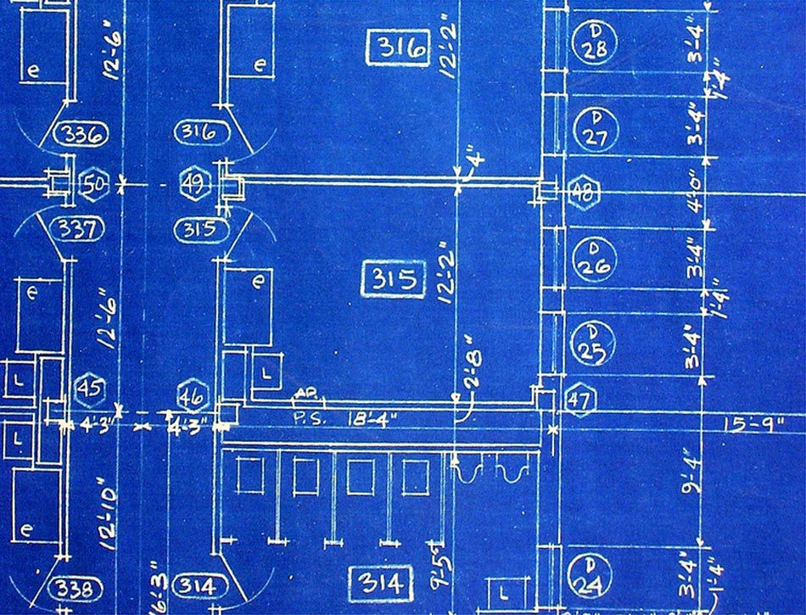
Structure and Content

Slide 15
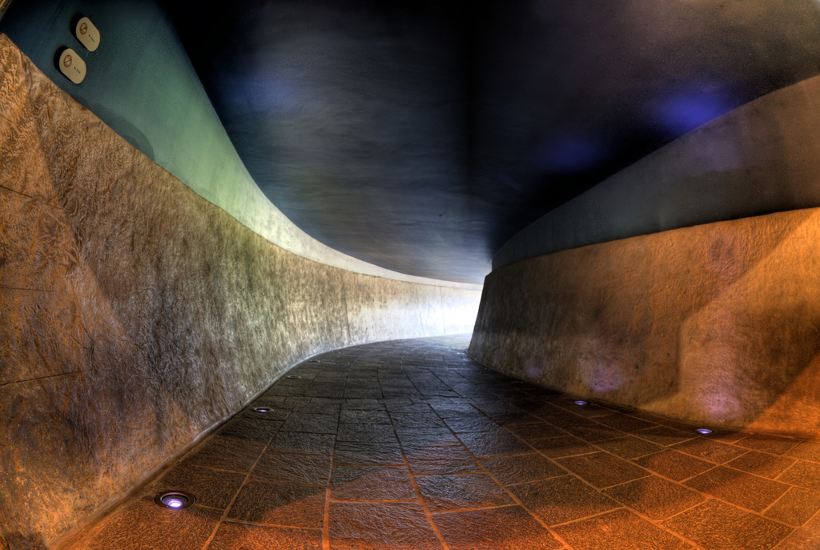
Structure – direction and narrowing the topic

Slide 16
Instead of imposing a limited choice and formal prep preparation time on the learner, another way of eliciting a short presentation is to try consciously to identify previous topics in earlier stages of the test. For example, the oral test can begin with a question and answer routine which deliberately asks about hobbies, professional interests, past experiences of different cultures, jobs, etc. Some examples of such probing questions are:
what do you do in your spare time?
What kind of books you like reading?
What did you do on your last vacation?
Do you enjoy traveling? Where to? Why?
If you could live anywhere in the world, where would you choose?
(Underhil)

Slide 17
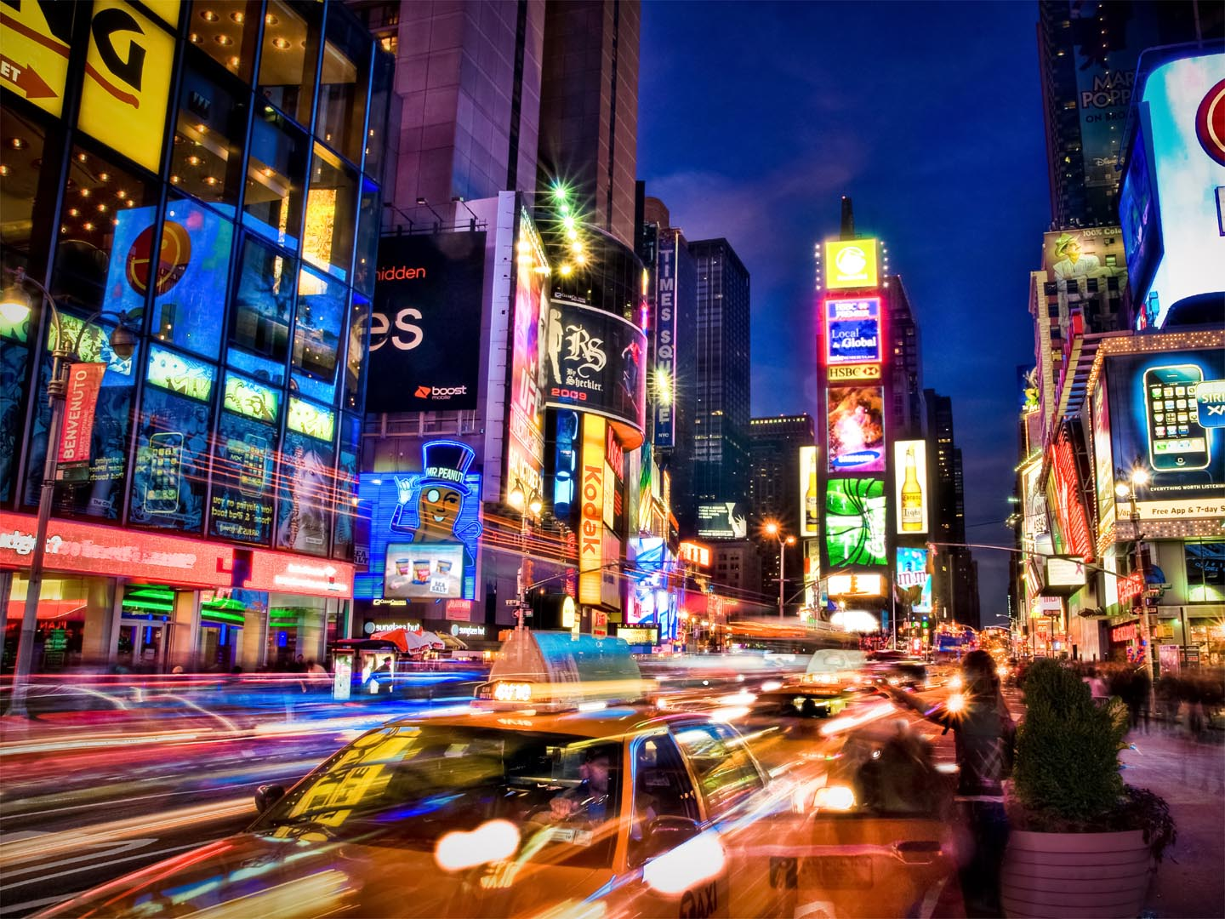
Too much going on

Slide 18
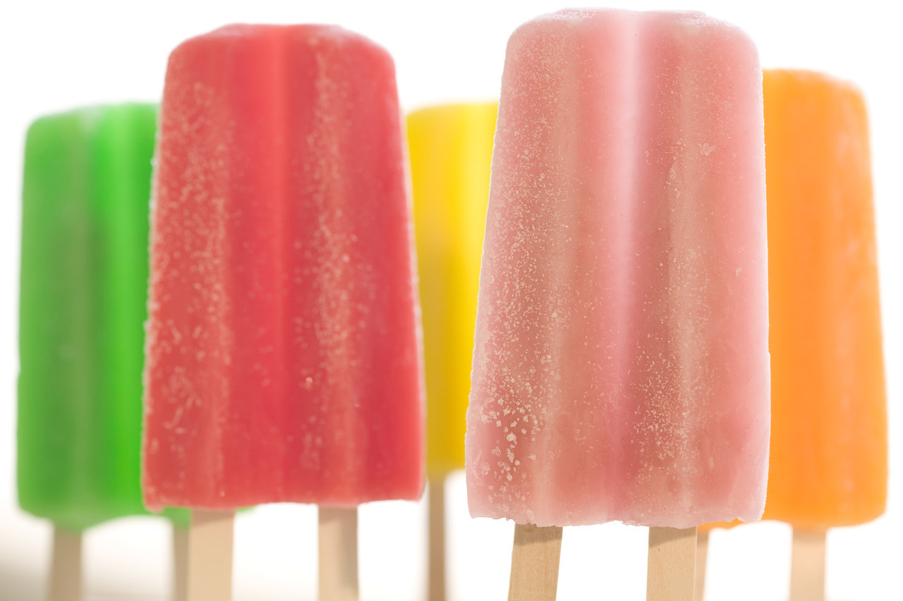
Variety

Slide 19
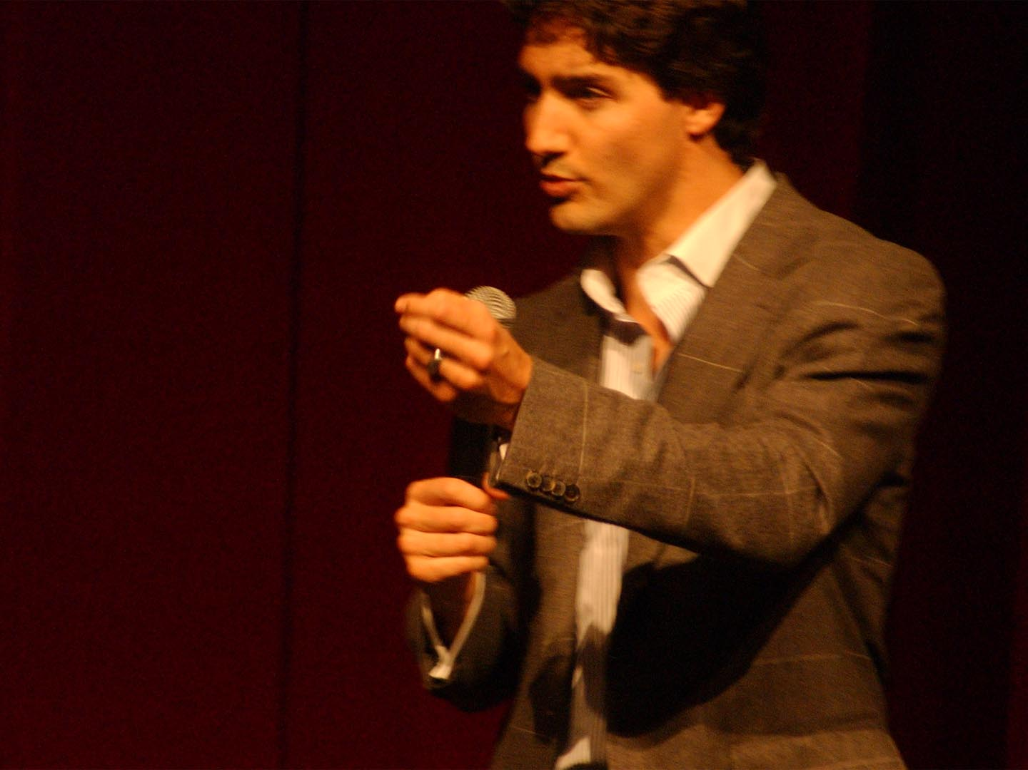
Nonverbal communication

Slide 20
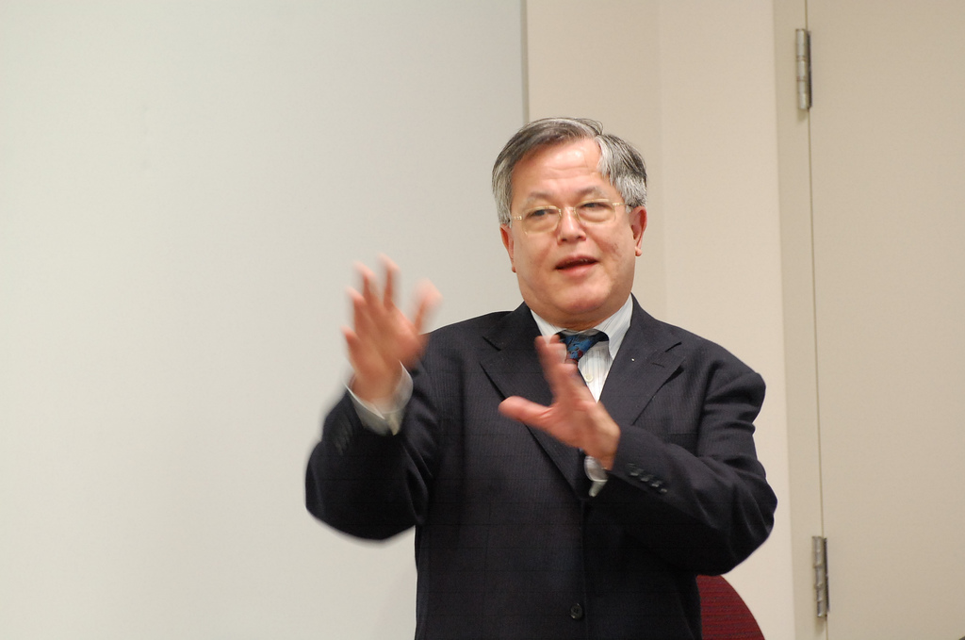
Gestures

Slide 21
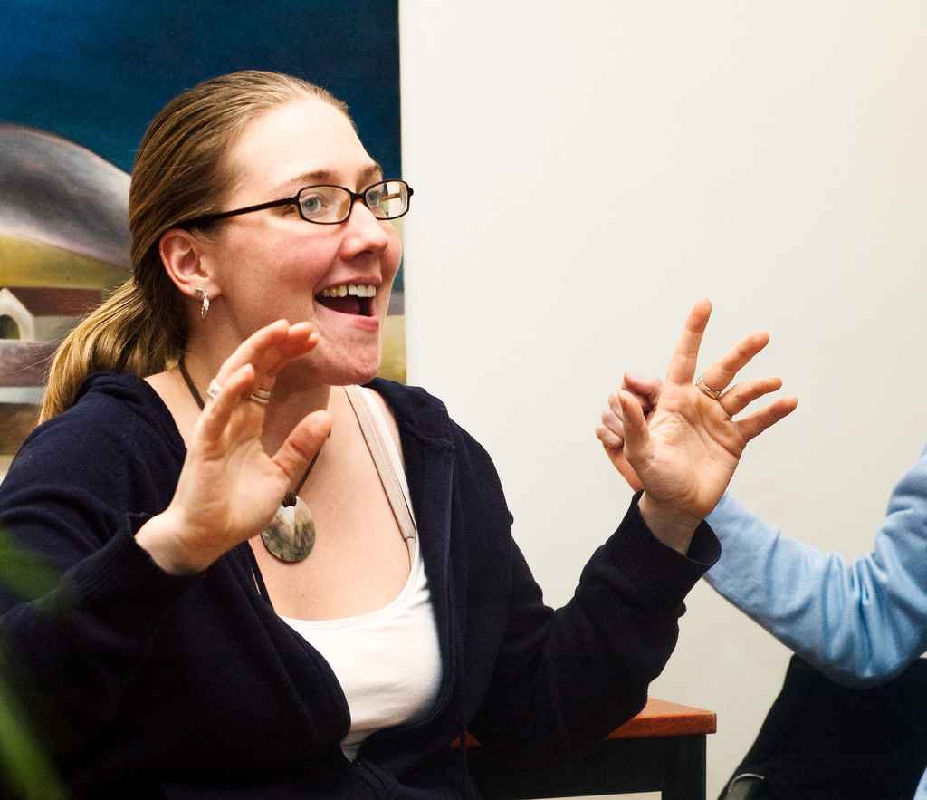
Enthusiasm

Slide 22
Reduce barriers between speaker and audience

Slide 23
Delivery

Slide 24
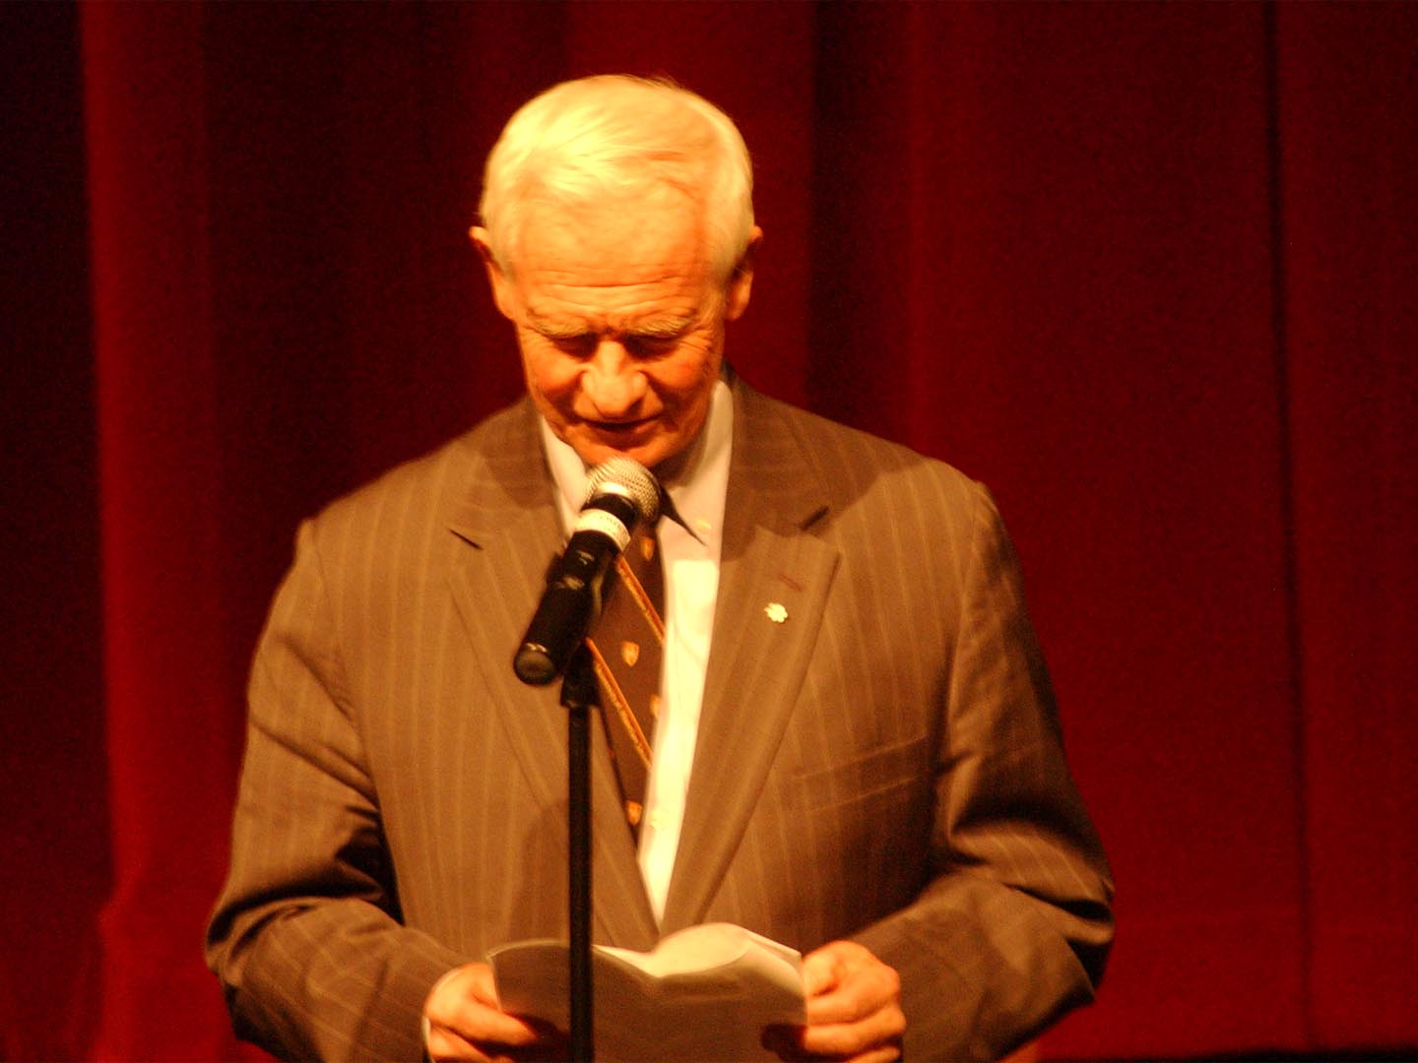
Don’t read !

Slide 25
Word Stress

Slide 26
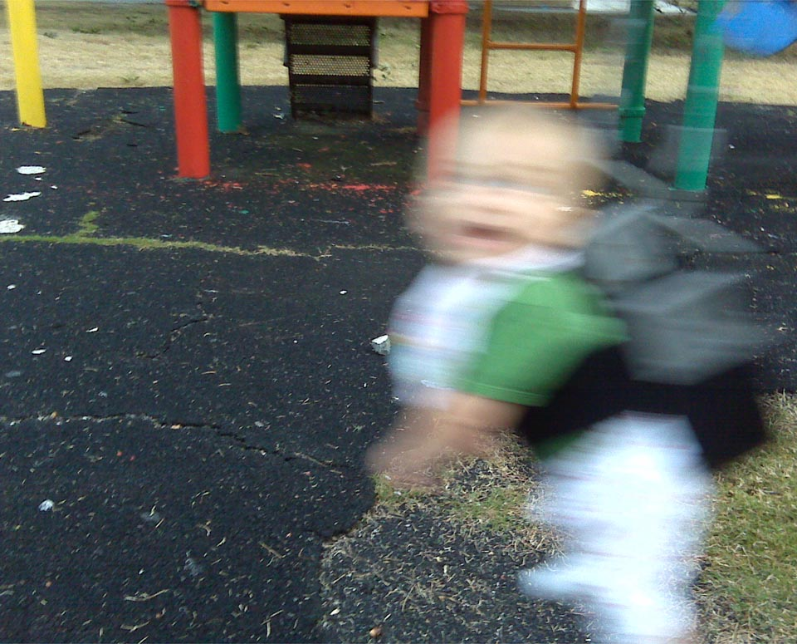
Sentence stress and reduced forms

Slide 27
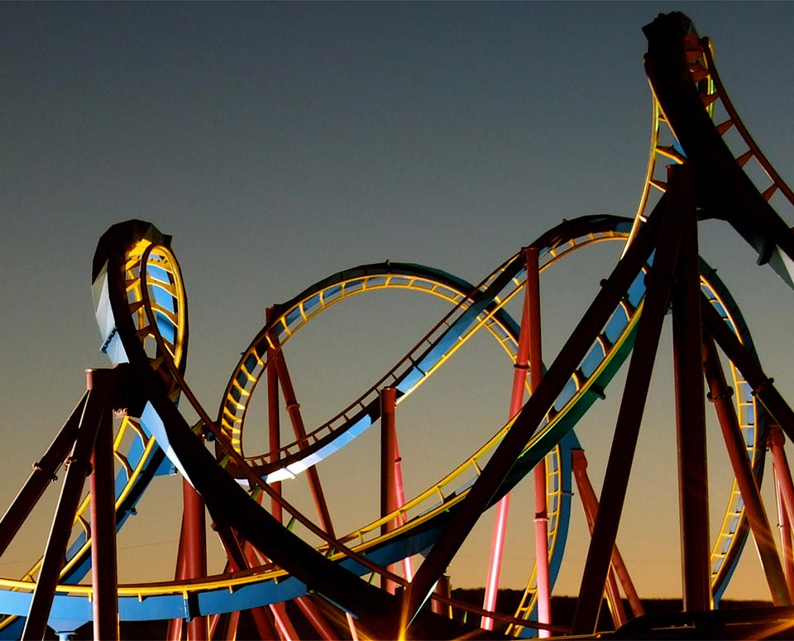
Basic intonation patterns

Slide 28
Delivery

Slide 29
Timing

Slide 30
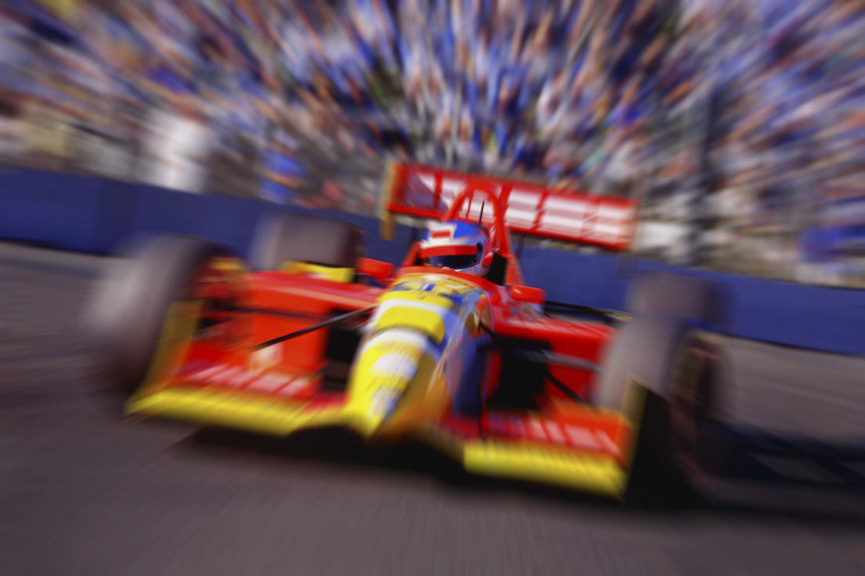
Speed of delivery

Slide 31
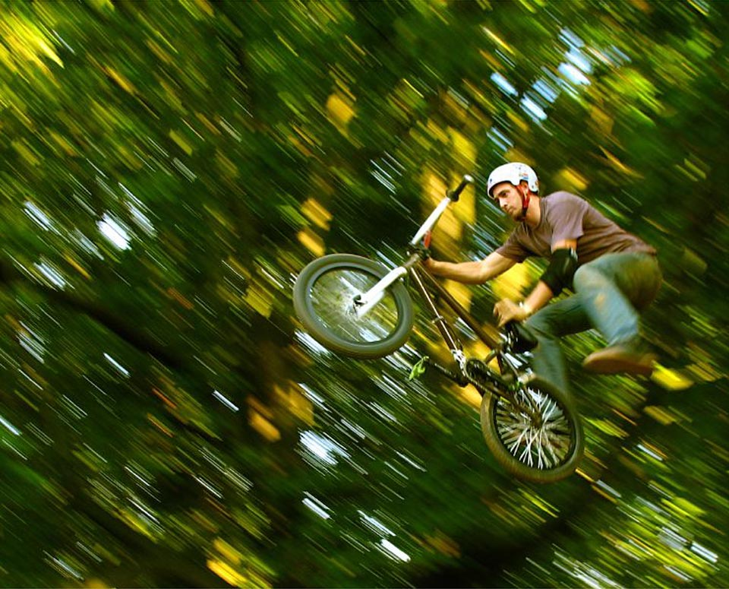
Risk-taking

Slide 32
What are the rest of the students doing?

Slide 33
Don’t be boring !

Slide 34
Excellent Good Needs Improvement Comments
Clear Thesis/Purpose
Organization
density of information.
Relevance to audience.
Use of relevant examples, details.
Use of transitions.
Coherence and clarity.

Slide 35
Voice
volume
speed of delivery.
Tone/level.
Accent/pronunciation

Slide 36
Gestures/Body Language
Hand Gestures
Body Position
Posture
Use of Stage Space
Handling of Visuals, Objects, etc

Slide 37
Student feedback
Quickly answer the following questions about the presentation after the presenter hasfinished. Circle the number you think best applies to the speaker. Number five is the highest score. Number one is the lowest. Write any comments on the lines below.
Did the speaker deliver the presentation clearly and confidently?
5 4 3 2 1
_____________________________________________________
did the speaker seemed well prepared?
Did the speaker move smoothly from idea to idea?
Did the speaker use adequate examples and explanations?
Speaker use movement and gestures appropriately?
Did the speaker make eye contact with the listeners?
Did the speaker make good use of supplemental materials?

Slide 38
Making a mini-presentation with limited preparation time.
Learners can be given a short list of topics. 10 to 15 min. before the oral test, and invited to choose one on which to speak for 2 min. During the test. The subjects will obviously be general, but should be phrased so as to encourage the learner to express his own opinions on specific aspects of the topic. Thus:
"do you agree with lower speed limits and the compulsory use of seat belts? Why?"
Is a better topic then:
"what should be done to improve road safety?"
And:
"what do you personally think are the best ways to improve contacts between people in different countries?"
Is better then:
"how can international understanding be improved?"

Slide 39
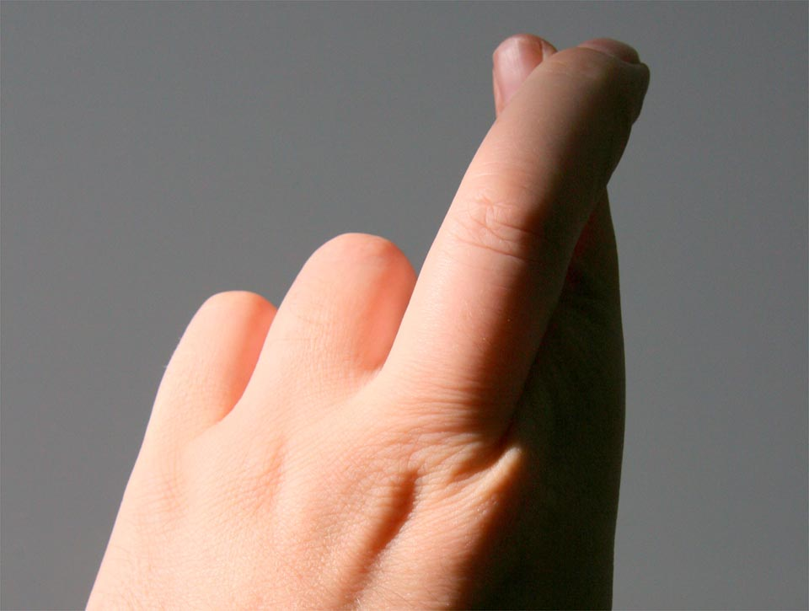
^{Intangibles}

Slide 40
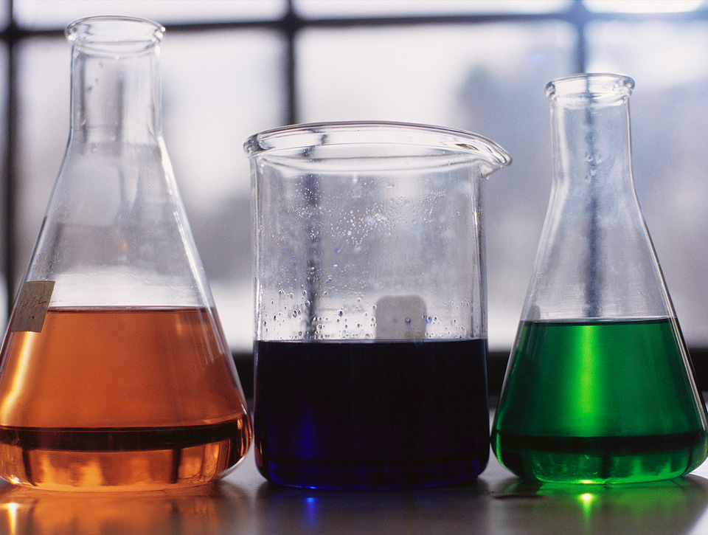

Slide 41
Questions

Slide 42
Useful resources

Slide 43
Photo Credits Some photos from flickr used under a Creative Commons license
Biking daredevil Martin Terber
Boy with glowing light “The hills are alive” Small and large buildings Ibrahim Iugaz
Blurred baby on swing Bart Everson
Roller coaster Justin Holzworth
Control key Faramarz Hashemi
Baby birds Robert S Donovan
Question mark Ethan Lofton
Colored thank you “vistamommy”

Slide 44
You’ll be able to download the handout and other resources at
www.joemcveigh.org

