Slide 1
Implementing Content-Based Language Instruction in your Classroom
Joe McVeigh
February 6, 2019
© 2019 by Joe McVeigh. Implementing Content-Based Language Instruction in your Classroom for the Office of English Language Programs. This work is licensed under the Creative Commons Attribution 4.0 License, except where noted. To view a copy of this license, visit http://creativecommons.org/licenses/by/4.0/

Slide 2
Today we will
define content-based instruction (CBI) and related terms
consider how to structure a CBI lesson
find source materials
establish language and content objectives
adapt texts as needed
determine key vocabulary
develop tasks to help students understand the content
assess student learning

Slide 3
What does content-based instruction mean?

Slide 4
Content-based language instruction is teaching English and teaching another subject area together in the same course

Slide 5
What are some possible content areas or subjects that can be taught in English?

Slide 6
Geography

Slide 7
History

Slide 8
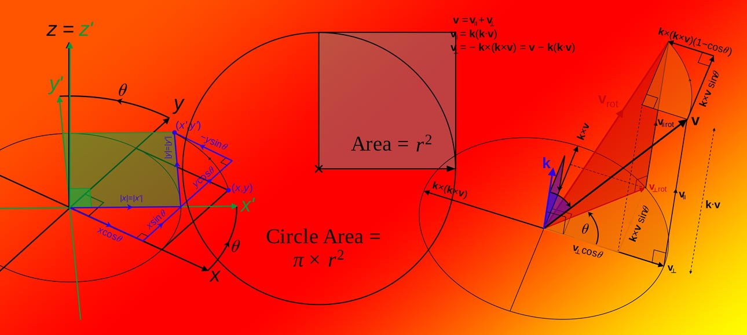
Math

Slide 9
Physics

Slide 10
Chemistry

Slide 11
Different kinds of content-based language instruction
Content-based instruction (CBI)
Content and Language Integrated Learning (CLIL)
English as a Medium of Instruction (EMI)

Slide 12
All types of content-based instruction (CBI, CLIL, EMI) have the same goals for students:
construct knowledge and develop understanding about a topic and a learning task;
use language meaningfully and purposefully; and
learn about language in the context of learning through language.

Slide 13
Different kinds of content-based language instruction
Content-based instruction (CBI)
Content and Language Integrated Learning (CLIL)
English as a Medium of Instruction (EMI)

Slide 14
Content-based instruction (CBI)
A formal definition: Content-based instruction (CBI) is “The integration of language teaching aims with content instruction” (Snow 2014)
Models of CBI (Brinton & Snow 2017)
Sheltered instruction: teacher supports students in class
Theme-based instruction: English class focuses on a specific theme or idea
Adjunct instruction: Two teachers work together (often in university settings), one on content and one on language

Slide 15
Models of CBI
Sheltered instruction
Commonly used in English-speaking countries with non-native students, for example in Canada and the United States
Second language students are separated from native English students
Either a separate class or a “pull out” program
An English teacher offers additional support for understanding
May use the SIOP (Sheltered Instruction Observation Protocol) model (Echevarria, Vogt, & Short, 2017)
Example
Primary school in the United States
Basic science class
Course is entirely in English. Teacher carefully includes lessons to make sure that English learners understand the content

Slide 16
Models of CBI
Theme-based instruction
Found in an English language course
Themes and topics are selected according to student interests and needs
May be an entire course or only part of the course
Contains readings, listening materials and other content about the selected theme
May integrate language skills such as listening, speaking, reading, and writing
Example
Secondary school in Japan
Intermediate spoken English class
Teacher chooses theme: marriage
Video of content; small-group discussions, role-plays, writing assignments

Slide 17
A good example of theme-based instruction
From English Teaching Forum

Slide 18
Models of CBI
The adjunct model
A content course and a language course are conducted at the same time
Language students take a separate class in addition to the regular course
Often conducted with two different teachers
Assessment of content by content teacher; language by language teacher
Example
University in New Zealand
Introductory course in sociology
Language students join with native English speakers
Language students meet separately with English teacher
Focus on helping student understand course content: vocabulary, reading, lectures, and prepare for writing assignments

Slide 19
Types of content-based language instruction
Content and Language Integrated Learning (CLIL)
Common in primary and secondary schools.
Primary focus is on the content. Language learning takes place indirectly.
Often a government policy, popular in Europe
Exposure to language gradually increases
Example
A high school in Spain
Physical education classes (PE, gym)
Activities are conducted about 60% in English, 40% in Spanish
A fair amount of explicit language support – changes over time

Slide 20
Types of content-based language instruction
English as a Medium of Instruction (EMI)
Common at university level
Focus is on content, which is delivered in the second language
Intensive exposure to the second language – but may not have explicit language instruction
Example
A university in Saudi Arabia
Graduate level courses in law
Books, lectures, writing, and exams are all in English
Minimal explicit language support

Slide 21
Review: Models of CBI
Content-based instruction (CBI)
Sheltered instruction
Theme-based instruction
The adjunct model
Content and Language Integrated Learning (CLIL)
English as a Medium of Instruction (EMI)

Slide 22
Review: All types of content-based instruction (CBI, CLIL, EMI) have the same goals for students:
construct knowledge and develop understanding about a topic and a learning task;
use language meaningfully and purposefully; and
learn about language in the context of learning through language.

Slide 23
Consider your own school context

Slide 24
Balancing language and content

Slide 25
Balancing language and content
A language-content continuum
More focus on More focus on
LANGUAGE CONTENT

Slide 26
Balancing language and content
Language-Driven
Content is used to learn L2.
Language learning has priority.
Content learning is incidental.
Language objectives determined by L2 course goals or curriculum.
Teacher integrates content into language-based course
Students evaluated on language skills/proficiency.
Content-Driven
Content is taught in L2.
Content learning is priority.
Language learning is secondary.
Content objectives determined by course goals or curriculum.
Teachers select language objectives for content-based course
Students evaluated on content mastery.
(from Met, 1999)

Slide 27
Planning and structuring lessons

Slide 28
Structuring lessons
Find source materials
Establish content objectives
Establish language objectives
Adapt texts as needed
Determine key vocabulary
Develop tasks to help students understand the content
Assess student learning

Slide 29
Find source materials

Slide 30
NASA Space shot

Slide 31
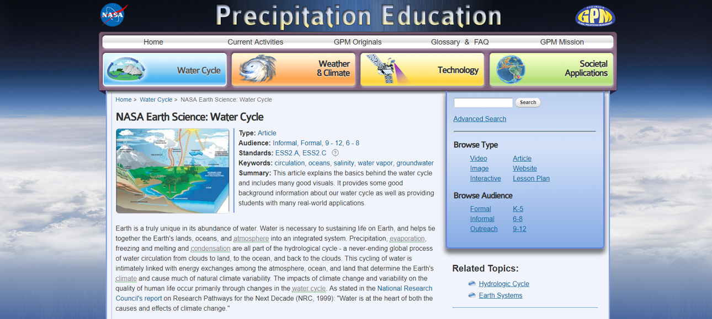
Finding materials: NASA

Slide 32
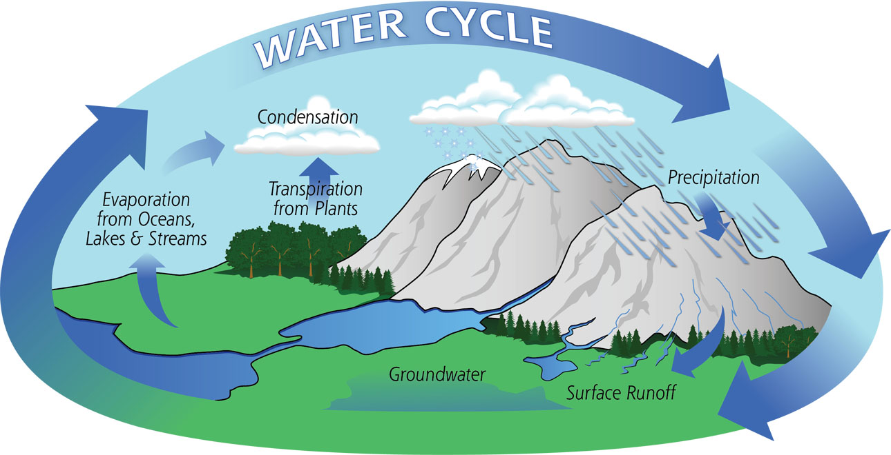
Activating background knowledge (schema)
NASA

Slide 33
Structuring lessons
Find source materials
Establish content objectives
Establish language objectives
Adapt texts as needed
Determine key vocabulary
Develop tasks to help students understand the content
Assess student learning

Slide 34
Establishing objectives – what is the target ?

Slide 35
What do I want the students to be able to do as the result of the instruction?

Slide 36
Establishing objectives
Content objectives: students will be able to _________________.
describe the water cycle
explain how evaporation works
give examples of different kinds of precipitation
Language objectives: students will be able to _________________.
define 3 key vocabulary terms
use the simple present tense correctly in a spoken explanation
write a well-structured paragraph

Slide 37
Structuring lessons
Find source materials
Establish content objectives
Establish language objectives
Adapt texts as needed
Determine key vocabulary
Develop tasks to help students understand the content
Assess student learning

Slide 38
Adapt texts as needed
Earth is truly unique in its abundance of water. Water is necessary to sustain life on Earth, and helps tie together the Earth's lands, oceans, and atmosphere into an integrated system. Precipitation, evaporation, freezing and melting and condensation are all part of the hydrological cycle - a never-ending global process of water circulation from clouds to land, to the ocean, and back to the clouds.

Slide 39
Vocabulary profile
Earth is truly unique in its abundance of water Water is necessary to sustain life on Earth and helps tie together the Earth s lands oceans and atmosphere into an integrated system Precipitation evaporation freezing and melting and condensation are all part of the hydrological cycle a never ending global process of water circulation from clouds to land to the ocean and back to the clouds
Vocabulary Profiler at the University of Hong Kong
http://www4.caes.hku.hk/vocabulary/profile.htm
RED: 1 - 1000 words
GREEN: 1001 - 2000 words
BLUE: Academic Word List words
BLACK: Off-list words

Slide 40
Adapt texts as needed

Slide 41
Methods for simplifying content
Scaffolding = supporting the language learner
Explaining vocabulary
Using graphs, charts, diagrams, or pictures
Using graphic organizers
Limiting the amount of new information that is introduced

Slide 42
Methods for simplifying content
Change the content so it is easier
Re-write the text so it uses easier vocabulary and is simpler
Provide explanations of key concepts in simple English or the first language
Re-record audio passages to be slower and clearer
Introduce the content more slowly
Provide subtitles for videos

Slide 43
Structuring lessons
Find source materials
Establish content objectives
Establish language objectives
Adapt texts as needed
Determine key vocabulary
Develop tasks to help students understand the content
Assess student learning

Slide 44
Which is more important, grammar or vocabulary?

Slide 45
The importance of subject-specific academic vocabulary
Most people do not __________ how much __________ affects them. It can affect how people think, __________, and act. Some __________, such as those in __________, can have the same __________ for everyone. Other __________ meanings may be different in different __________. We can __________ our __________ of ourselves and the world around us by learning about what __________ can mean or __________.

Slide 46
The importance of subject-specific academic vocabulary
Most people __________ __________ realize how much color affects __________. It __________ affect how people think, feel, and act. __________ colors, such as those __________ nature, can have the same meaning __________ everyone. Other color meanings __________ __________ different __________ different cultures. We __________ increase our understanding __________ ourselves and the world around __________ by learning about what colors __________ mean __________ represent.

Slide 47
The importance of subject-specific academic vocabulary
Most people do not realize how much color affects them. It can affect how people think, feel, and act. Some colors, such as those in nature, can have the same meaning for everyone. Other color meanings may be different in different cultures. We can increase our understanding of ourselves and the world around us by learning about what colors can mean or represent.

Slide 48
The importance of subject-specific academic vocabulary
NASA

Slide 50
Structuring lessons
Find source materials
Establish content objectives
Establish language objectives
Adapt texts as needed
Determine key vocabulary
Develop tasks to help students understand the content
Assess student learning

Slide 51
Develop tasks to help students understand the content
Modify the tasks so they are appropriate for your students
Activate background knowledge
Teach unfamiliar vocabulary words
Introduce content via reading, listening, or video
Scaffold student understanding with illustrations, graphs, and diagrams
Give students opportunities to use the new language

Slide 52
Small group activities

Slide 53
Lab work and individual experiments

Slide 54
Making posters for display

Slide 55
Writing

Slide 56
Sequencing activities

Slide 57
Structuring lessons
Find source materials
Establish content objectives
Establish language objectives
Adapt texts as needed
Determine key vocabulary
Develop tasks to help students understand the content
Assess student learning

Slide 58
Assessing student work

Slide 59
Models for assessing student work
Are we assessing language or content? Or both?
Is our feedback formative or summative?
What will we ask student to do to demonstrate their knowledge?

Slide 60
Formative vs. summative assessment

Slide 61
Sample tasks for the classroom
Directions: Write the correct term in each box.
NASA

Slide 62
Writing activities

Slide 63
Oral presentation

Slide 64
Putting it all together

Slide 65
Thank you
joe@joemcveigh.org

Slide 66
References
Content-Based Second Language Instruction: What is it? Center for Advanced Research on Language Acquisition (CARLA) at the University of Minnesota http://carla.umn.edu/cobaltt/CBI.html
Hauschile, S., Poltavtchenko, E., & Stoller, F. L. (2012). Going green: Merging environmental education and language instruction. English Teaching Forum 2012, No. 2, pp. 2-13 https://americanenglish.state.gov/files/ae/resource_files/50_2_3_hauschild-et-al.pdf
Horn, B. (2011). The future is now: Preparing a new generation of CBI teachers. English Teaching Forum 2011, No. 3, pp. 2-9 https://americanenglish.state.gov/files/ae/resource_files/49_3_2_horn.pdf
Met. M. (1999, January). Content-based instruction: Defining terms, making decisions. NFLC Reports. Washington, DC: The National Foreign Language Center
Snow, M. A. & Brinton, D. M. (2017) The content-based classroom: New perspectives on integrating language and content (2nd ed.). Ann Arbor: University of Michigan Press.
Water Cycle Unit: https://pmm.nasa.gov/education/water-cycle

