Slide 1
Empowering students with media literacy
Empowering Students with Media Literacy
Joe McVeigh

Slide 2
Overview
Introducing the idea of “created” media
Defining media literacy
Using media literacy in the EFL classroom
Analyzing media sources
Producing media with your students

Slide 3
Questions
How do you get most of your news about the world?
What kinds of media have you used in class with your students? Don’t include materials that came with your course book.
Have you ever asked students to produce media?

Slide 4
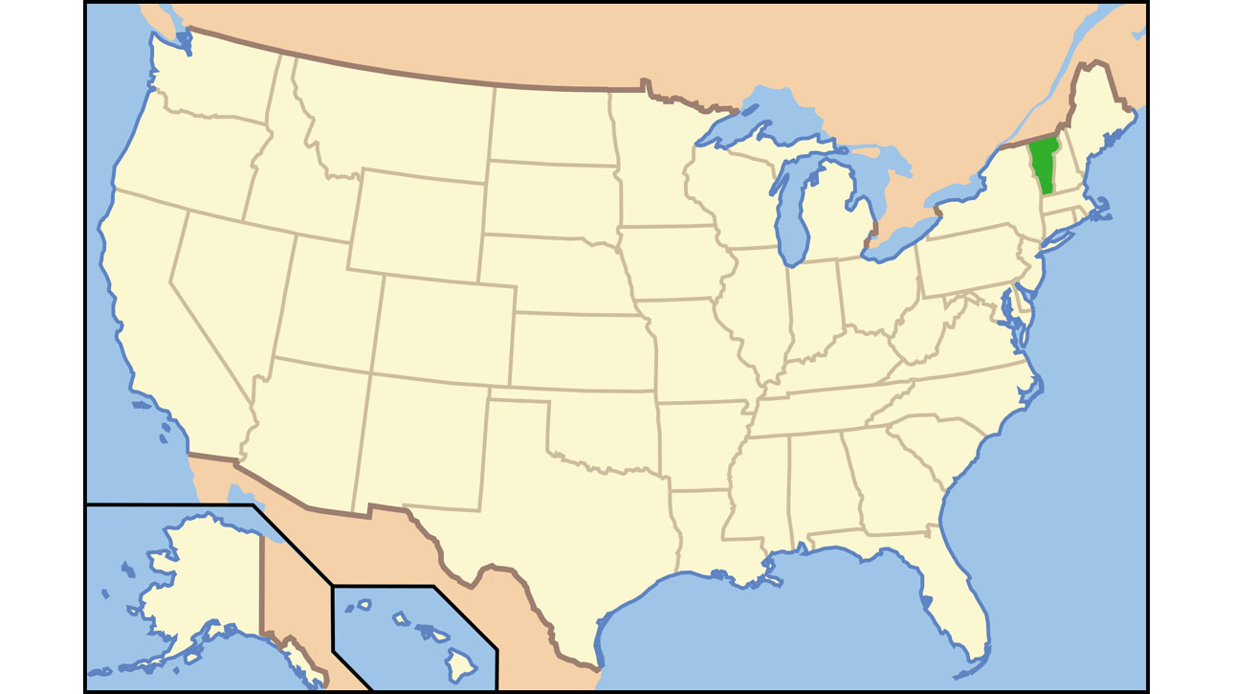
Intro: Vermont
Vermont

Slide 5
His name is Nat. That is short for Nathaniel.
He is 13 years old.
He is an eighth-grade student in middle school.
He is a fast runner.
He is the co-captain of his cross-country running team.
He is also now taller than his mother!

Slide 6
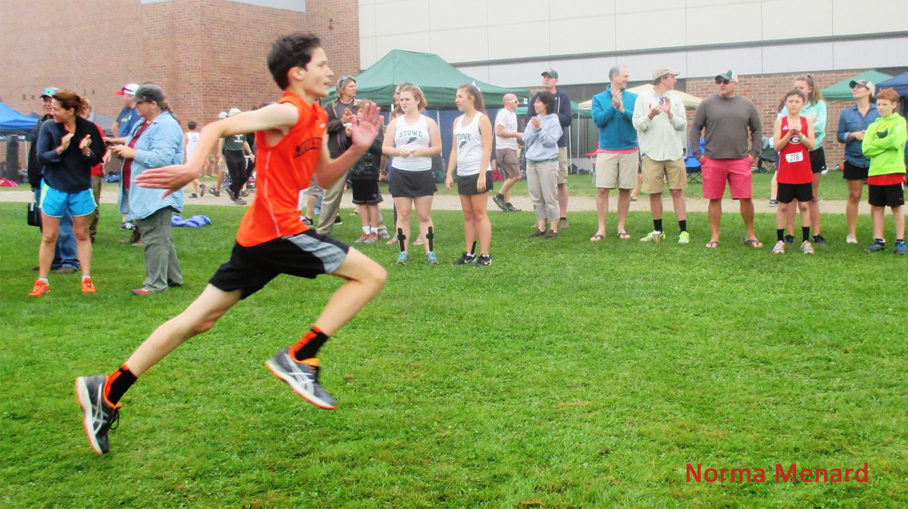
Intro: Images – Runner finish line
Social media posting reads: “His cross-country team's co-captain, Nat kicks in to lead the Middlebury Union Middle School Tigers at the finish line.”

Slide 7
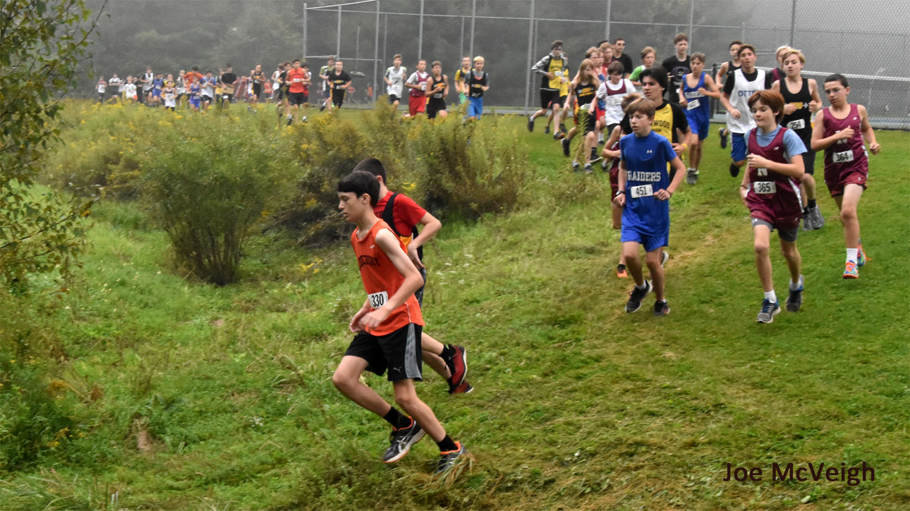
Intro: Images – Runner downhill 1

Slide 8
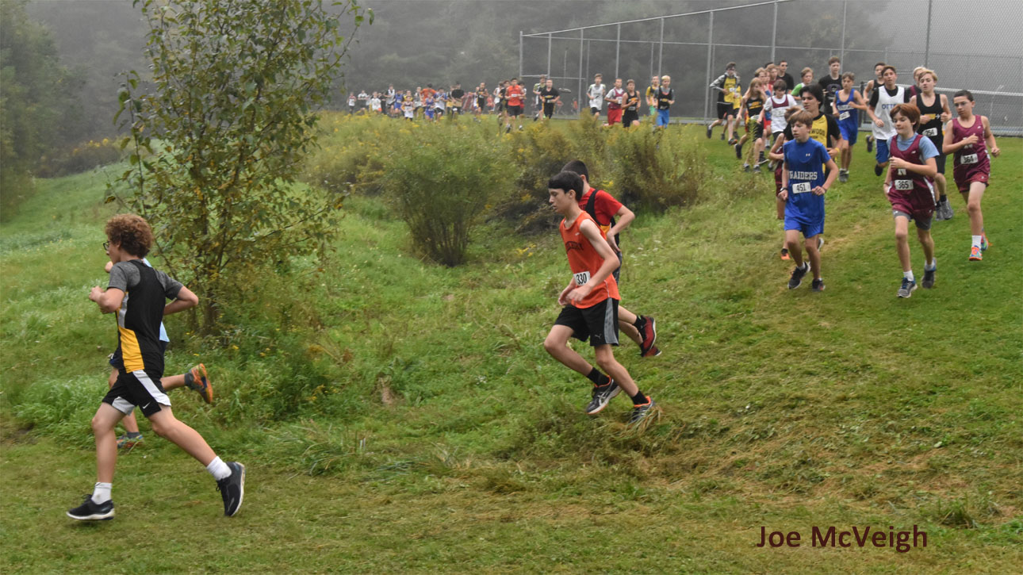
Intro: Images – Runner downhill 2

Slide 9
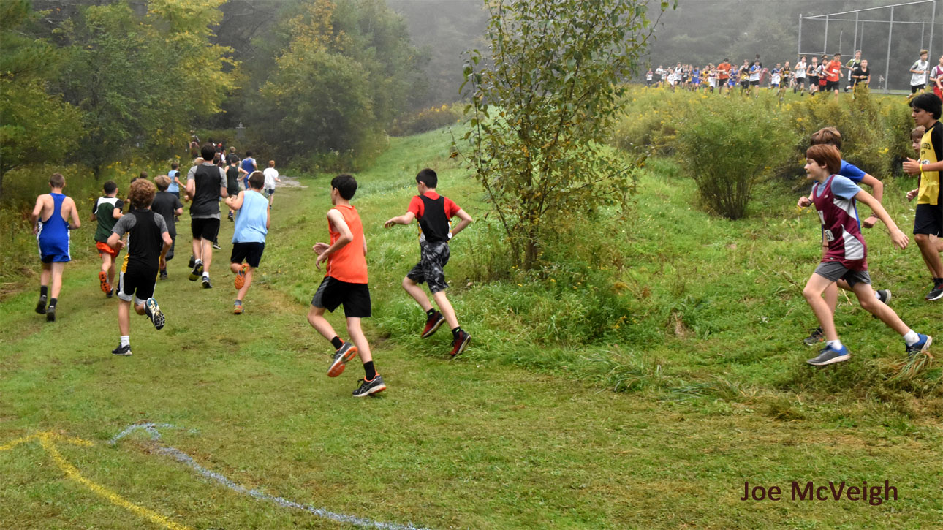
Intro: Images – Runner turn corner

Slide 10
Intro: Images – Runner finish line again
“His cross-country team's co-captain, Nat kicks in to lead the Middlebury Union Middle School Tigers at the finish line.”

Slide 11
When thinking about media literacy, we need to ask: “What is in the frame of the camera or photograph?”

Slide 12
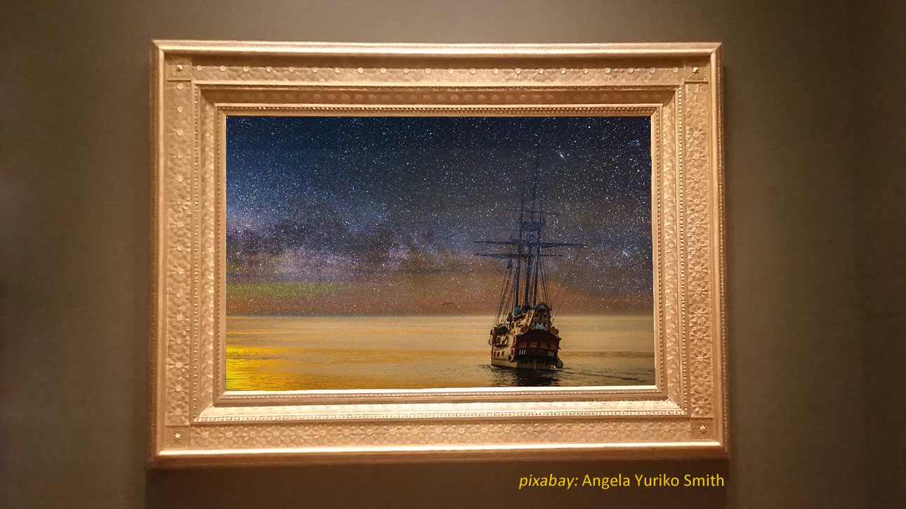
Frame

Slide 13
Frame

Slide 14
When thinking about media literacy, we need to ask: “What is in the frame of the camera?”
What is inside the frame that we do see?
What is outside the frame that we don’t see?
What would we see if we looked in another direction?
Who is controlling what we see?

Slide 15
The producer of the media controls what we see
The producer of the media controls what we see.
They are “creating” the media.

Slide 16
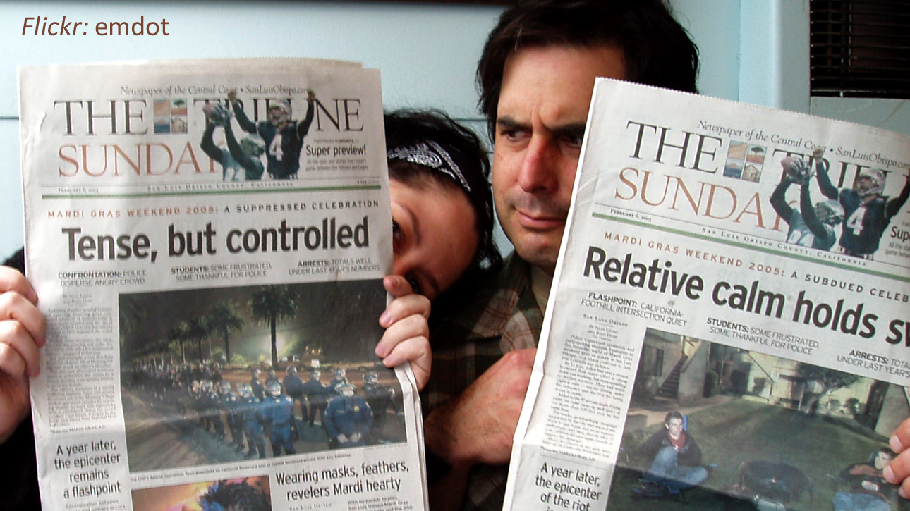
Newspaper example

Slide 17
The producer of the media always has choices about what to show and how to show it.
What does a writer choose to include in a newspaper article?
What does a writer choose not to include?
How might a different writer describe the scene?
Who is controlling what we read?

Slide 18
The producer of the media controls what we see.
They are “creating” the media.

Slide 19
PART 1: Defining media literacy
literacy
critical thinking
different types of media
what do we mean by “media” ?

Slide 20
Defining media literacy – literacy reading
Literacy: reading

Slide 21
Defining media literacy – literacy writing
Literacy: writing

Slide 22
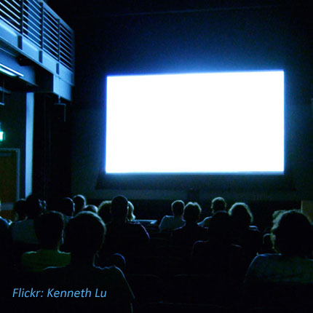
Literacy: knowledge that relates to a particular subject
information
literacy
film literacy
computer literacy

Slide 23
Defining media literacy
literacy
critical thinking
types of media
what do we mean by “media”?

Slide 24
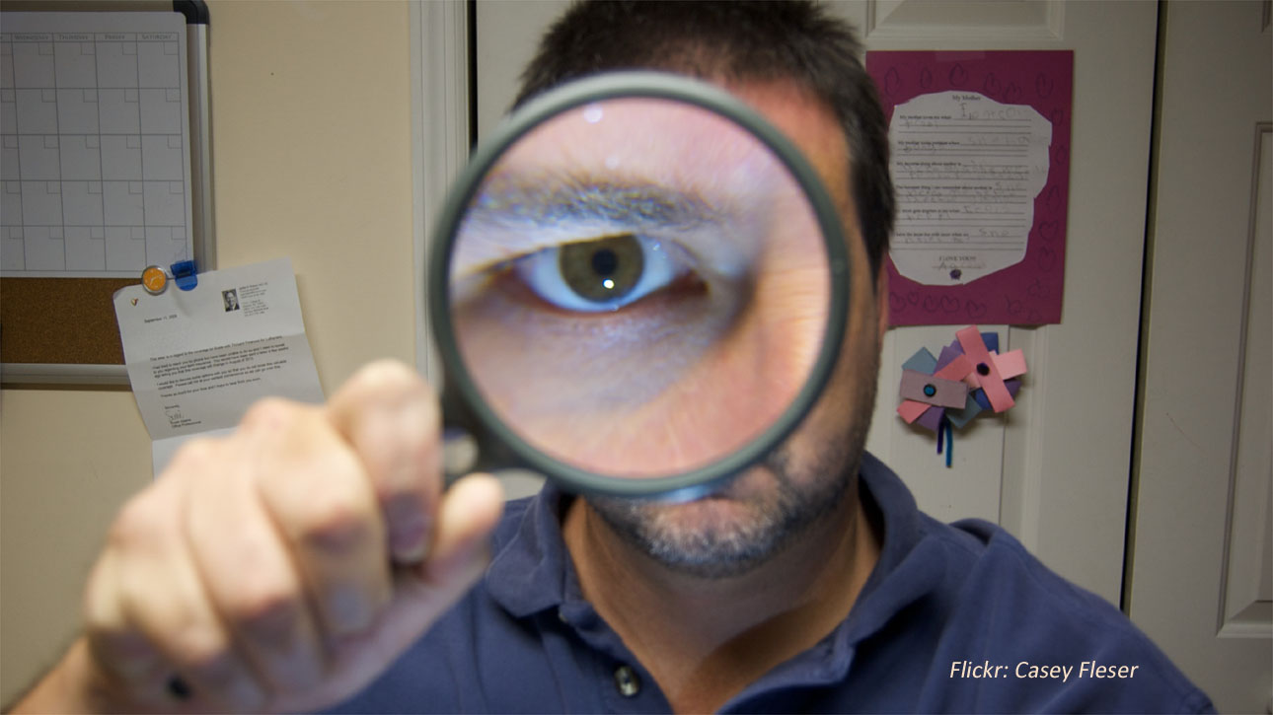
Defining media literacy – critical thinking
Critical thinking

Slide 25
Critical thinking means
to take in information and actively analyze it from different perspectives
to compare it with other similar information
to evaluate that information
the goal is to reach an answer or a conclusion

Slide 26
Defining media literacy
literacy
critical thinking
types of media

Slide 27
Types of media
traditional media

Slide 28
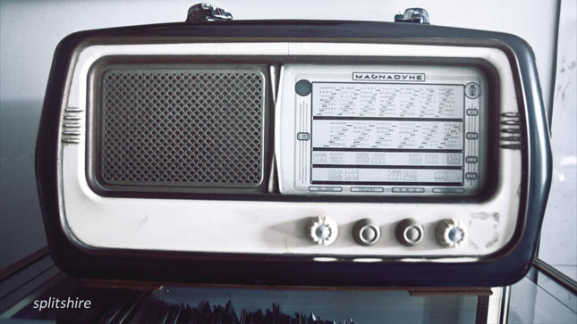
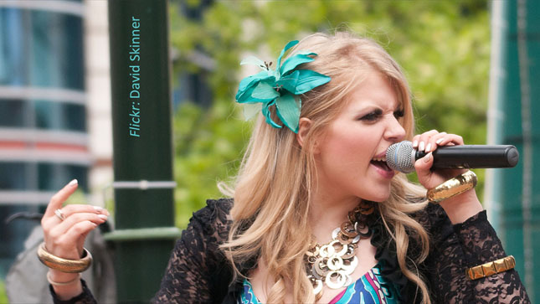

Slide 29
Types of media
traditional media
digital media (but not social)

Slide 30
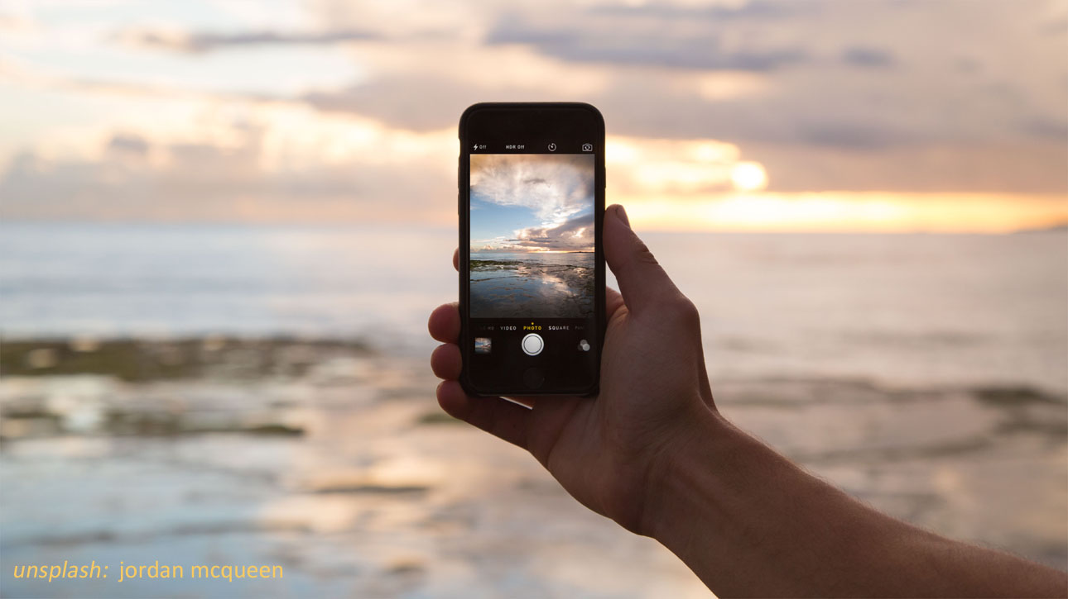

Slide 31
Types of media
traditional media
digital media
social media

Slide 32
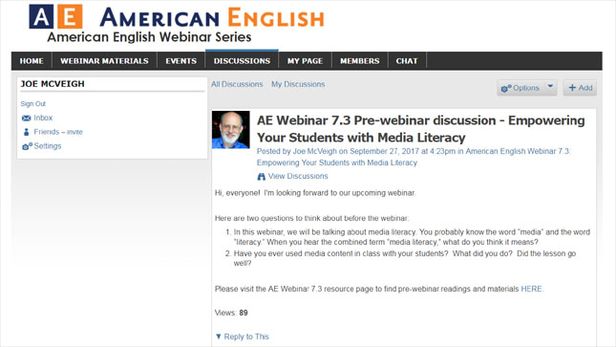
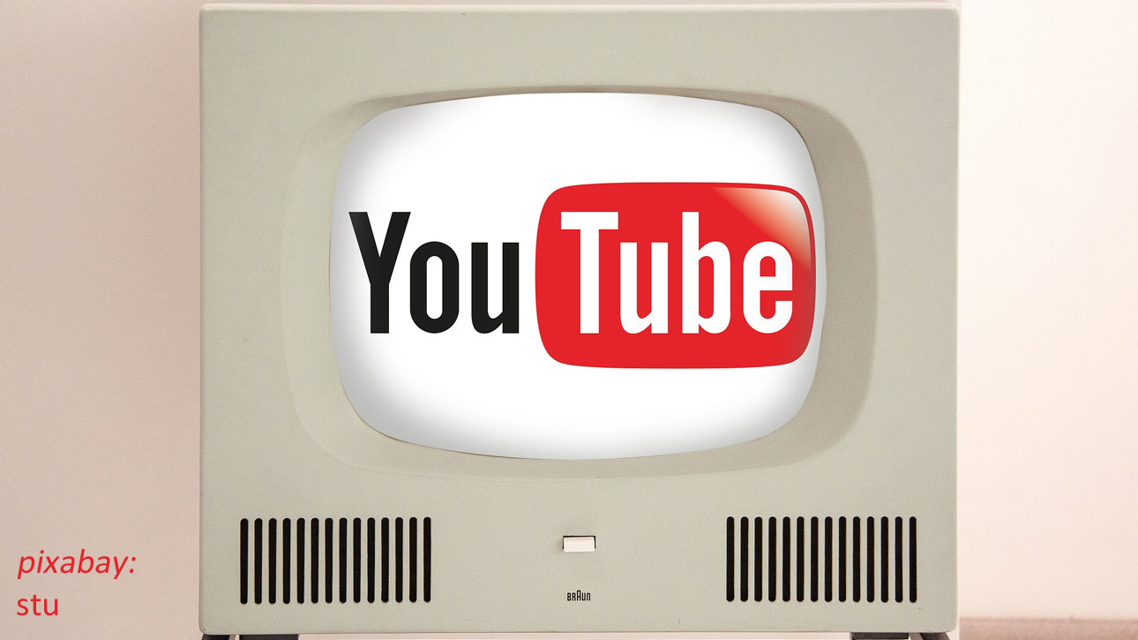
Defining media literacy –social media

Slide 33
Defining media literacy
literacy
critical thinking
types of media
traditional, digital, social
what do we mean by “media”?

Slide 34
Is “media” a transmission method, or the content that is sent or received?
newspaper
television
YouTube website
newspaper article
television program
video seen on YouTube
Media can be either or both

Slide 35
Defining media literacy – traditional - the news
“ the news media ”

Slide 36
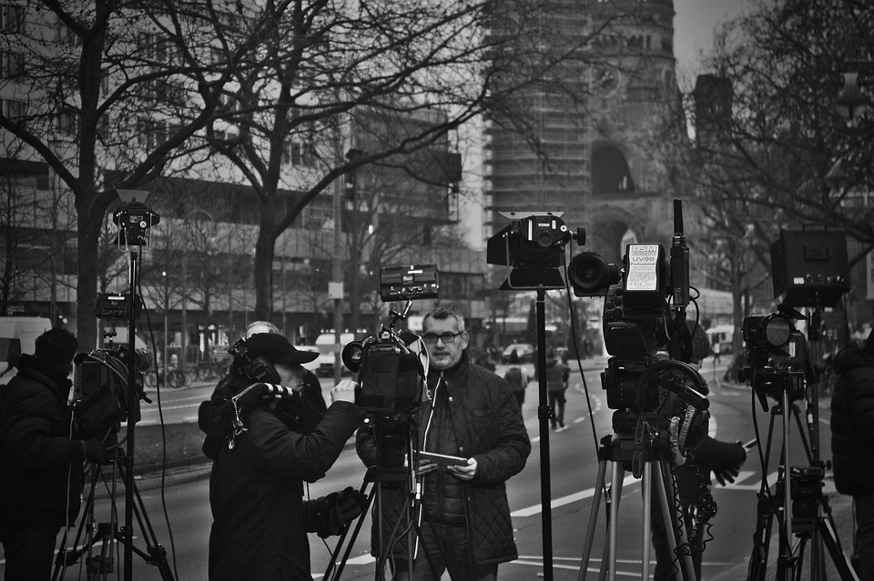
“ the news media ”
“ the press ”

Slide 37
How would you define “media literacy”?

Slide 38
Defining media literacy
The ability to access, analyze, critically evaluate, and produce communication in a variety of forms
Like traditional literacy, it involves critical thinking, analytical skills, and being able to express yourself in different ways
It also involves using media wisely and effectively, including deciding if information from different sources is believable

Slide 39
Social Media
Social
Media

Slide 40
Poll Question: How many of these social media outlets have you used?
Social media use

Slide 41
Defining media literacy – digital – cell phones 1

Slide 42
Defining media literacy – digital -- cell phones 2

Slide 43
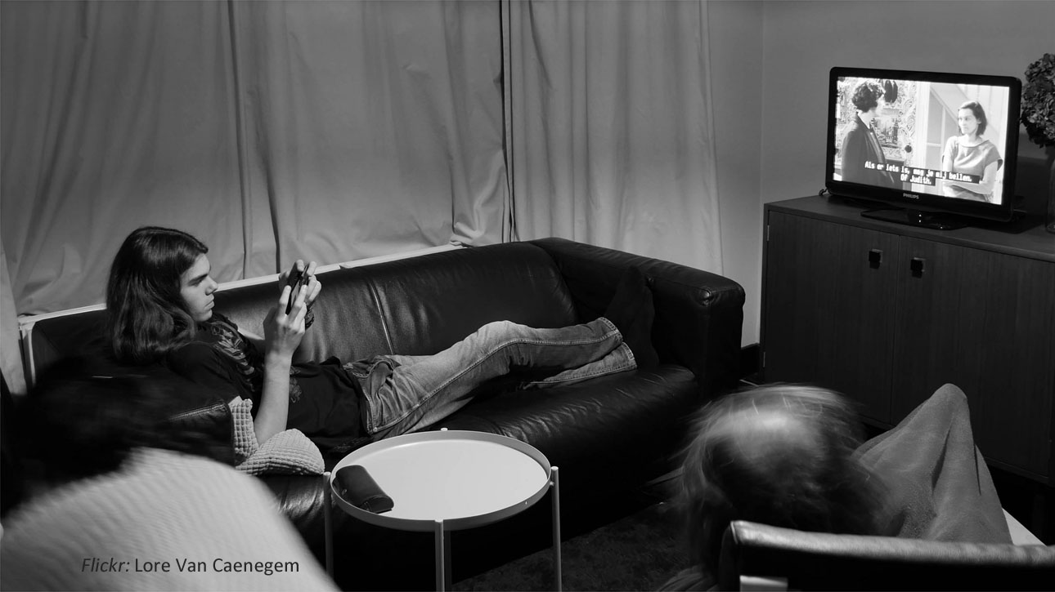
Defining media literacy – digital – combined

Slide 44
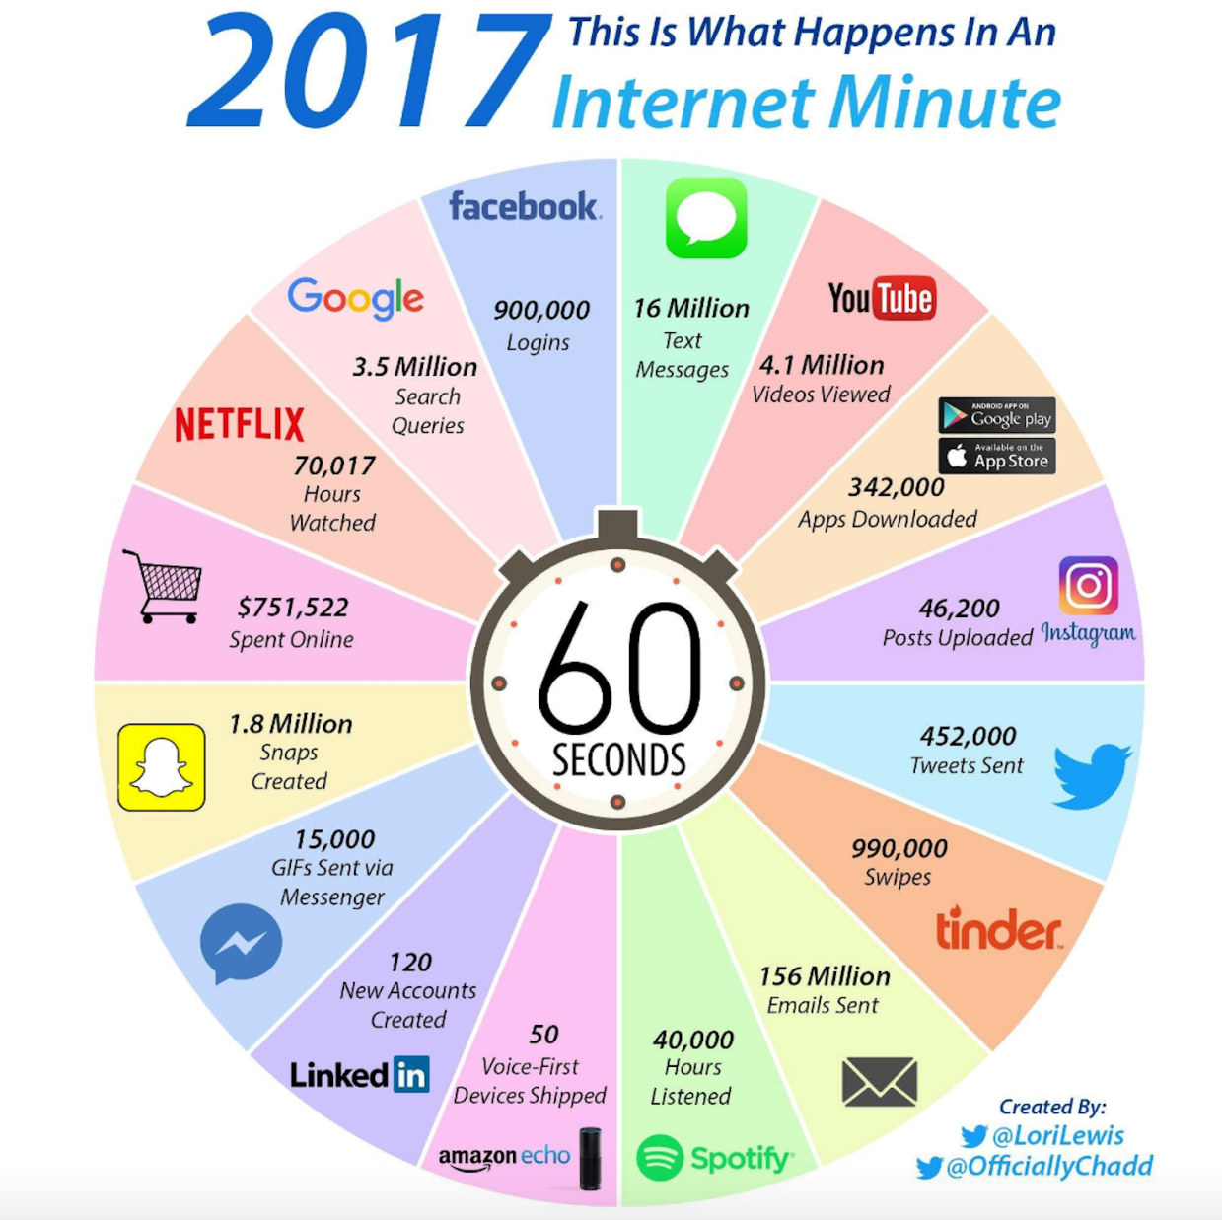
Defining media literacy – social – every minute on the internet

Slide 45
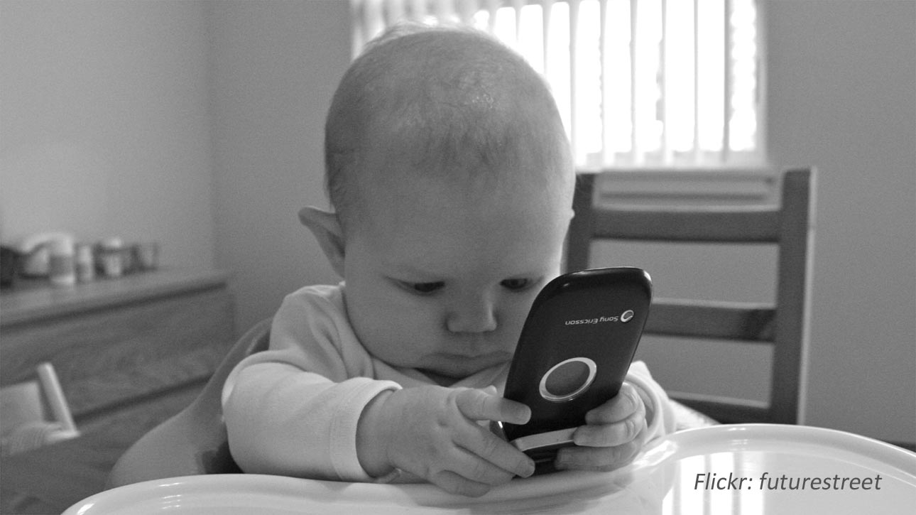
Defining media literacy – social – baby cell phone

Slide 46
Social Media Safety and Etiquette
SOCIAL MEDIA SAFETY AND ETIQUETTE
Be cautious about sharing personal information; don’t put your birthday or address in your profile
Make passwords hard to guess and change them regularly
Don’t “talk” to strangers
Don’t try to make “friends” with someone you don’t know
Don’t ask a complete stranger for help
Younger students should ask for parents’ permission

Slide 47
PART 2: Why teach media literacy to our students?

Slide 48
Why teach media literacy to our students?
Encourages discussions about how the media promotes certain social values through how it shows beauty, importance, family, love, success, freedom, and consumerism
Allows students to access, analyze, and evaluate popular texts
Engages students’ communication and higher-level thinking skills
Uses authentic materials
Appeals to student interests and increases motivation

Slide 49
Why teach media literacy to our students?
Requires real language for meaningful communication
Permits teachers to include various activities that appeal to many kinds of learning styles
Provides a large amount of language input and output so students learn to use effective communication strategies
Helps students evaluate and respond to arguments, which develops their analytical skills

Slide 50
PART 3: How to analyze media sources
Analyzing advertisements
Evaluating sources of information
Identifying false, biased, or sensationalized information in the media

Slide 51
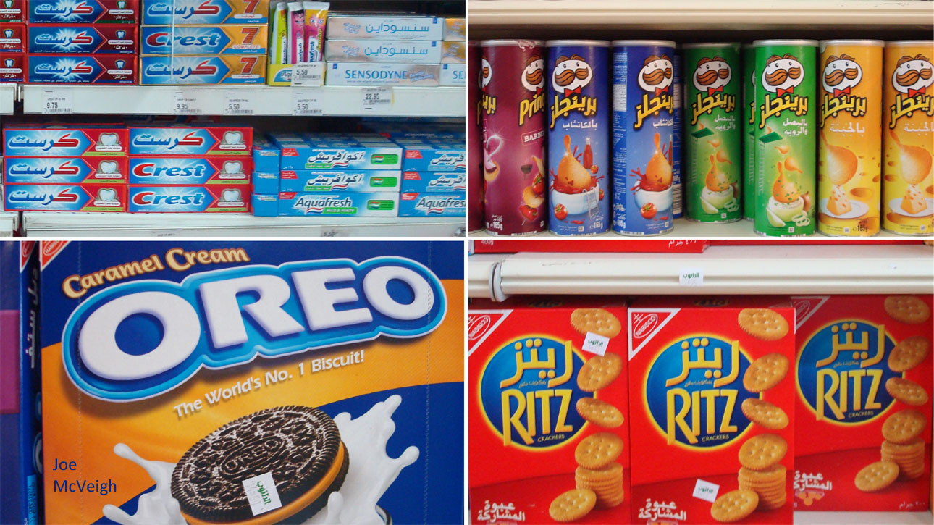
Advertising – All the comforts of home
Advertising

Slide 52
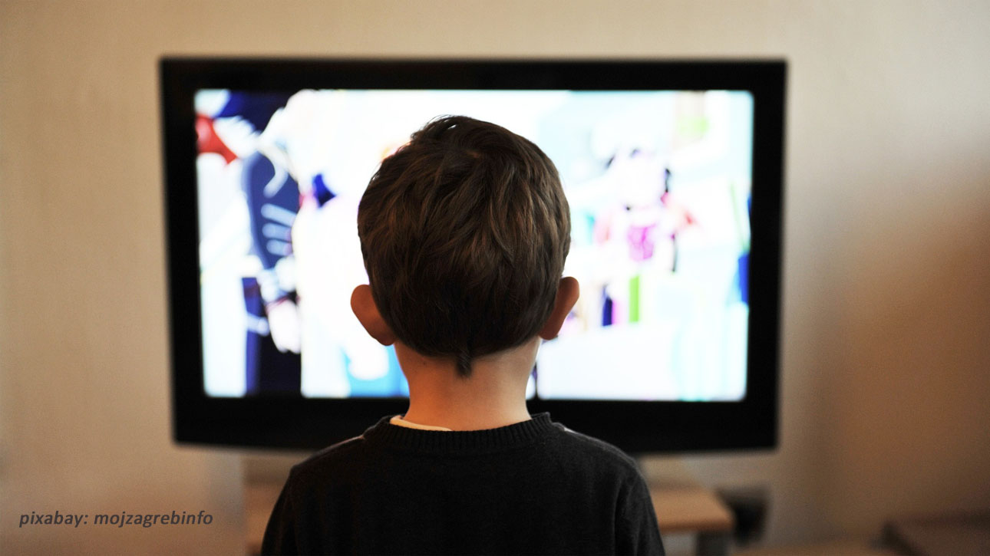
Advertising – Kid watching television

Slide 53
Questions to ask when thinking about media
1. ANALYZING ADVERTISEMENTS: Questions to ask
Who paid for this ad? Why?
To what age group, economic group, and gender does this media appeal? What text or images bring you to this conclusion?
What kind of lifestyle is presented? How is it glamorized or made attractive?
What is the obvious message? What do they want me to do?
What are the hidden messages in this media?
What techniques of persuasion does this ad use?

Slide 54
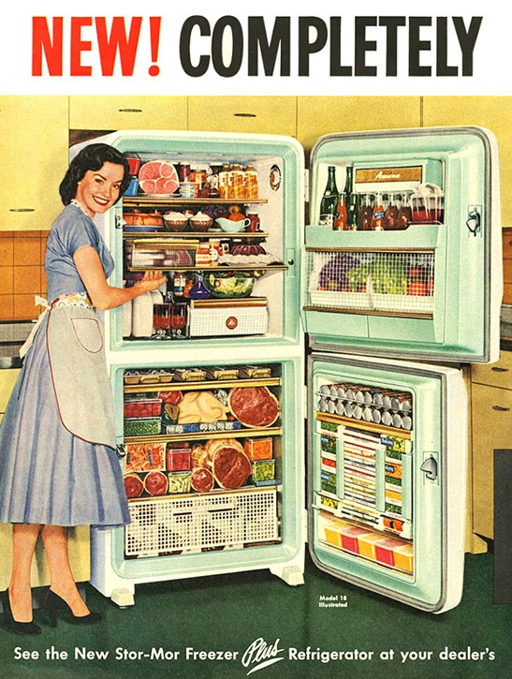
Who paid for this media?
To what age group, economic group, and gender does this media appeal?
What kind of lifestyle is presented? How is it glamorized or made attractive?
What is the obvious message in this media?
What are the hidden messages in this media?

Slide 55
Advertising – Schwinn

Slide 56
Advertising – Methods of persuasion
ADVERTISING: Common methods of persuasion
Hyperbole (exaggeration) - it’s the best in the world!
Humor - made you laugh
Testimonials - famous people say it is good
Popularity - everyone else is doing it, shouldn’t you?
Scientific evidence or appeal to authority
Beautiful people - “You can’t be too rich or too thin.”

Slide 57
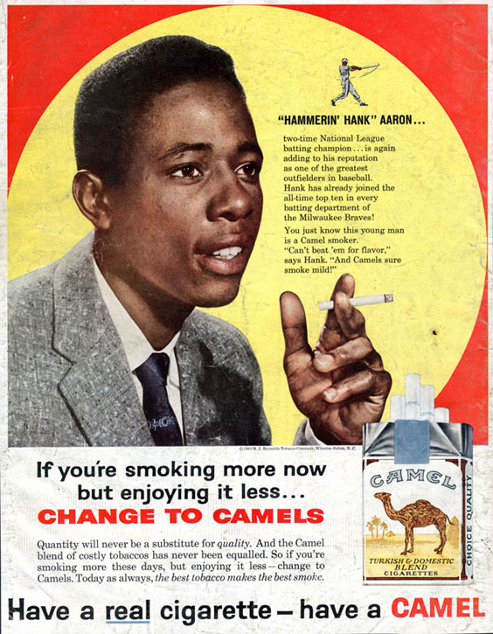

Slide 58
Advertising Activity – Critical viewing
ACTIVITY: Critical Viewing
Ask students to bring in examples of advertisements, or collect some from magazines, or show short television commercials.
In small groups, have students answer key questions about each item:
Who paid for this media?
To what age group, economic group, and gender does this media appeal? What text or images bring you to this conclusion?
What kind of lifestyle is presented? How is it glamorized or made attractive?
What techniques of persuasion does this ad use?
What is the obvious message in this media? What do they want you to do?
What are the hidden messages in this media?

Slide 59
Advertising Activity – Critical viewing
ACTIVITY: Critical Viewing
Think about the language in the advertisements.
Ask students to find adjectives that describe the product or service being advertised.
Is there a “testimonial”?
Ask students to write down vocabulary words the person uses to describe the product.
Ask students to create their own ad for a different product using some of the same language.

Slide 60
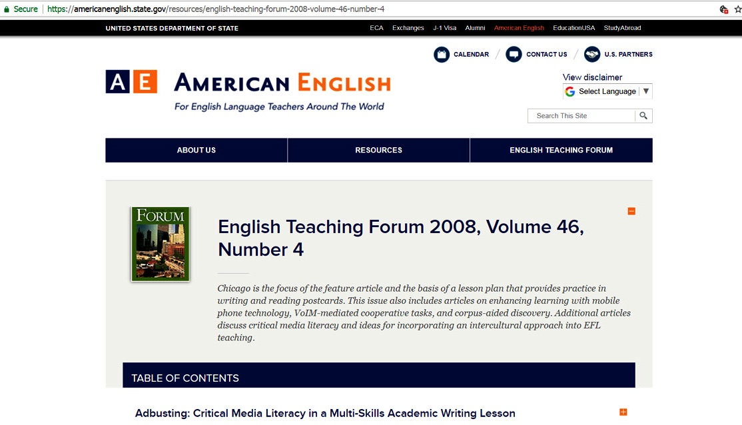

Slide 61
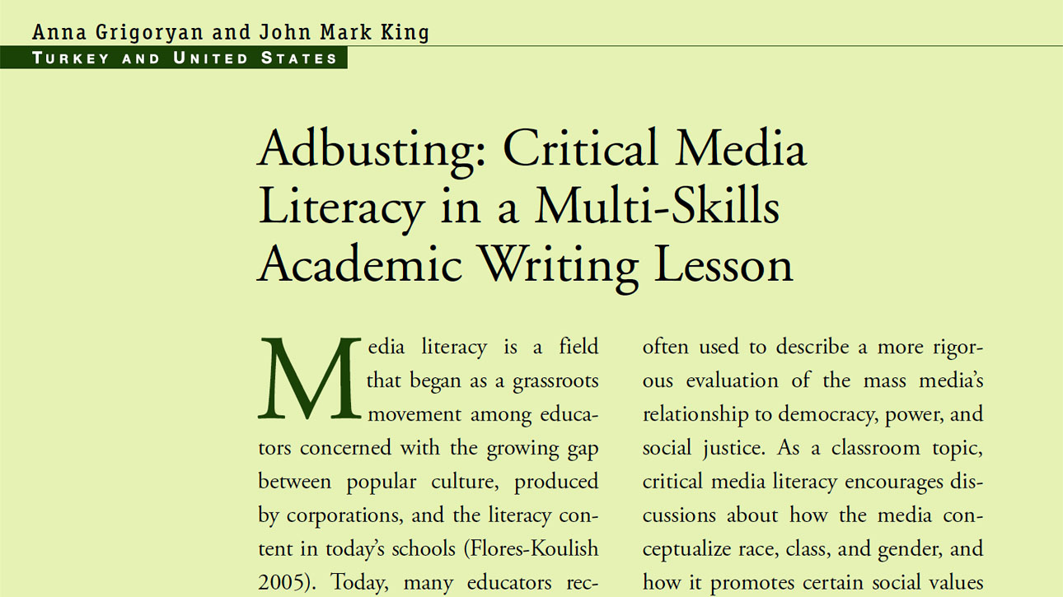
Advertising – Forum article 2

Slide 62
Advertising Activity: Adbusters
ACTIVITY: Adbusters
See the article in English Teaching Forum for instructions on a great multi-skills academic writing project to address issues in advertisements with advanced writing students.

Slide 63
2. Evaluating information sources
If we see a news story or something on the internet, how can we know if it is trustworthy?

Slide 64
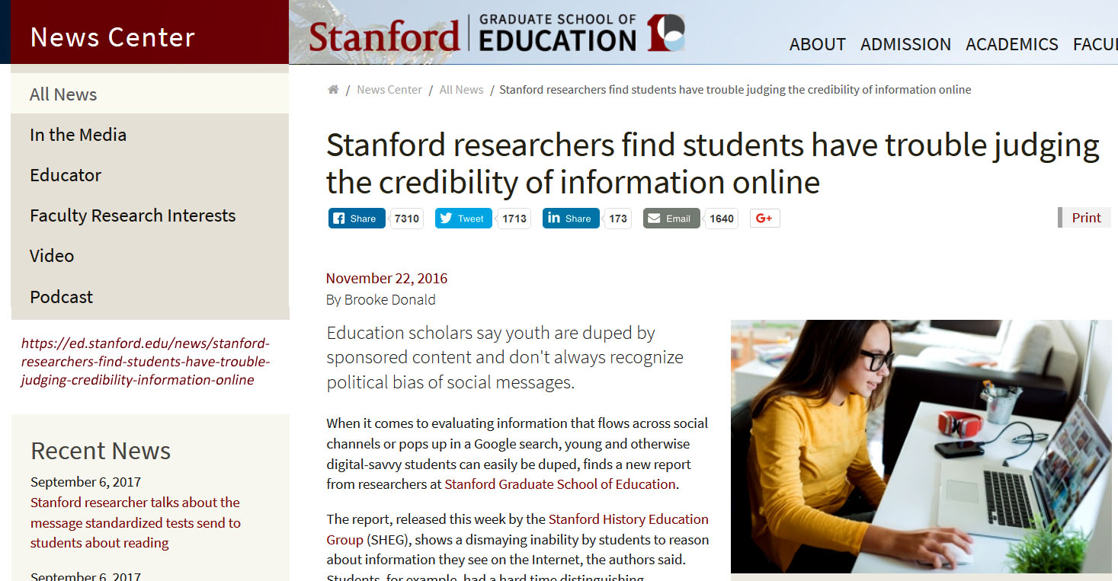
Media Bias: Judging Credibility

Slide 65
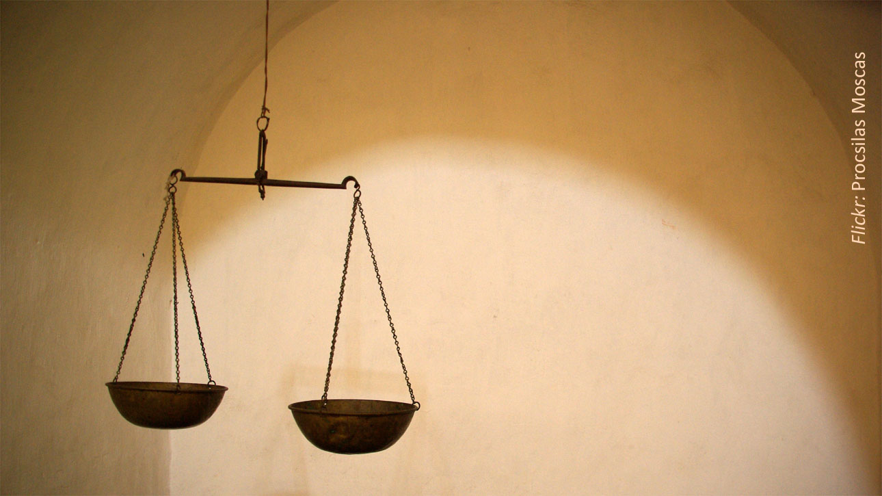
Media Bias: Balance – scales of justice
Balance - evenness

Slide 66
Social: Trusting internet sources 1
TRUSTING INTERNET SOURCES
Adapted from criteria from Roger Sevilla, Project Look Sharp
AUTHORITY
Who is the author or sponsor of the site?
Is the author qualified and/or reputable? An expert? What are the author’s credentials?
Is there an “About” page?
ACCURACY
Is the information reliable and error-free?
Are there typographical errors, spelling mistakes, or bad grammar?
Is the information part of a larger publication?
Can the information be crosschecked with a reliable source?

Slide 67
Social: Trusting internet sources 2
TRUSTING INTERNET SOURCES
Adapted from criteria from Roger Sevilla, Project Look Sharp
OBJECTIVITY
Does the information show a minimum of bias?
Is the page designed to change your opinion?
Is there a statement of the purposes and objectives of the site?
Are there links to commercial sites selling products/services?
CURRENCY
Is there a date on the page? If so, when was the last update?
How current are the links? Have some expired or moved?
COVERAGE
What topics are covered? How in-depth is the material?

Slide 68
Media Images: Panorama – city

Slide 69
Media Images: Panorama – ocean

Slide 70
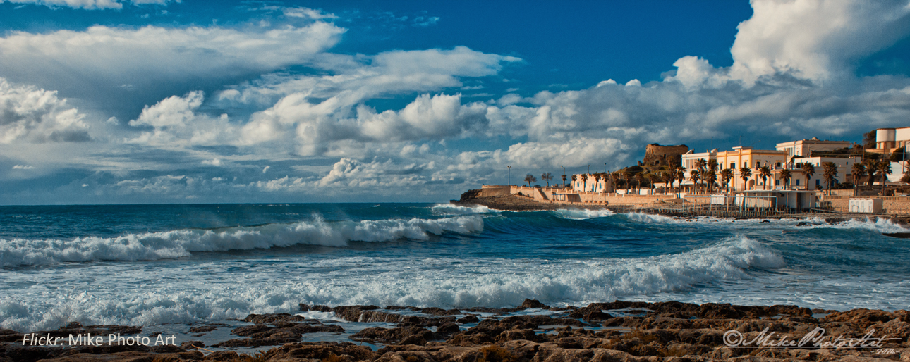
Media Images: Panorama all
What is inside or outside the frame? What choices has the producer of the media made?

Slide 71
3. Identifying false, biased, or sensationalized information in the media

Slide 72
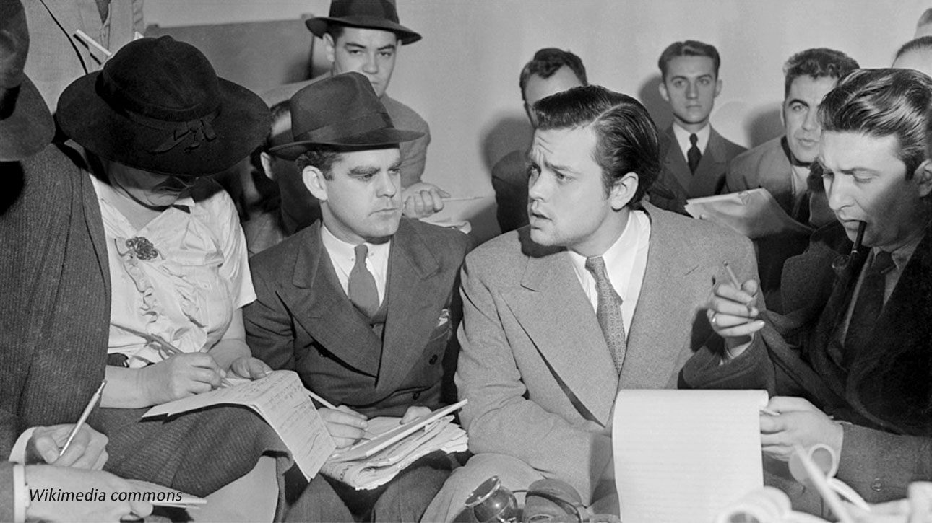
1938 – most news and entertainment from radio
The War of the Worlds
From a science-fiction novel
Radio drama
Invasion of Earth from the planet Mars
Pretended to be real news

Slide 73
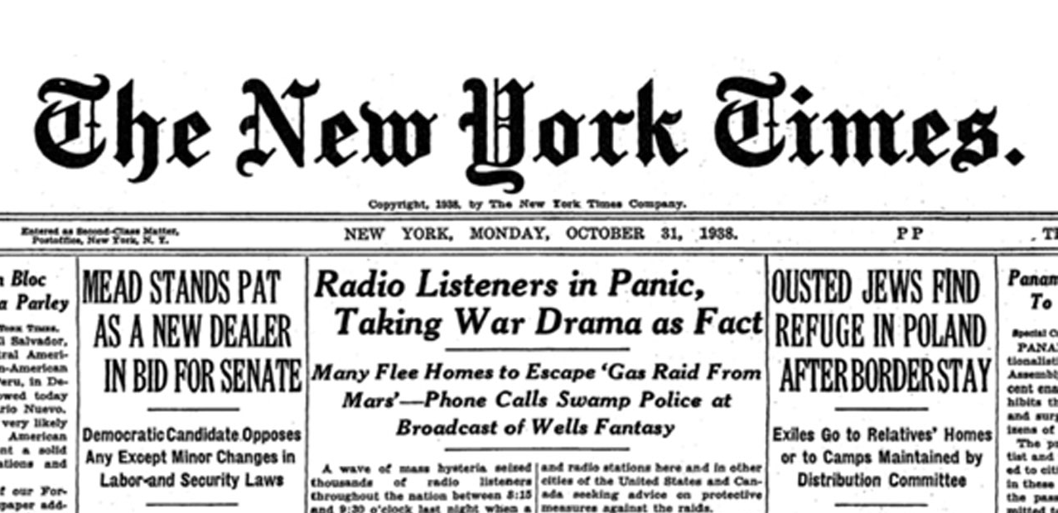
Media Bias: War of the Worlds NY Times headline

Slide 74
Media Bias: Activity: Train Your Brain to Spot Fake News
ACTIVITY: Train your brain to spot false news
adapted from the News Literacy Project
Double-check the source
Check the web site address
Be aware of your reaction
False news stories try to provoke a strong response
Watch for “red flags”
Excessive punctuation ??!?!!? or ALL CAPITAL LETTERS?
Look at well-known fact-checking sites, such as FactCheck.org, Snopes.com and PolitiFact.com

Slide 75
Tabloid headlines
Man explodes on beach!!!
Woman gives birth while skydiving!!!

Slide 76
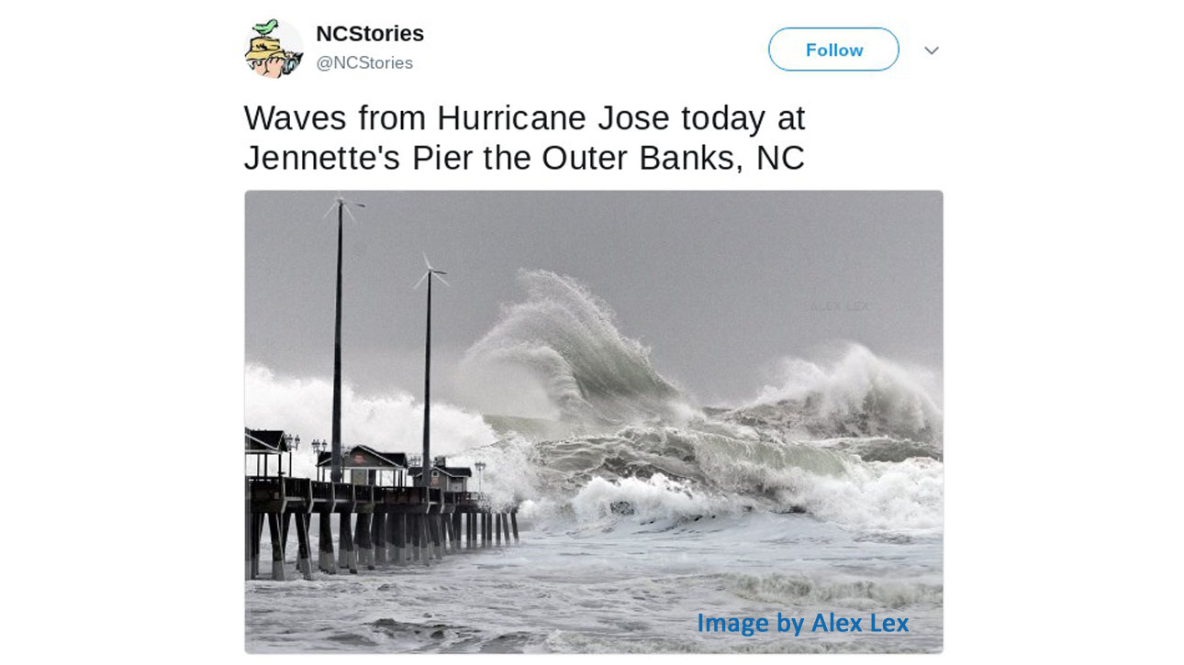
Media Images: Hurricane Jose posting

Slide 77
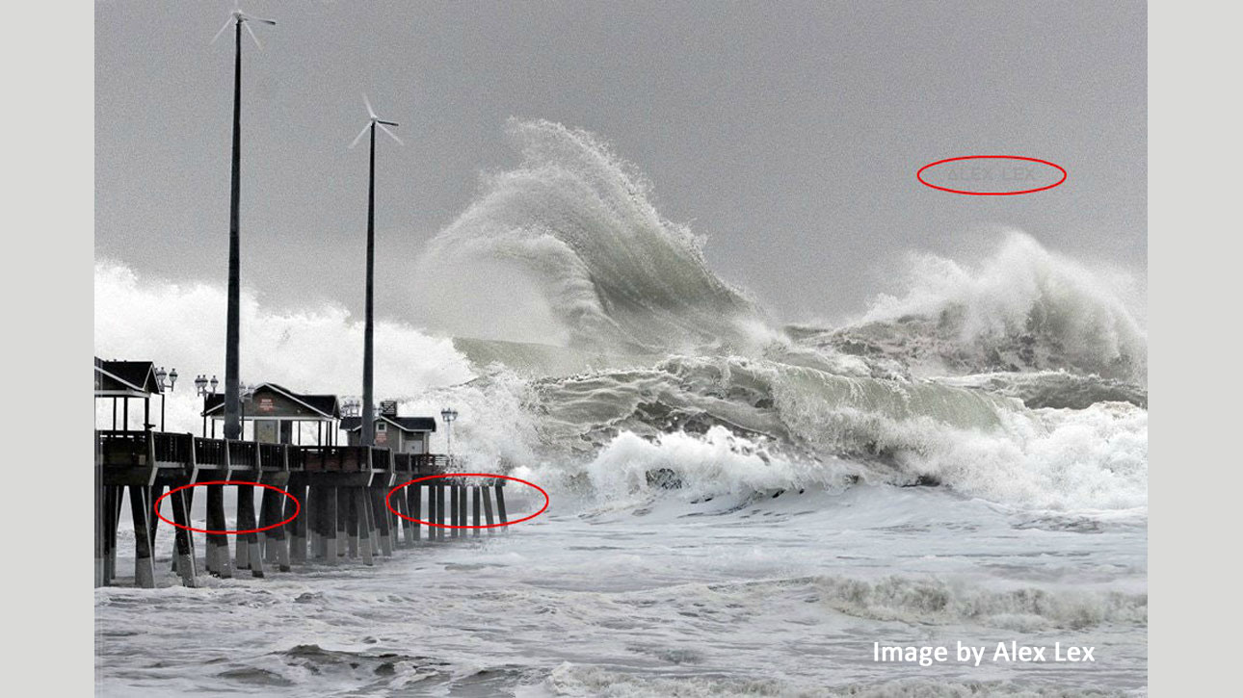
Media Images: Hurricane Jose deconstruction

Slide 78
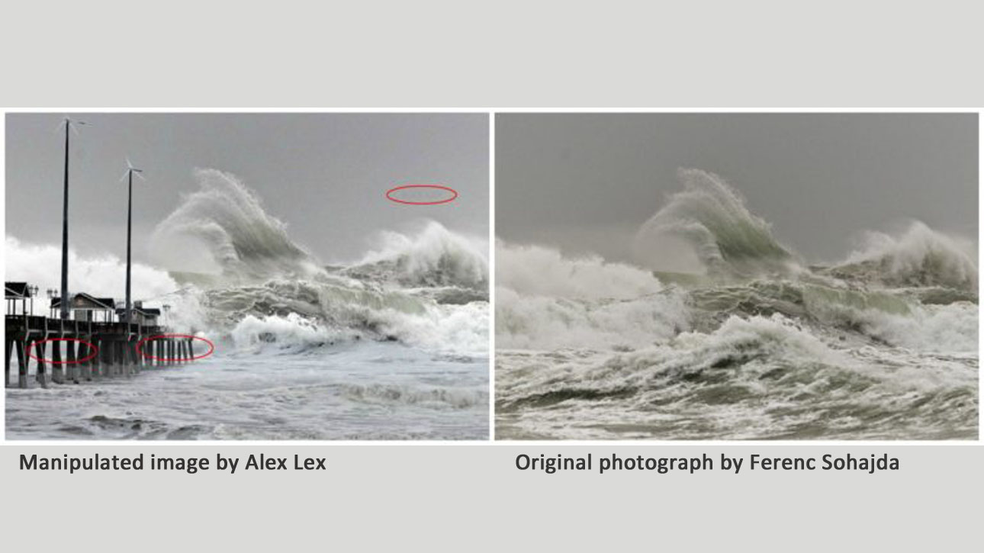
Media Images: Hurricane Jose comparaison

Slide 79
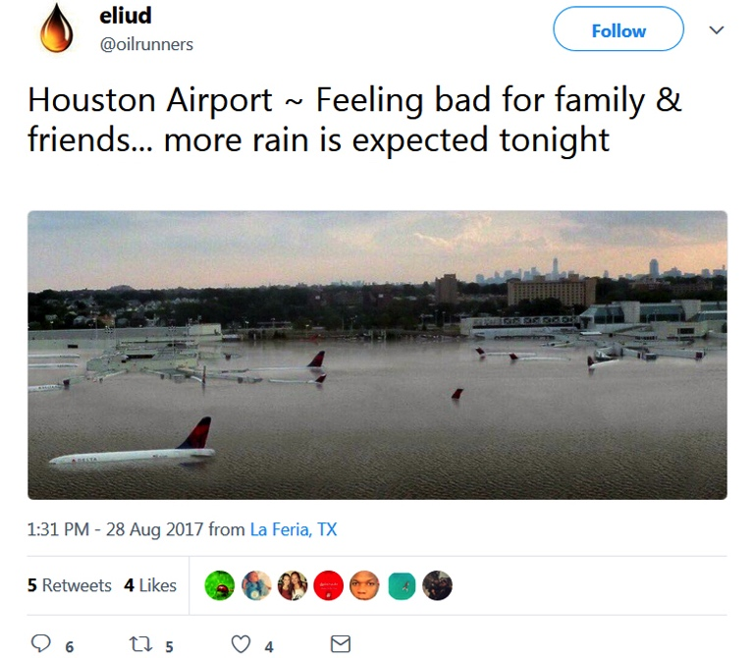
Media Images: Huracane Harvey – airplanes

Slide 80
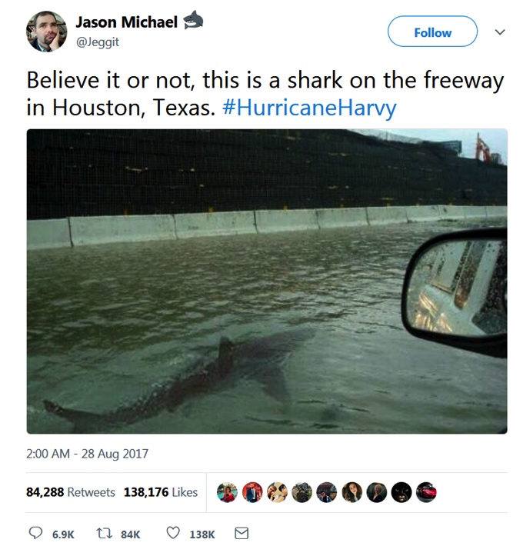
Media Images: Hurricane Harvey sharks

Slide 81
Social: Activity clickbait
ACTIVITY: “Beware of red flags”
Some headlines on the web consist of exaggerated expressions designed to grab your attention
These headlines look interesting, but they usually are trying to get readers to click on them to show them advertisements
Don’t let your students waste their time!

Slide 82
Social: Activity clickbait
ACTIVITY: “Beware of red flags”
Hand out the list of common exaggerated headlines on the next slide.

Slide 83
Social Activity: Common clickbait expressions
COMMON EXAGGERATED HEADLINES
You won't believe this . . .
This _______ will change your life
With this one weird trick . . .
. . . you won't believe what happens next.
17 secrets _______ don't want you to know
Lose 15 kg in 3 months with this natural product
The hot new _______ everyone is talking about

Slide 84
Social: Activity clickbait
ACTIVITY: “Beware of red flags”
Hand out the list of common exaggerated headlines on the next slide.
Review vocabulary words in the headlines.
Ask the class to complete the missing parts of the headlines.
Discuss: Who came up with the most interesting headline?
Talk with your students about the techniques that advertisers use to get their attention.

Slide 85
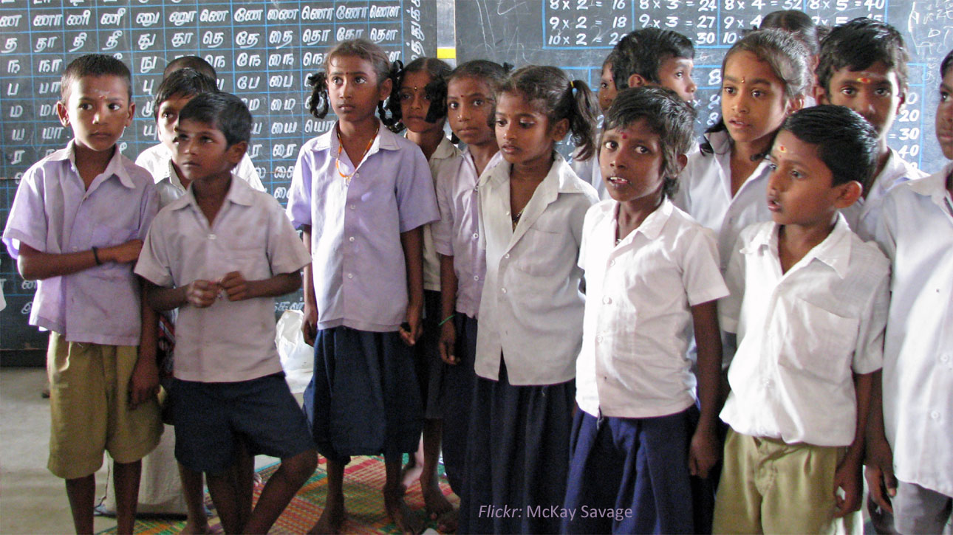
Producing: involving the class
PART 4: Producing media in your classroom

Slide 86
Student media creation

Slide 87
Producing: writing
Writing projects

Slide 88
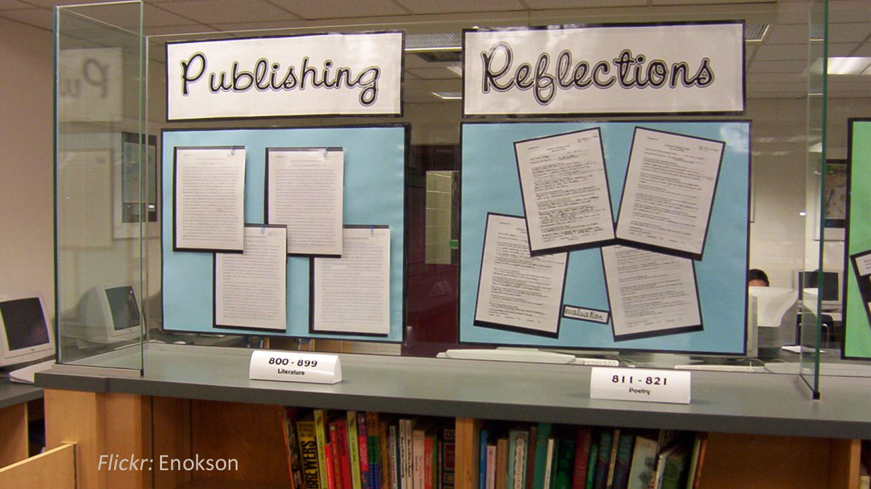
Producing: publishing student work

Slide 89
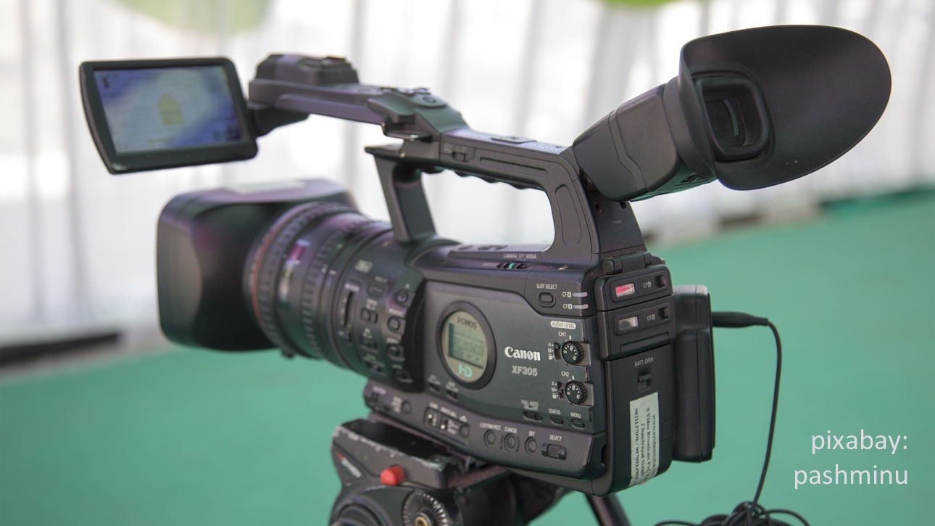
Producing TV news show - Tiger TV

Slide 90
Media production activities: three examples
Students write blogs about movies (Chile)
Students make their own TV commercial
Students write entries for the online encyclopedia Wikipedia (Japan)

Slide 91
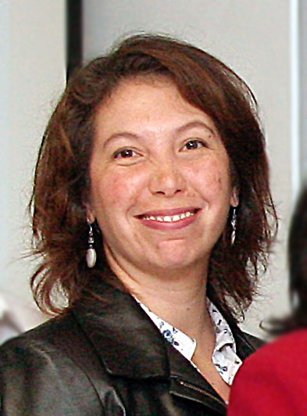
Student media production example: Blogs about movies from Chile
University-level film and literature class
In pairs or small groups, students chose a movie and wrote blog posts about it; then they responded to other students’ posts
Focused on listening, speaking, reading, writing, and vocabulary skills as well as critical thinking and analysis
Miriam Salazar Vélar

Slide 92
Chilean Movie Blog example 1

Slide 93
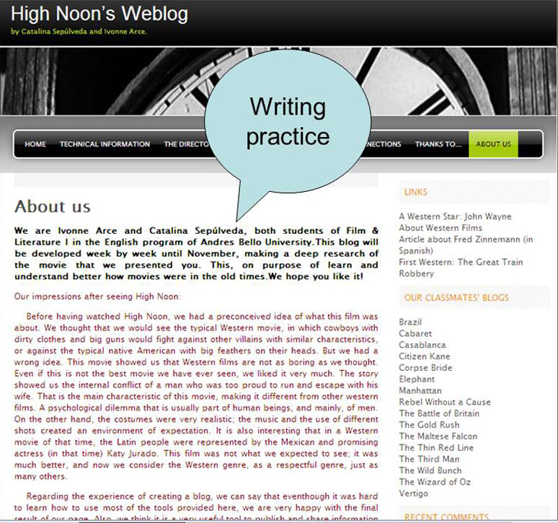
Chilean Movie Blog example 2

Slide 94
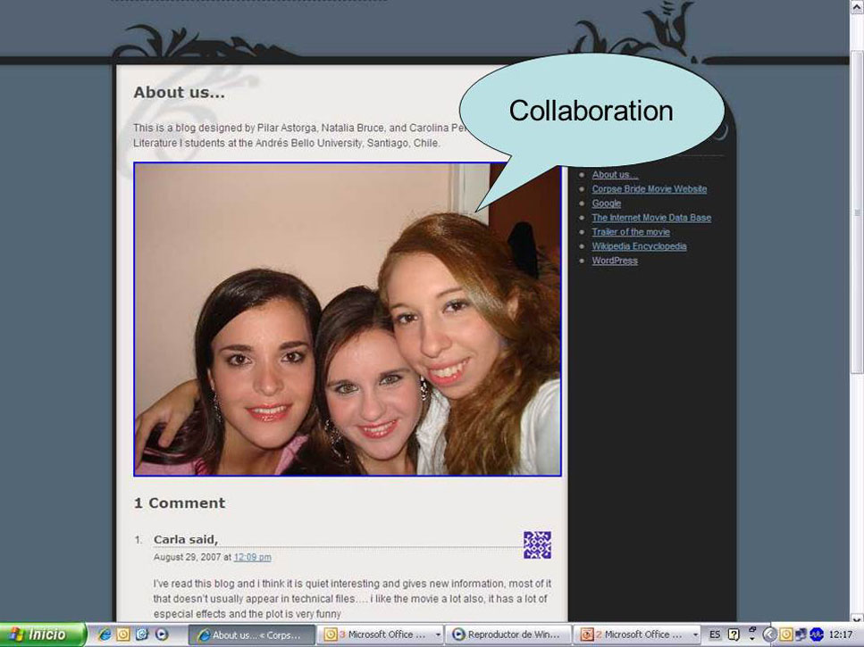
Chilean Movie Blog example 3

Slide 95
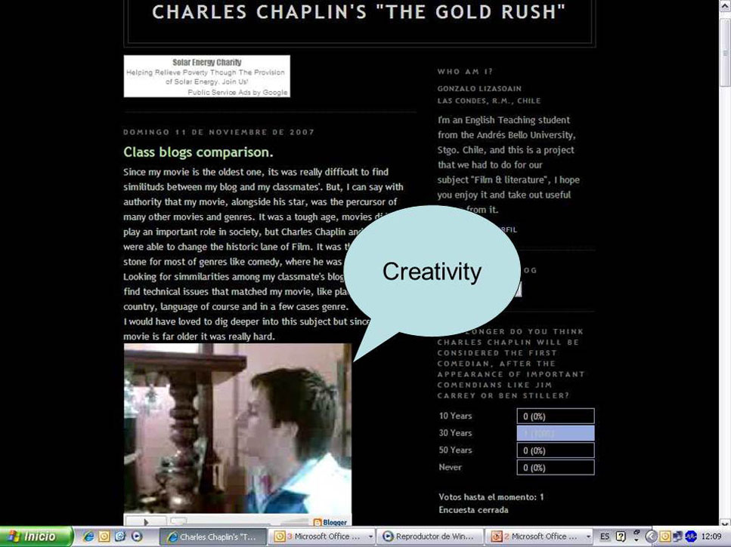
Chilean Movie Blog example 4

Slide 96
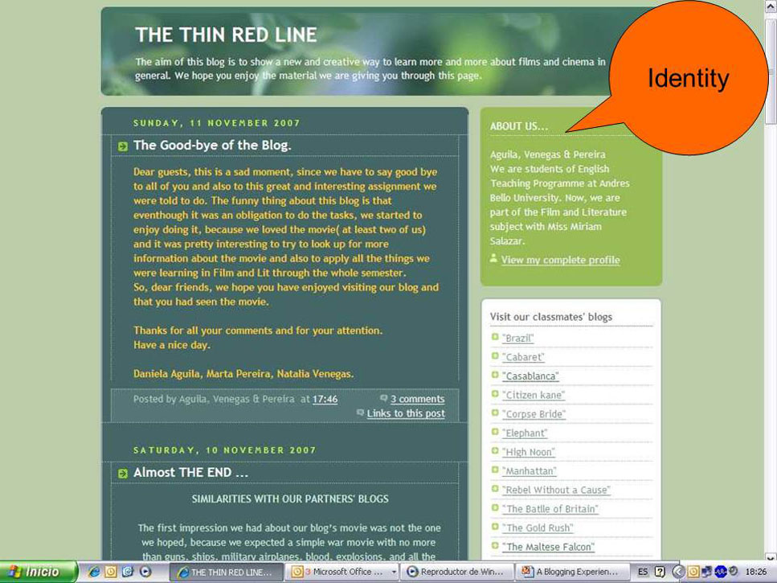
Chilean Movie Blog example 5

Slide 97
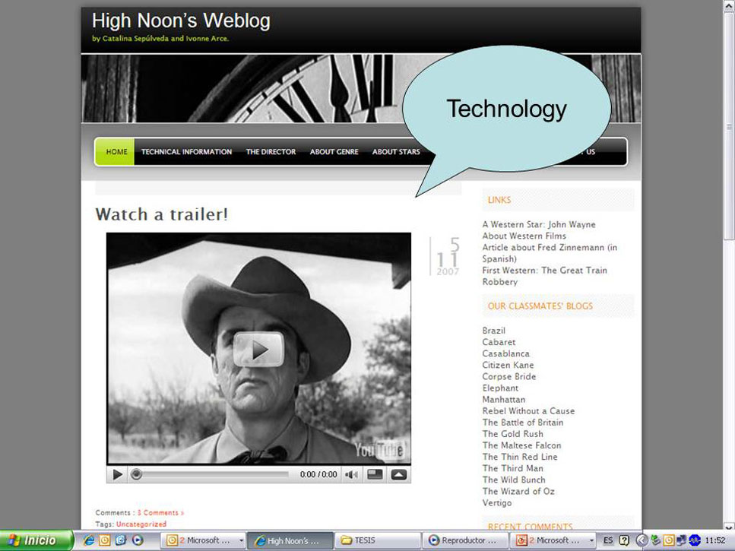
Chilean Movie Blog example 6

Slide 98
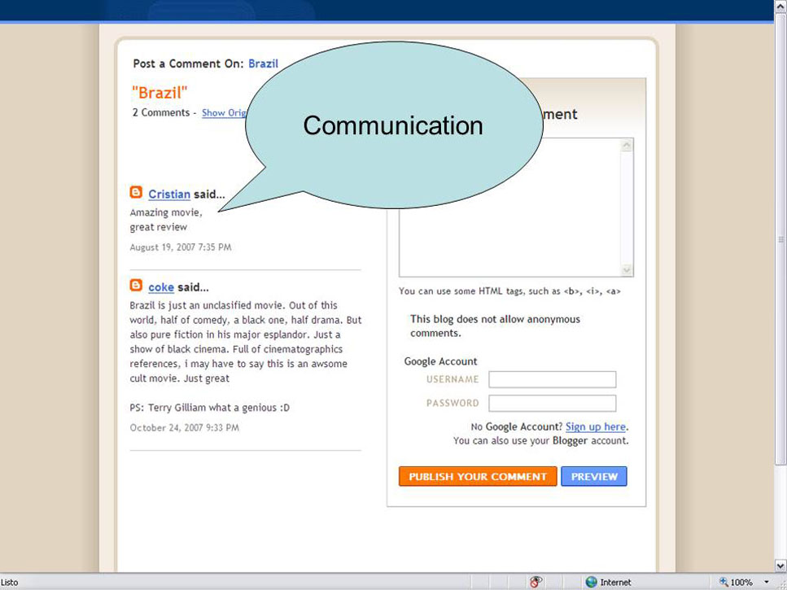
Chilean Movie Blog example 7

Slide 99
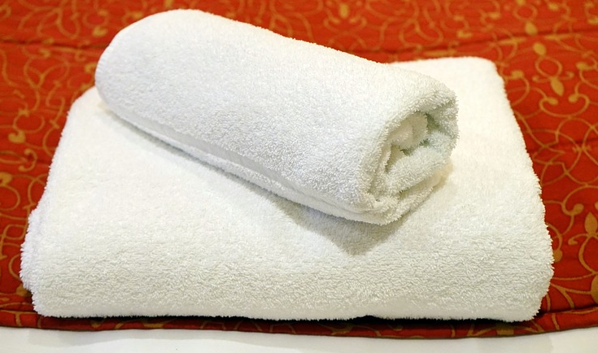
Producing: Activity Advertisements - white towel 1
ACTIVITY: Make a TV Commercial
Adapted from Project Look Sharp
Divide the class into small groups.
Explain that each group will design a TV commercial to sell a white towel. They'll need to decide:
a name for their product
what characters will be in the commercial
what the background and setting will be like
how the story will take place
what the voiceover will say
what kind of music will be playing in the background, and so on…

Slide 100
Producing: Activity Advertisements - white towel 3
Explain, however, that each group will be designing their commercial for a different target audience.
Do not announce each group’s target audience aloud.
Write it down or tell each group quietly.
Give students time to write and plan their commercials and to rehearse them.

Slide 101
Producing: Activity Advertisements - white towel 3
Ask each group to act out their commercial for the class. Have each group start by giving the name of their product, but not their target audience.
Alternative: Assign students to make videos of the commercials and show them in class.
When the group is finished, have the other students guess the target audience, giving evidence from the commercial.

Slide 102
Producing: Activity Advertisements - white towel 2
Target audiences that work well are:
adult women
adult men
college students (could be separate groups for males and females)
teens
young children
For a large class, assign the same target audience to more than one group; see how similar or different the commercials are.

Slide 103
Producing: Activity Advertisements - white towel 3
Instead of a white towel, what is another simple product that you could use for the commerical in this activity?
The object needs to be something with multiple uses that could be used by different audiences.

Slide 104
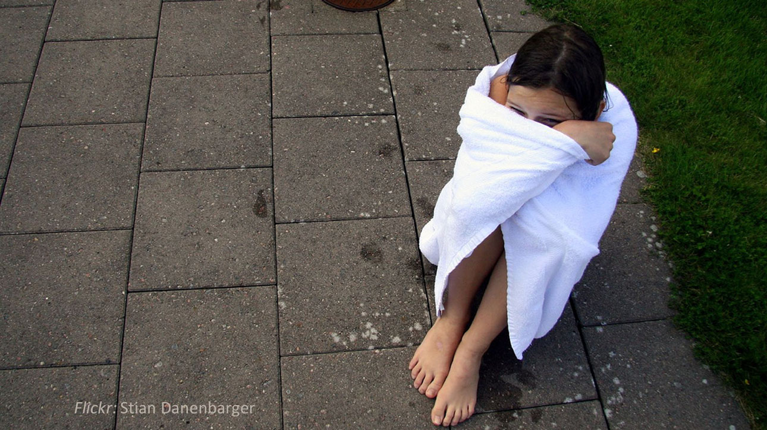
a great place to hide from your friends
warms you up when you feel cold
protects you when you don’t want to talk to anyone

Slide 105
Producing: Activity Advertisements - white towel 3
Now you try!
What might be some expressions you would use if you were trying to sell the white towel to mothers?
What about to auto mechanics?

Slide 106
Student media production example: Wikipedia entries from Japan
University-level academic writing class
Students studied and then wrote entries for the online encyclopedia Wikipedia
This helped students analyze media sources, research topics, and then write encyclopedia entries
Jennifer Louise Teetor

Slide 107
Student media production example: Wikipedia entries from Japan
Students studied the structure of a Wikipedia article that had been identified as well-written
They analyzed references from a variety of sources
They compared the well-written articles with “articles needing attention”
Then they chose topics, wrote drafts, received feedback from peers and teacher, published articles on Wikipedia, and received feedback from Wikipedia editors
Helped them develop confidence in their writing abilities

Slide 108
Wrap up: Thanks
Thank you!!!
Twitter: @joemcveigh

Slide 109
Special Thanks
Special thanks!!!

Slide 110
See this presentation again ?
http://americanenglishwebinars.com

Slide 111
Photo credits
Thanks to the photographers who permitted their work to be used under a Creative Commons Attribution License. You can find the source of each picture credited directly on the relevant slide.
For more detailed credit information for the Creative Commons photos, see the Photo Credits document in the Webinar 7.3 section of the American English Webinars Ning site. Other photos are from attribution-free sites such as Pixabay, and various open-source stock photo sites such as Hubspot and Splitshire.

Slide 112
Wrap up: Bibliography
Bibliography
Grigoryan, A. & King, J. M. (2008). Adbusting: Critical media literacy in a multi-skills academic writing lesson. English Teaching Forum, 46(4) pp. 2–8.
Hart, M. (2008). Media literacy grades 7–8. Westminster, CA: Teacher Created Resources, Inc.
Hobbs, R. & Moore, D. C. (2013). Discovering media literacy: Teaching digital media and popular culture in elementary school. Thousand Oaks, CA: Corwin.
Potter, W. J. (2016). Media literacy (8th ed.). Thousand Oaks, CA: Sage.
Teeter, J. L. (2016). Using Wikipedia to make English academic writing meaningful for undergraduates. In P. Clements, A. Krause, & H. Brown (Eds.). Focus on the learner. Tokyo: JALT
Useful websites
Center for Media Literacy: www.medialit.org/reading-room/reading-room-article-index
Project LookSharp: www.projectlooksharp.org
The News Literacy Project: www.thenewsliteracyproject.org
You can print a copy of this bibliography. Look for “Bibliography” in the Webinar 7.3 section of the American English Webinars Ning site.

