Slide 1
Looking In, Looking Out:
Teachers Learning from Ourselves and Others
Joe McVeigh
16 February 2019
CamTESOL
Phnom Penh

Slide 2
Feeling stress

Slide 3
Create a safe space
Joanna Colwell

Slide 4
Own the room

Slide 5
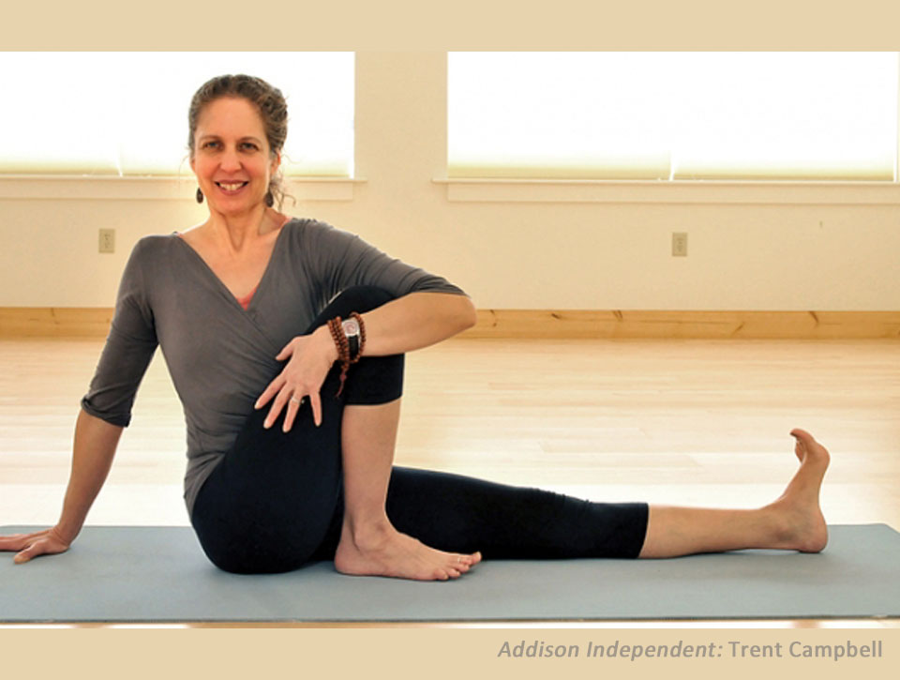
Take it slowly at first

Slide 6
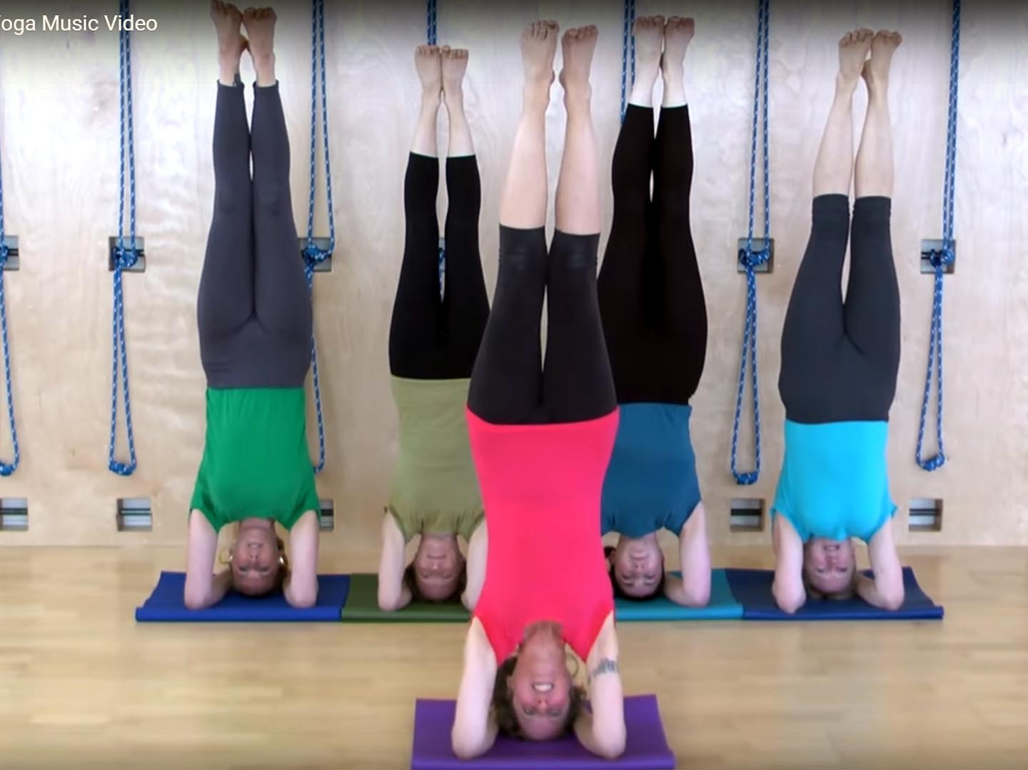
Adapt instruction to
student abilities

Slide 7
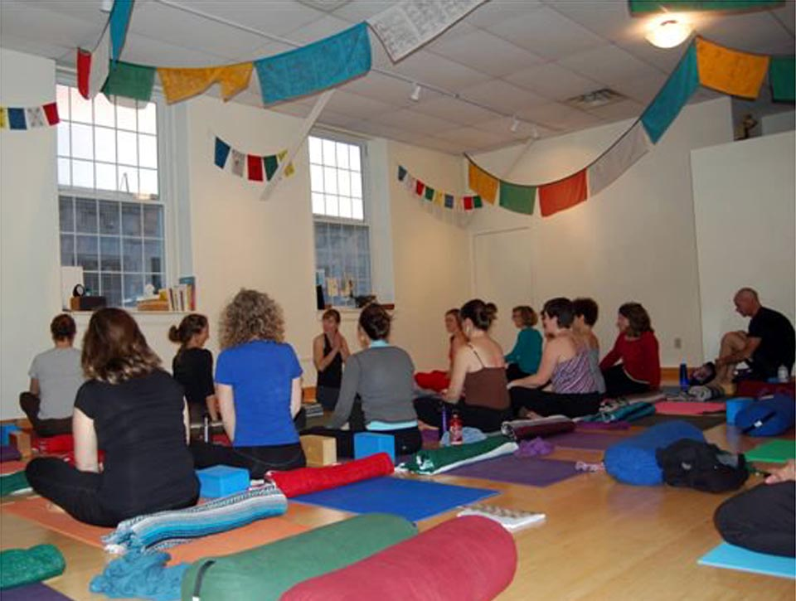
Build a community

Slide 8
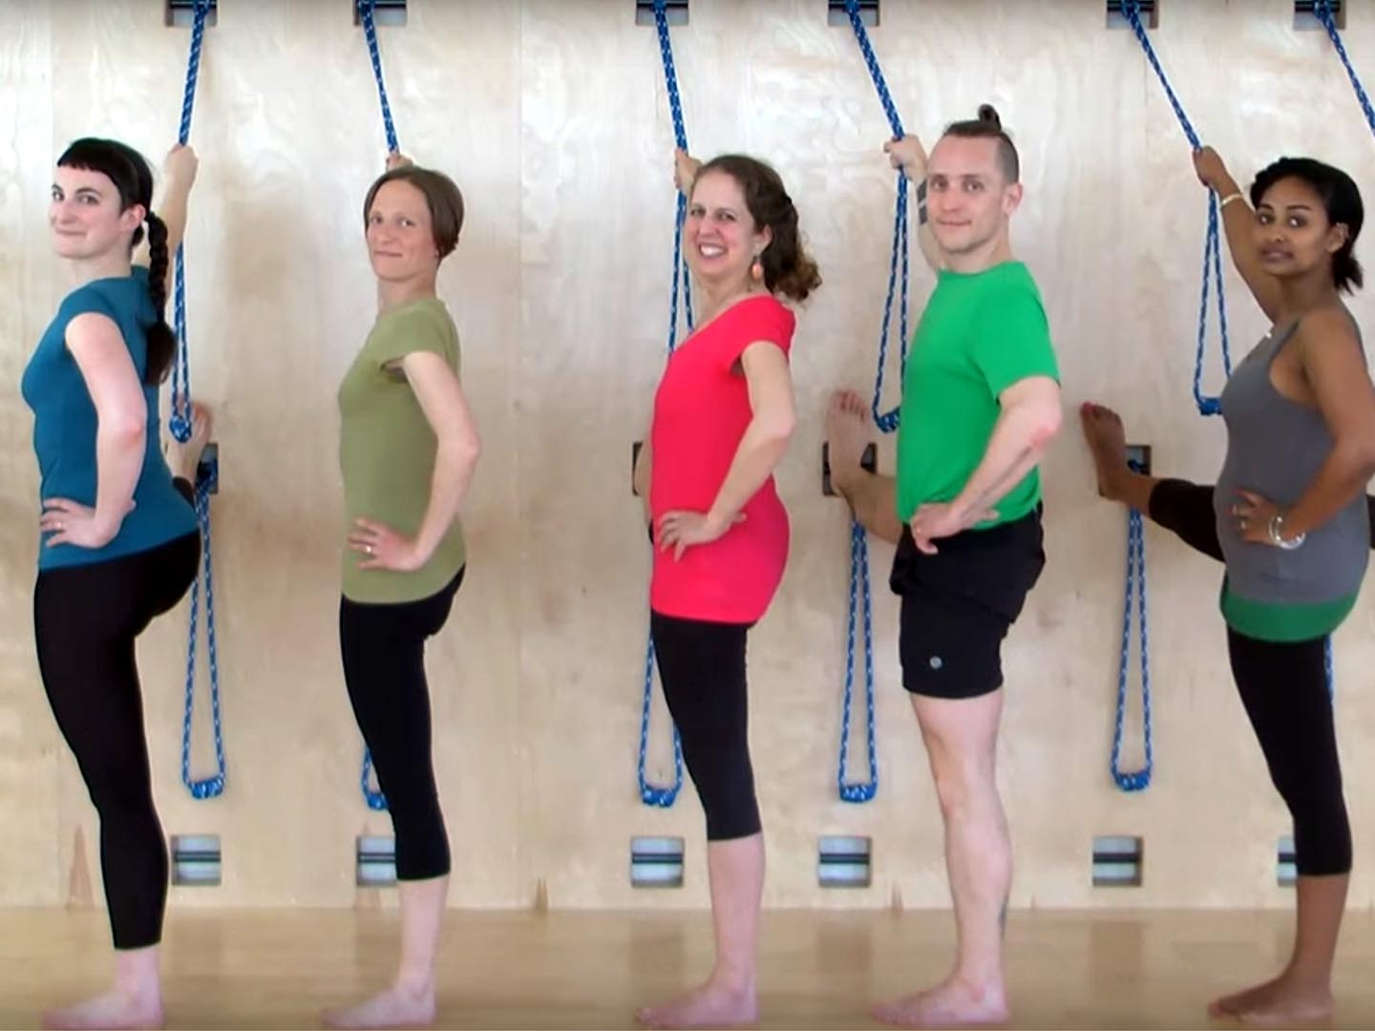
Mix
it
up

Slide 9
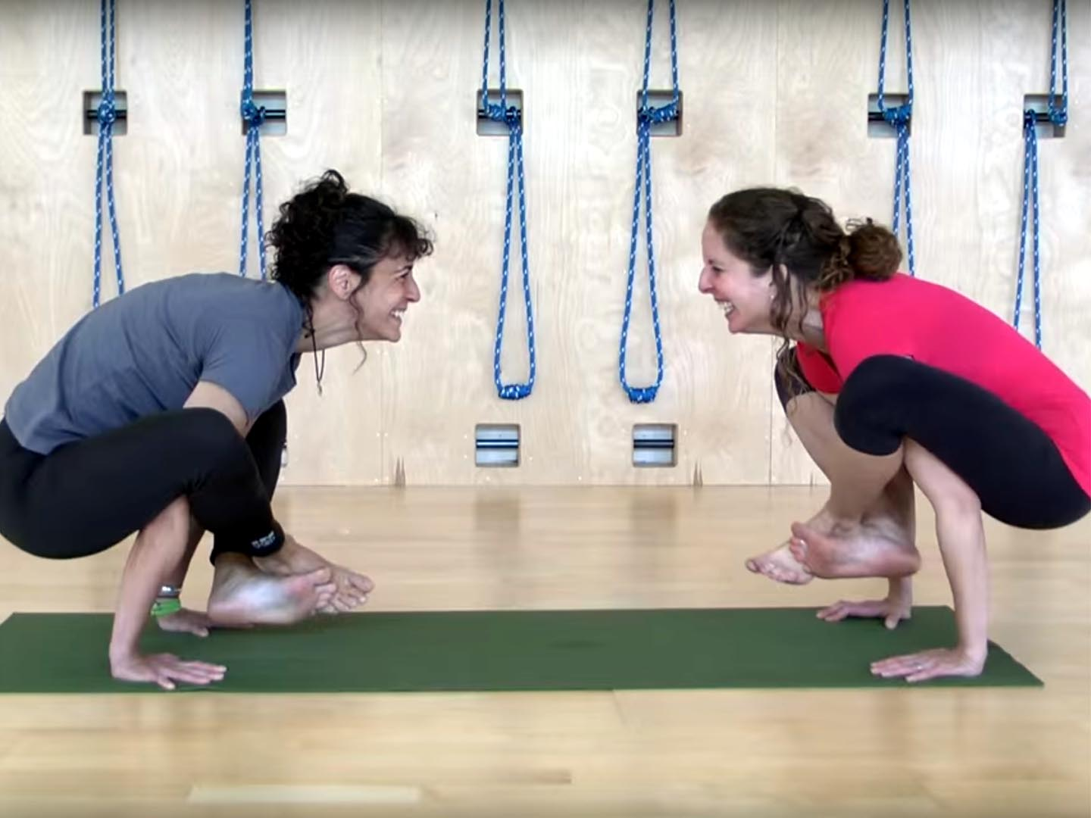
Make it fun !

Slide 10
Comprehension Check

Slide 11
Quiz
Create a safe __________.
Own the __________.
Take it __________ at first.
Adapt instruction to student __________.
Build a __________.
__________ it up.
Make it _________.
*7
space
room
slowly
abilities
community
Mix
fun

Slide 12
Looking outward

Slide 13
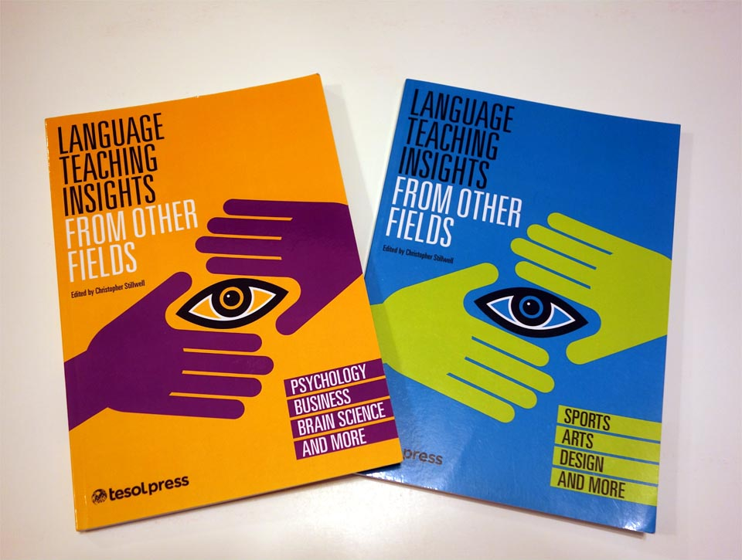

Slide 14
How would a ...
a project manager | plan a lesson?
a business school professor | teach discussion skills?
a bartender | create a safe, social classroom environment?
a restaurant reviewer | critique student writing?
a whitewater kayaker | teach a language class?
— Stillwell 2013, 2015

Slide 17
Looking outward

Slide 18
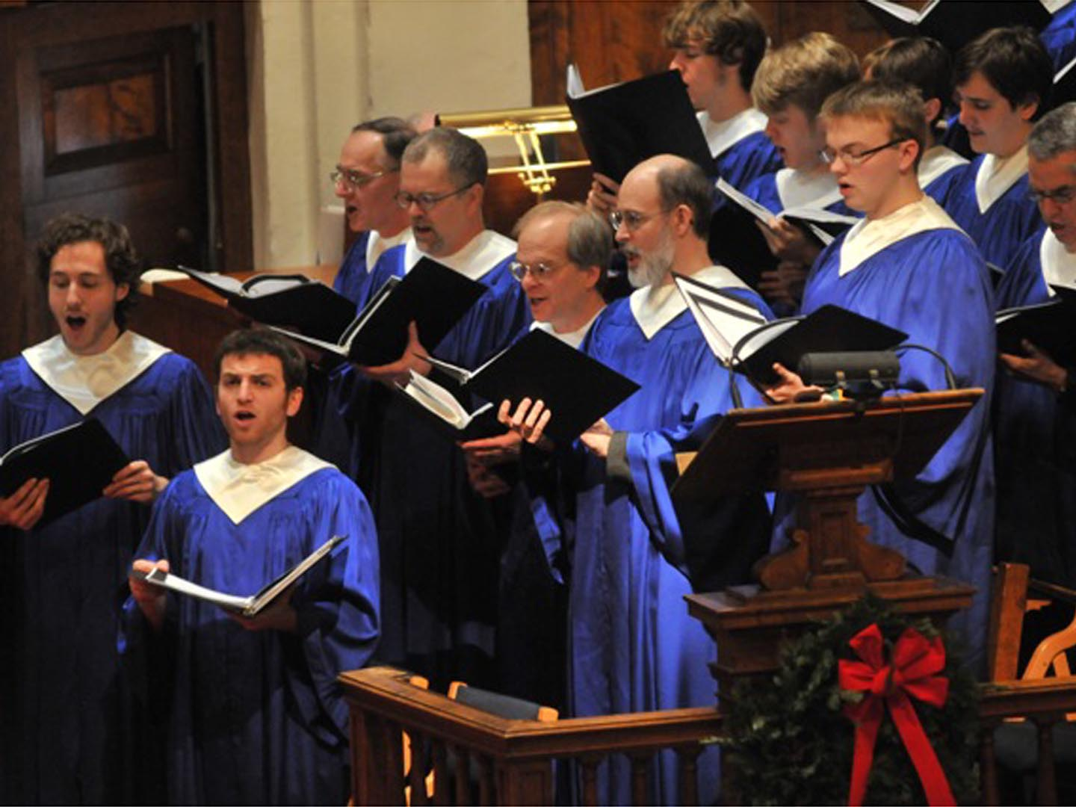

Slide 19
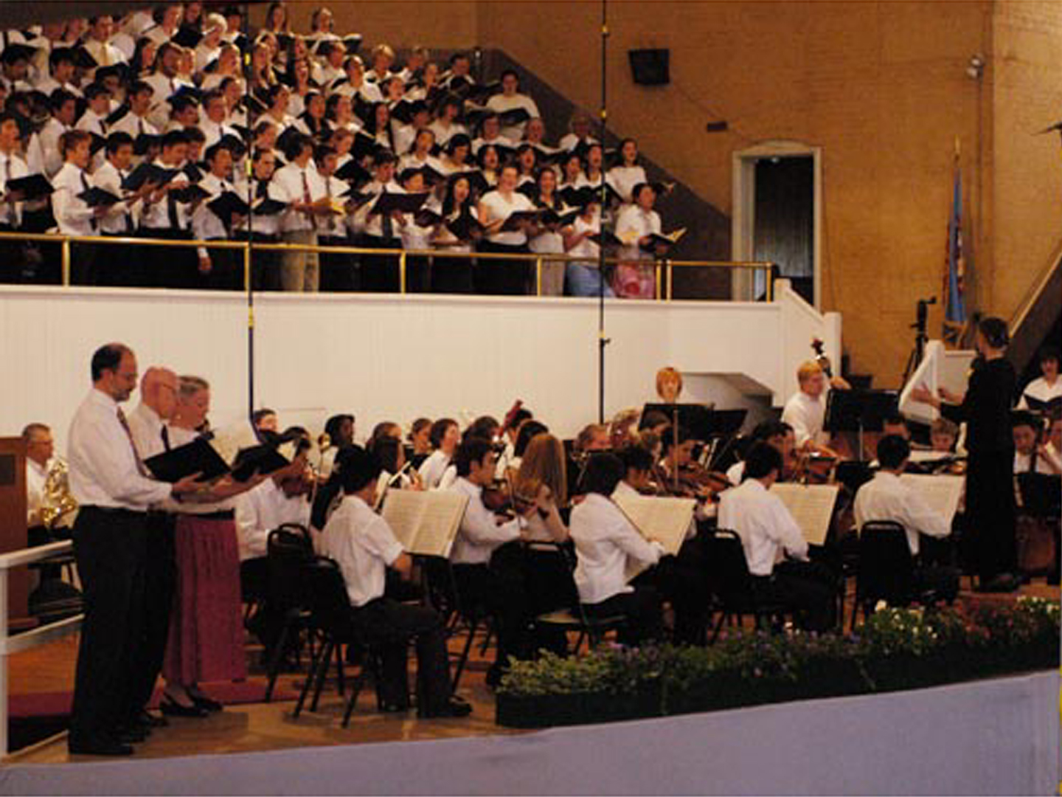
conductor
* 1

Slide 20
Preparing for discussion
Stop reading your program book.
Don’t “jump the gun.” Wait for the signal.
Find a partner. Change your seat if you need to.
Introduce yourself very briefly.
Share your ideas on this question for two minutes.
Be ready to stop on the signal.

Slide 21
Your turn to work
What similarities can you see between being a music conductor and an English teacher?
Turn to a partner and share your ideas for two minutes

Slide 23
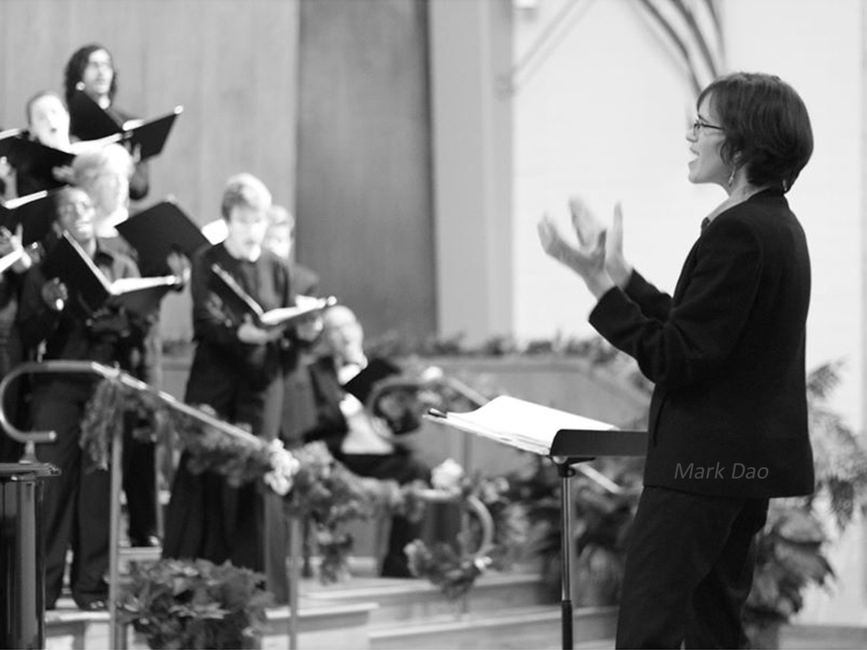
Don’t waste time
Eliza Rubenstein

Slide 24
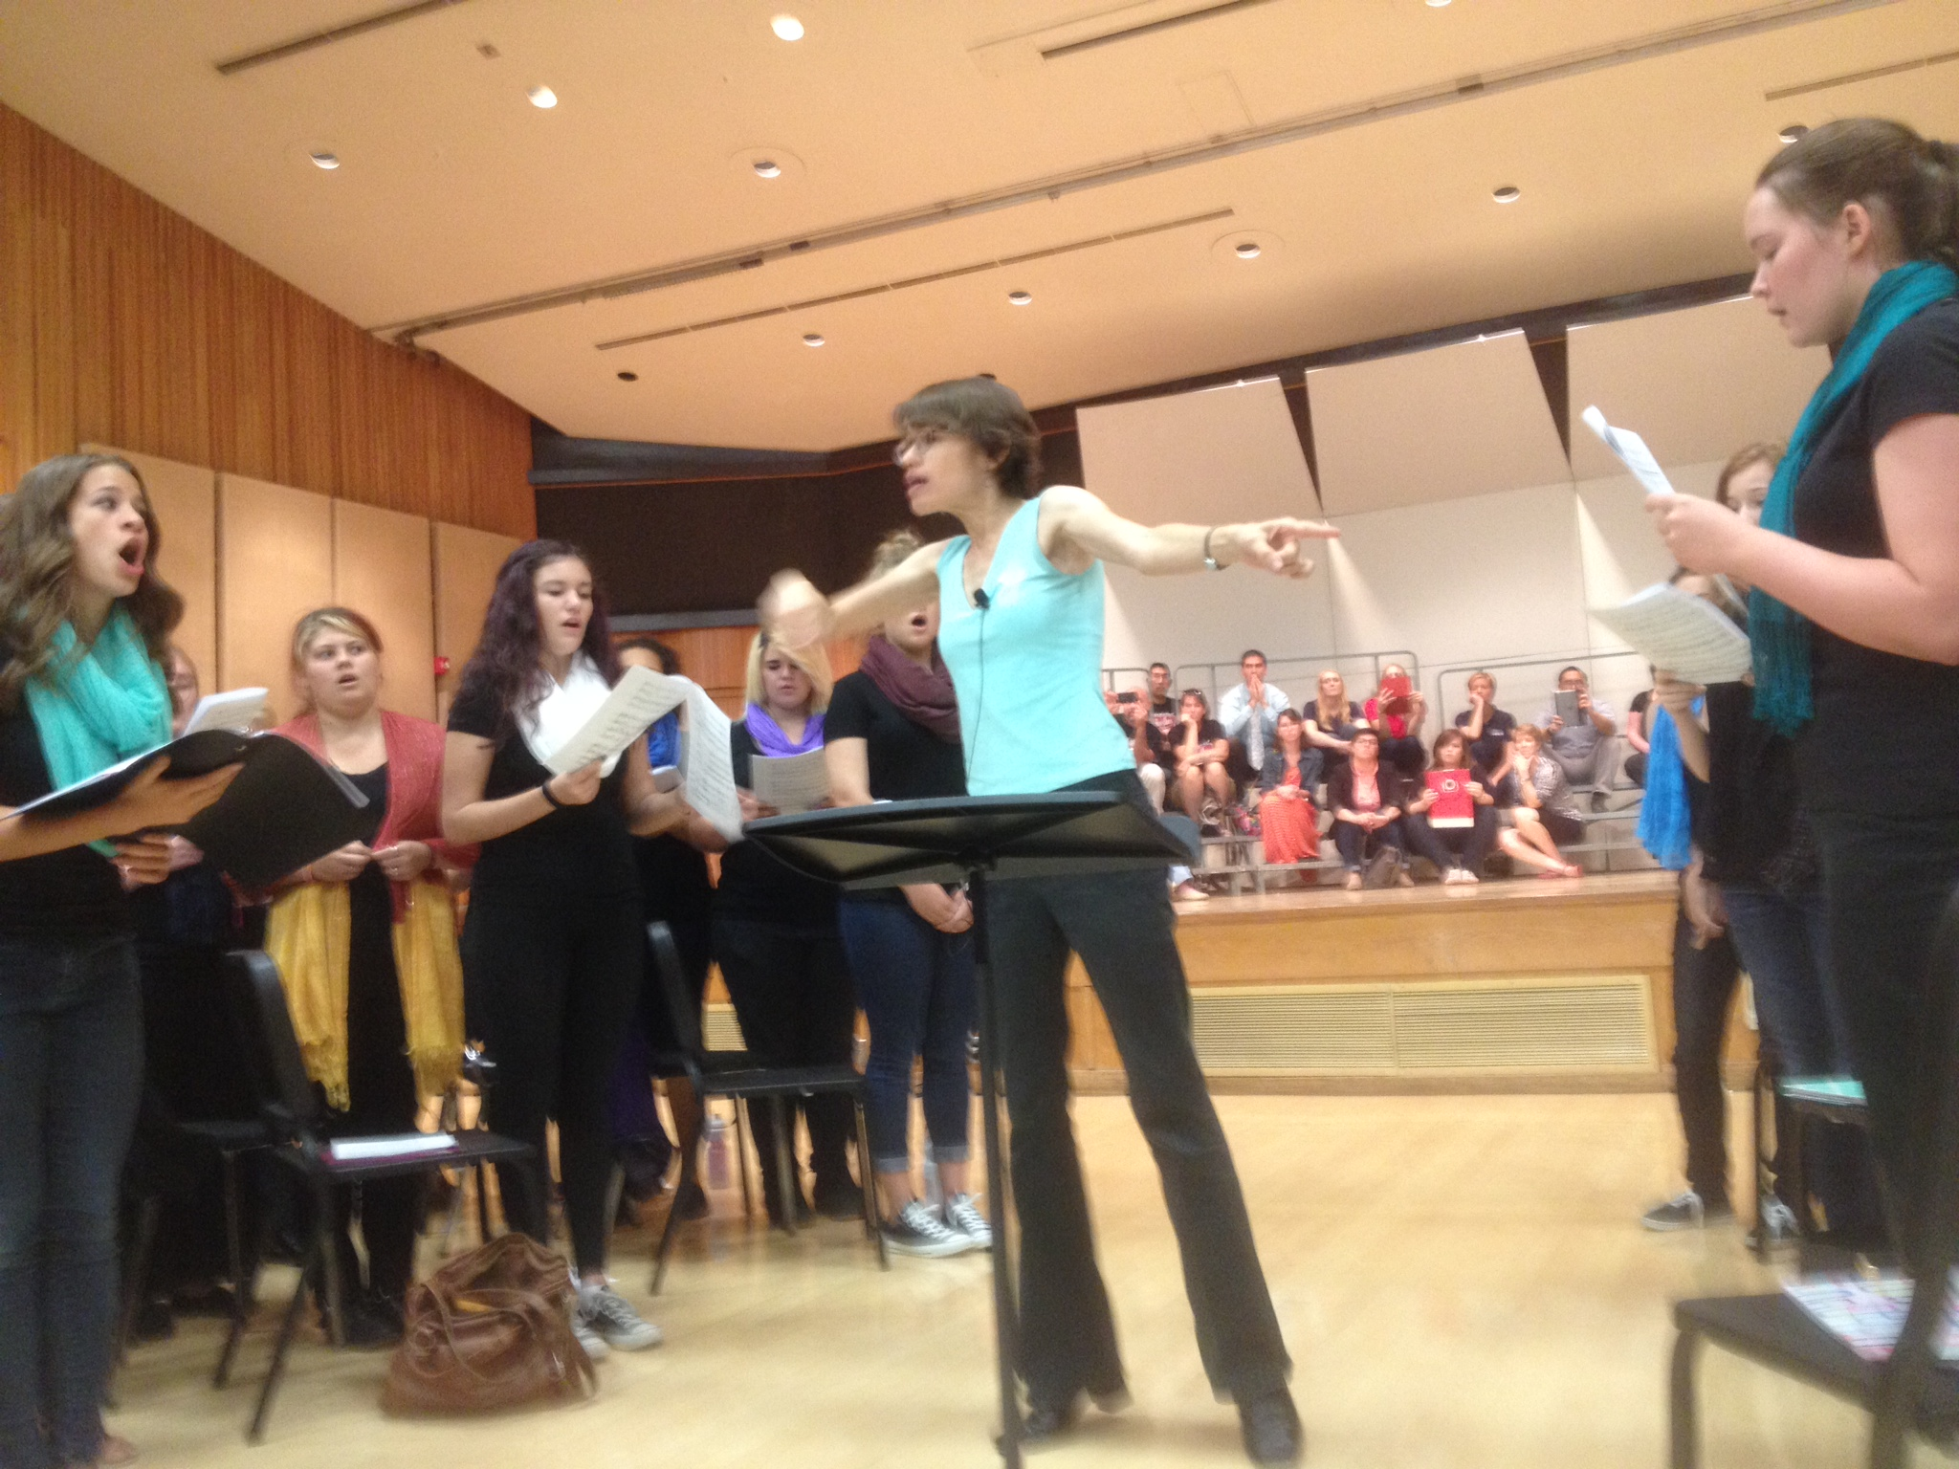
Avoid blame

Slide 25
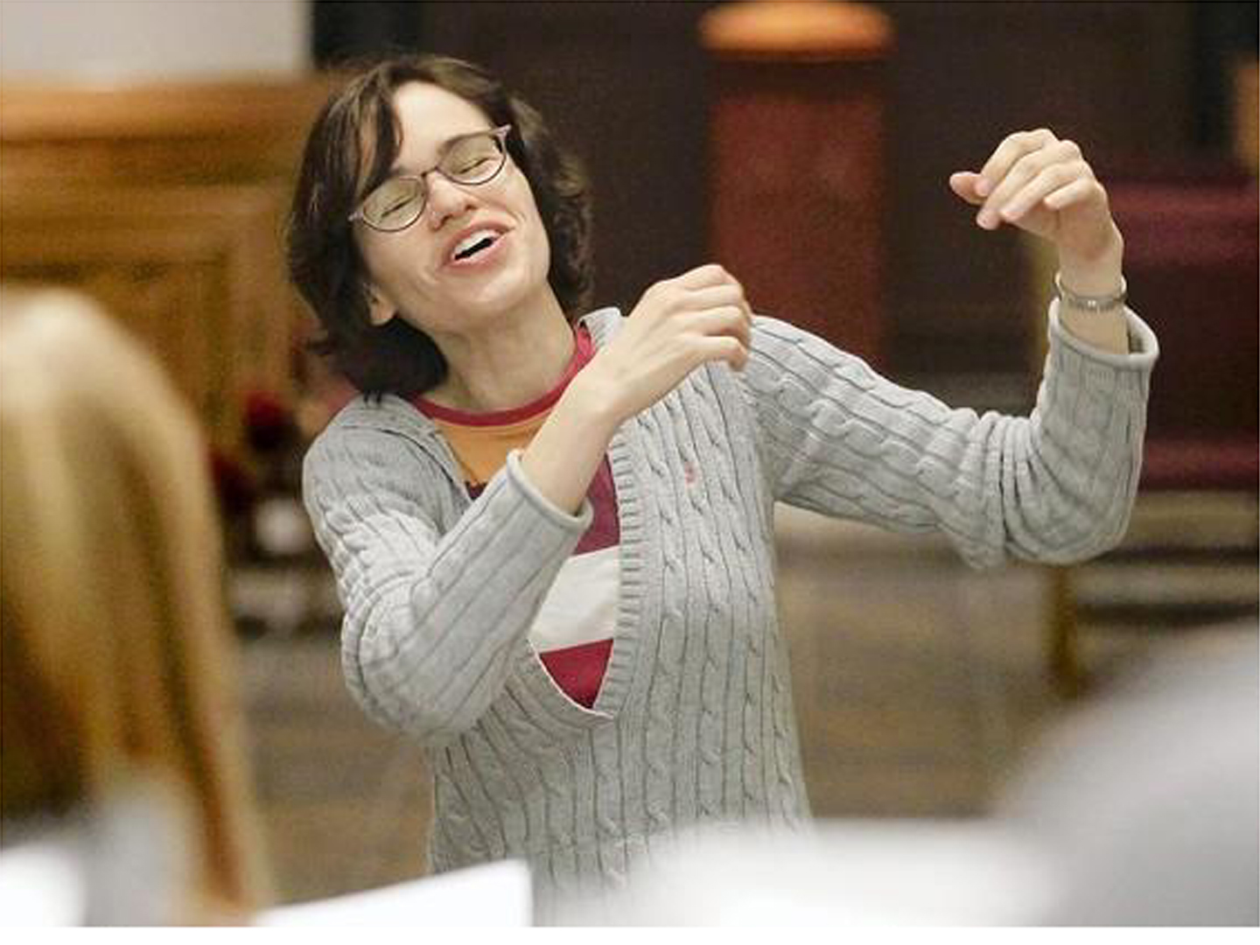
Focus on the solution

Slide 26
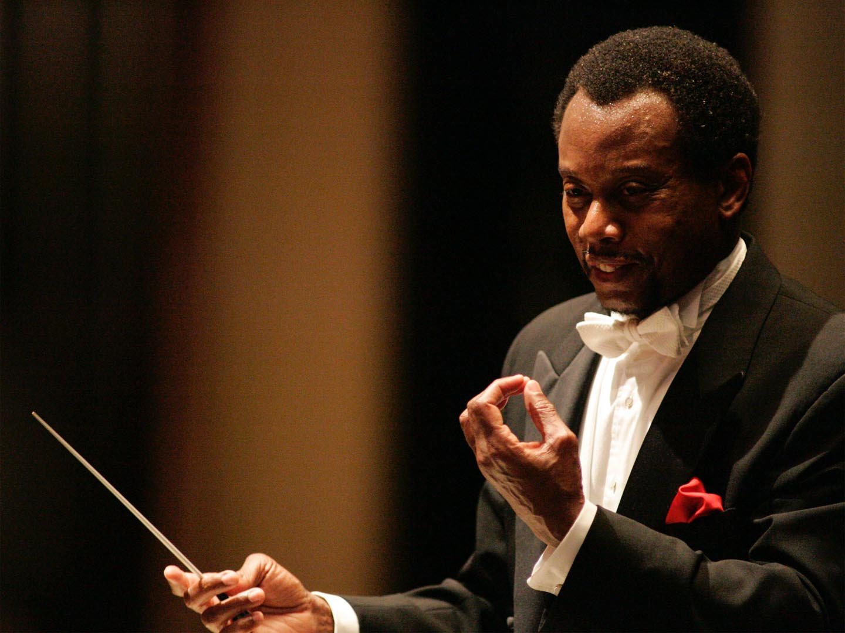
Create high expectations
Raymond Harvey

Slide 27
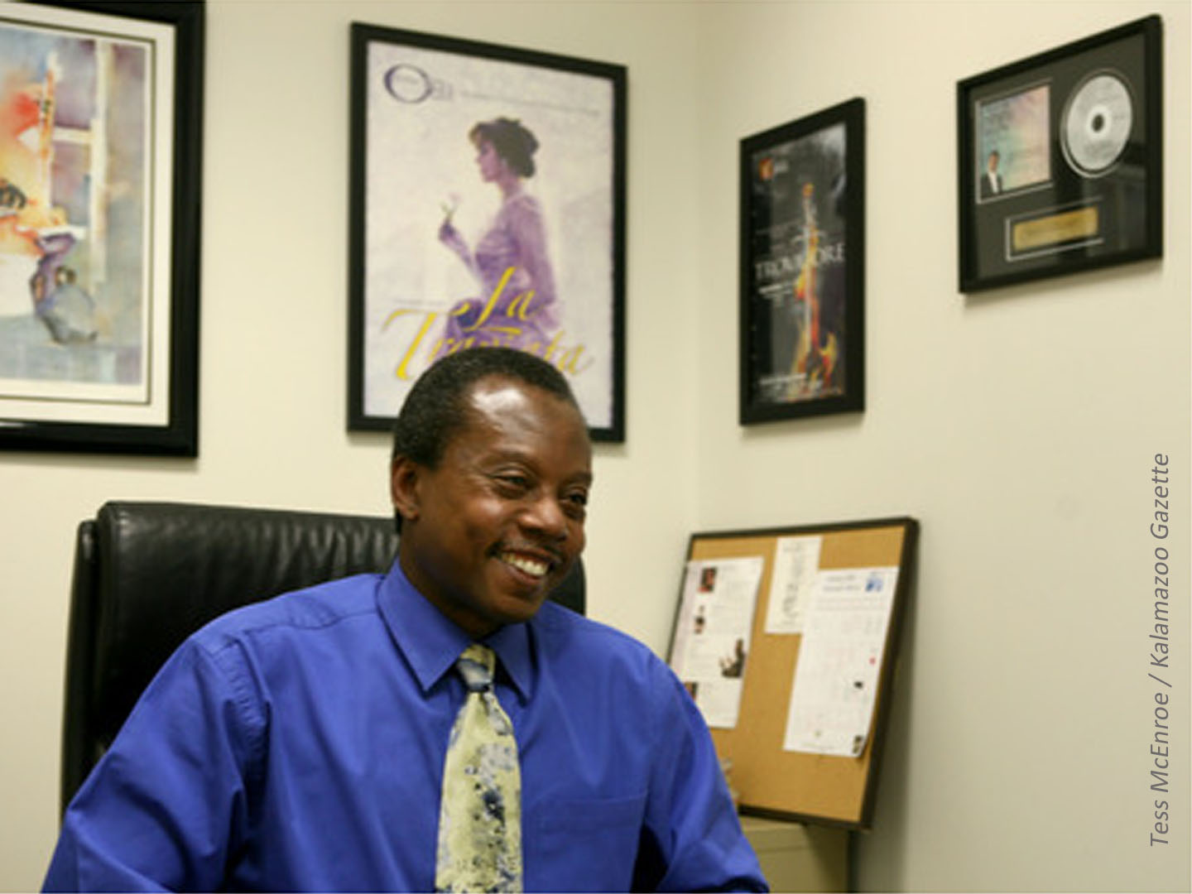
Deal evenhandedly
with
everyone

Slide 28
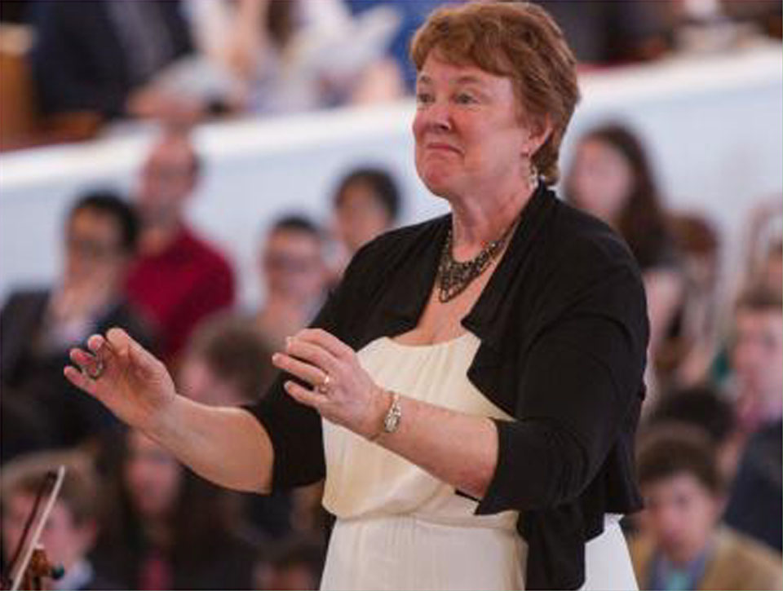
Set the right level of challenge
Sheila Heffernon

Slide 29
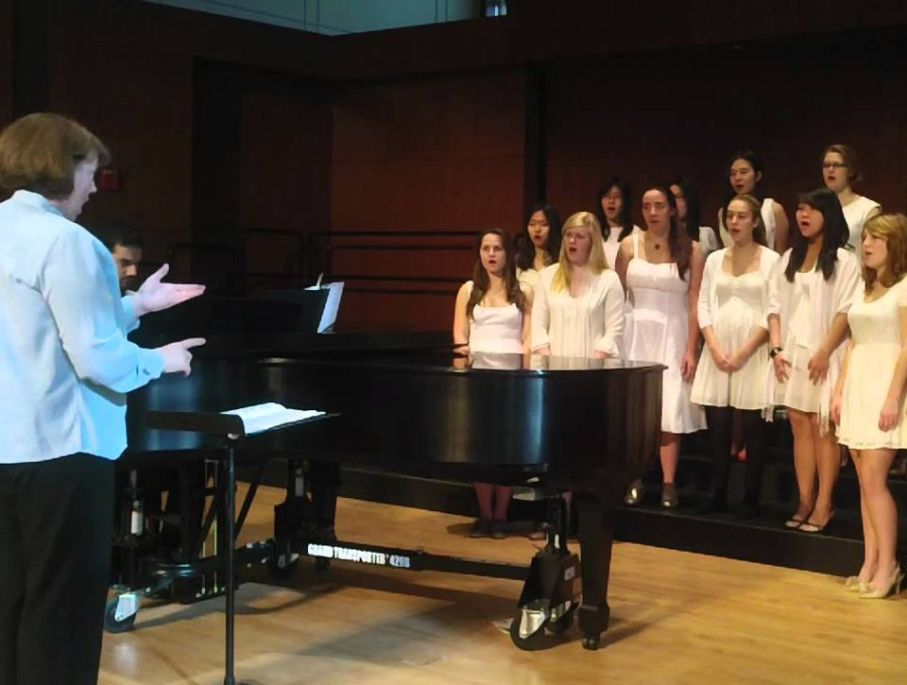
Design activities for success

Slide 30
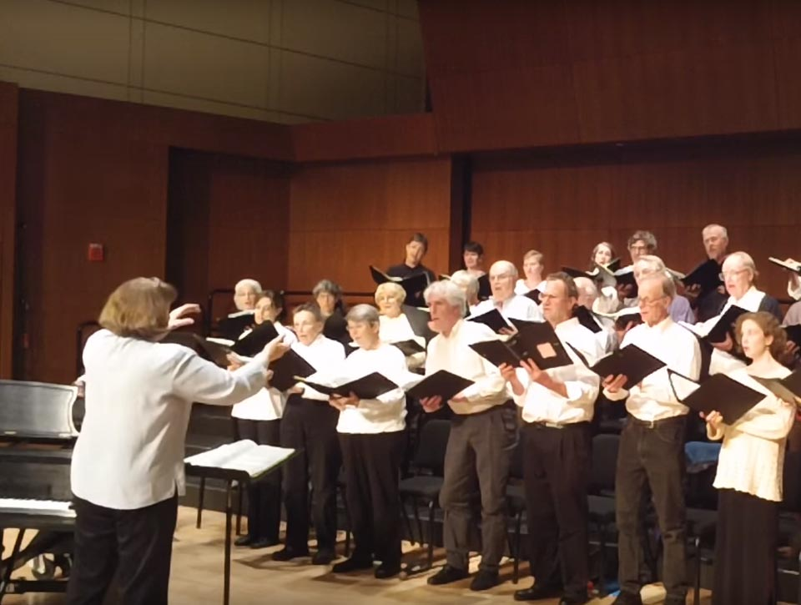
Offer encouragement

Slide 31
Quiz
Don’t waste__________.
Avoid __________.
Focus on the__________.
Create high __________.
Deal __________ with everyone.
Set the right level of __________.
Design activities for _________.
Offer __________.
time
blame
solution
expectations
evenhandedly
challenge
success
encouragement
*8

Slide 32
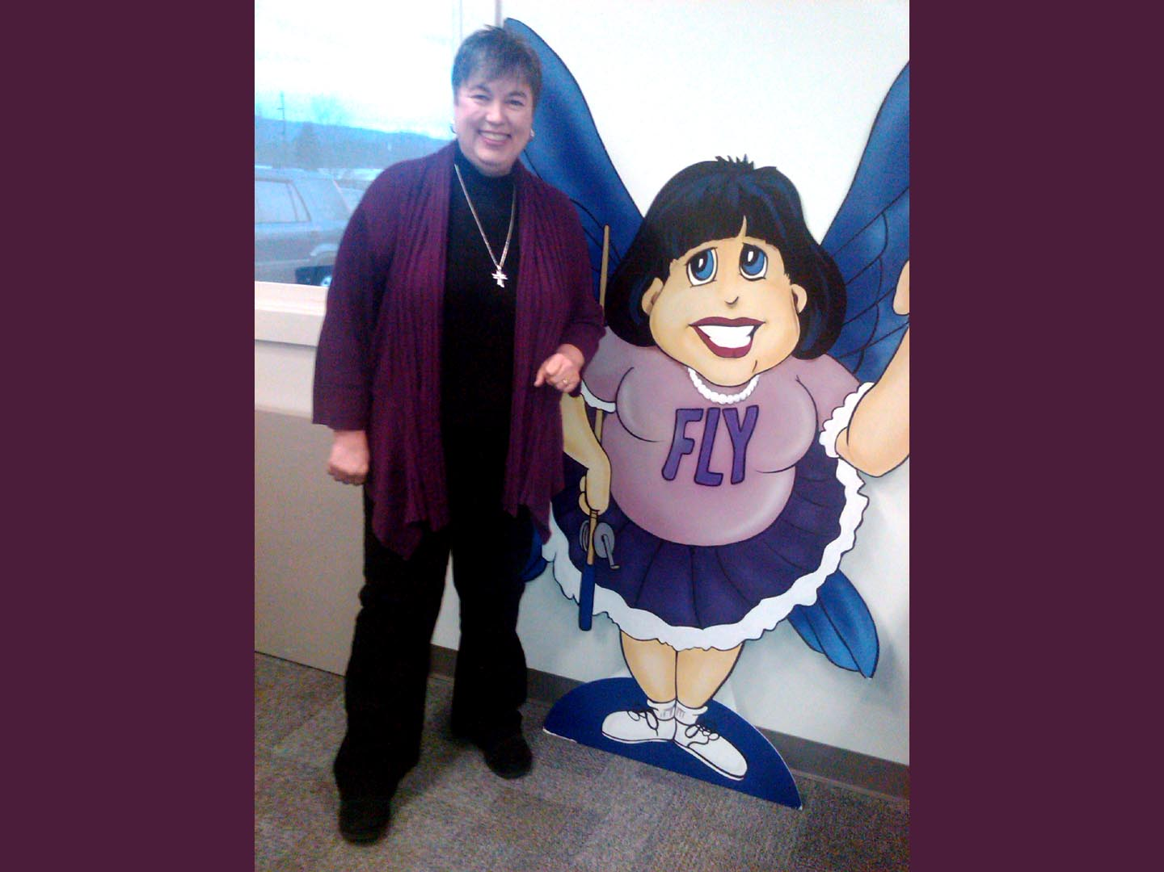
Marla
Cilley
Professional
organizer

Slide 33
There is
power in
routines

Slide 34
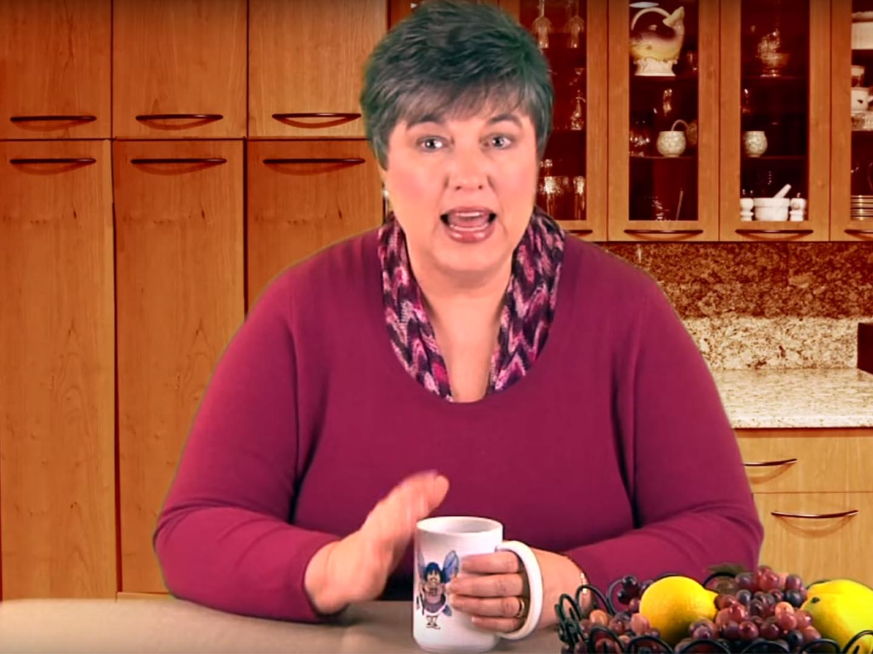
Celebrate small
successes

Slide 35
Sometimes you need to be a drill sergeant
Sometimes you need to be a drill sergeant

Slide 36
Be kind to yourself

Slide 37
Quiz
There is p__________ in r__________.
Celebrate s__________ s__________.
Sometimes you have to be a d_________ s______________.
Be k__________to y__________.

Slide 38
Answers
There is power in routines.
Celebrate small successes.
Sometimes you have to be a drill sergeant.
Be kind to yourself.

Slide 39
Your turn to work
Think of a person from another field whose work you admire….
What do they do?
What makes them effective in their work?
What could you use in your classroom?

Slide 41
Looking outward

Slide 43
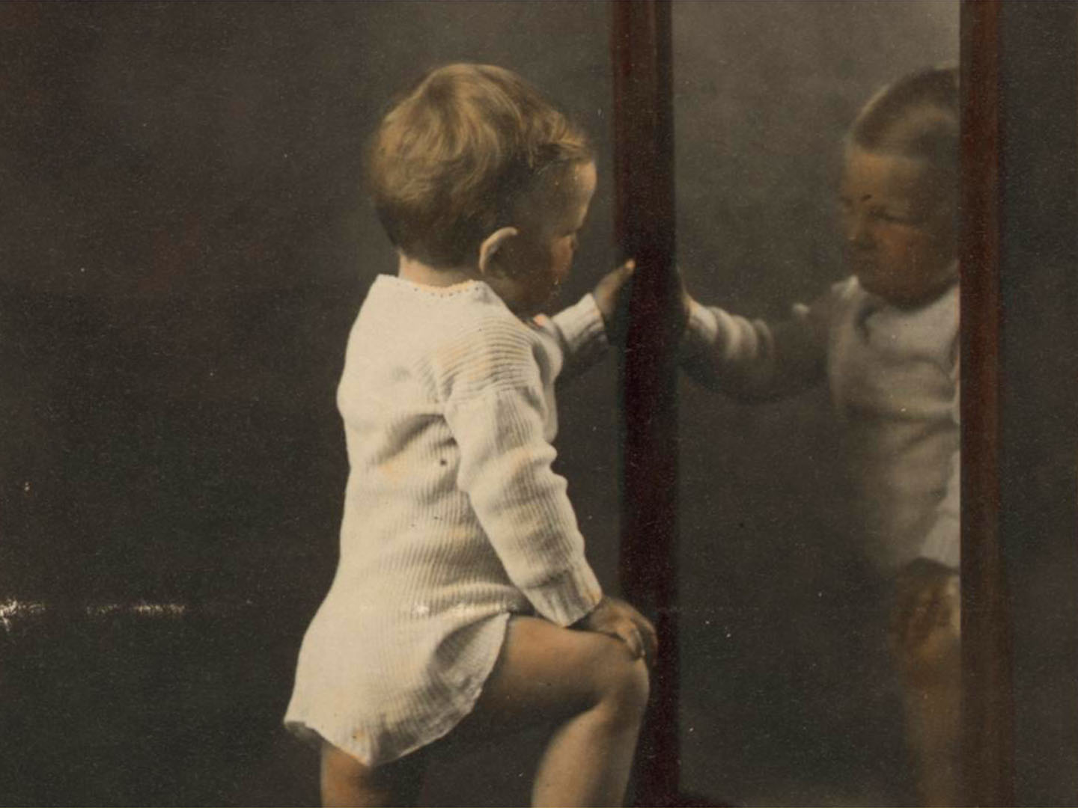
Looking
inward

Slide 44
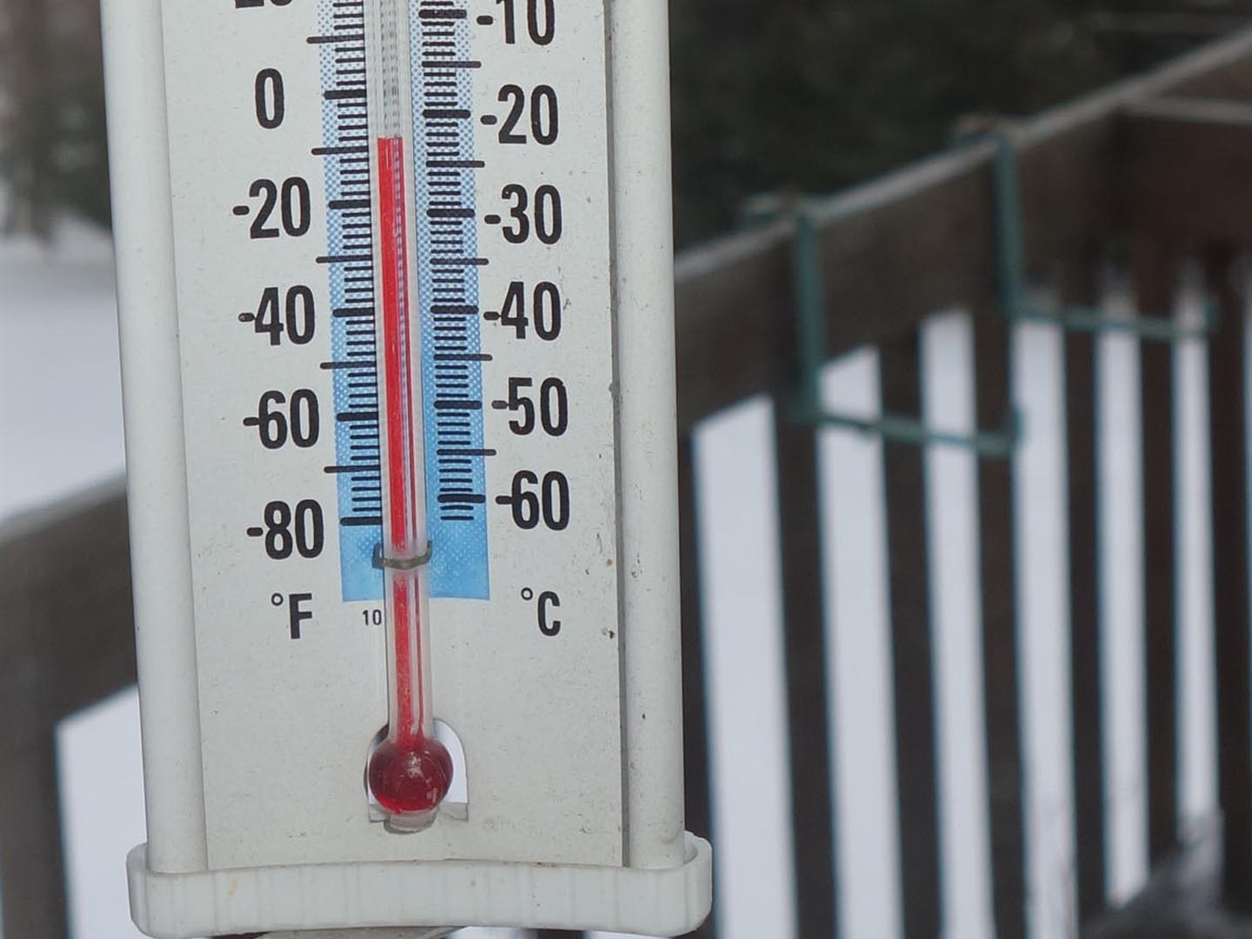
What is the temperature in the room?
*1

Slide 45
Atmosphere
Two teachers

Slide 46
And have not love . . .
If I speak in the tongues of men or of angels,
but do not have love, I am only a noisy gong or
a clanging cymbal. If I have the gift of prophecy and can understand all knowledge and if I have faith that can move mountains, but do not have love, I am nothing. If I give everything I have to the poor, but do not have love, I gain nothing.
—1st Letter of St Paul to the Corinthians, Chapter 13

Slide 47
And have not love . . .
If I speak a foreign tongue
With near-native pronunciation
With impeccable grammar
And a rich idiomatic vocabulary,
But have not love . . .
If I have sophisticated discourse strategies
And intercultural competency,
But have not love . . .
—Smith & Carvill, (After 1st Corinthians 13)

Slide 48
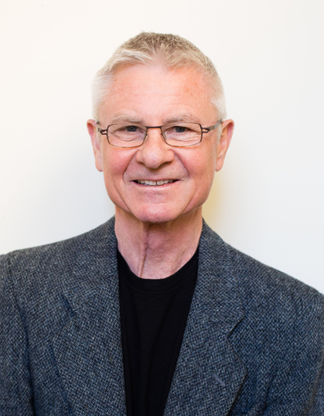
I love Spanish !
—Nunan, quoting his daughter in Arnold & Murphy, 2015

Slide 49
Atmosphere
“My conclusion is that we teachers create a personal atmosphere in our classes, that it is perceivable to everyone except ourselves, that it makes a difference to the learning that takes place there, and that it is difficult to get a strong impression of what our own atmosphere ‘tastes’ like to others.” —Underhill in Arnold & Murphy, 2015

Slide 50
Your turn to work:
Recall a classroom you’ve been in as a student. Think about the teacher. What sort of an “atmosphere” did that teacher give off? Was it positive or negative? How did it help or hinder your learning?
Share your experience with a partner.

Slide 52
Atmosphere
“.. . we seem to have a blind spot for our own personal psychological atmosphere, though not for the other’s, albeit seen through our own filters.”
—Underhill in Arnold & Murphy, 2015

Slide 53
Class observations and performance appraisal
What is on the class observation checklist ?

Slide 54
Language study as a human experience
“Language study is inevitably a total human experience; writers and teachers ought therefore to act as though it is.” —Stevick, 1971

Slide 55
Sending unconscious messages
“. . . I believe that the most important teaching we do is that which is often called modeling—the unconscious messages we send merely by acting the way we act.”
– Clarke, 2003

Slide 56
Looking
inward

Slide 57
Who is the self that teaches?
The question we most commonly ask is the “what” question – what subjects shall we teach?
When the conversation goes a bit deeper, we ask the “how” question – what methods and techniques are required to teach well?
Occasionally, when it goes deeper still, we ask the “why” question – for what purpose and to what ends do we teach?
But seldom, if ever, do we ask the “who” question – who is the self that teaches? How does the quality of my selfhood form – or deform – the way I relate to my students, my subject, my colleagues, my world?
—Palmer 1997
*4

Slide 58
Truthful
Tuesday

Slide 59
On being screwed up
“Everyone is screwed up, broken, clingy, and scared, even the people who seem to have it more or less together. They are much more like you than you would believe. So try not to compare your insides to their outsides.” — Anne Lamott, 2015

Slide 60
Resistance to change
“Dedicated and hard-working teachers attend conference workshops and pursue advanced degrees in order to improve their teaching, but they avoid taking risks in their classrooms to try out new techniques, observe other teachers, or work with coaches to explore new ways of engaging students. “ —Clarke in Arnold & Murphy, 2015

Slide 61
What is a part of your own teaching or inner life that you would like to work on?

Slide 63
Complex problems and simple answers
“For every complex question there is usually a simple answer
—and it’s usually wrong.” —H.L. Mencken

Slide 64
Are your focusing more on the problem or on the solution?

Slide 65
Solution focused questions
1) What are your best hopes?
2) What difference would that make?
3) What is already working in the right direction?
4) What would be the next sign of progress? What would the next step be?
Fredrike Bannink: 1001 Solution-focused questions

Slide 66
Problem focused vs. solution-focused
Problem-Focused | Solution-Focused
Looking for faults is important | Designing solutions is important
The past is important | The future is important
Big changes are needed | A small change is often enough
Resources must be acquired | Resources are already present
Insight into or understanding of the problem is a precondition | Insight into or understanding of the problem comes with or after the change
—Bannink

Slide 67
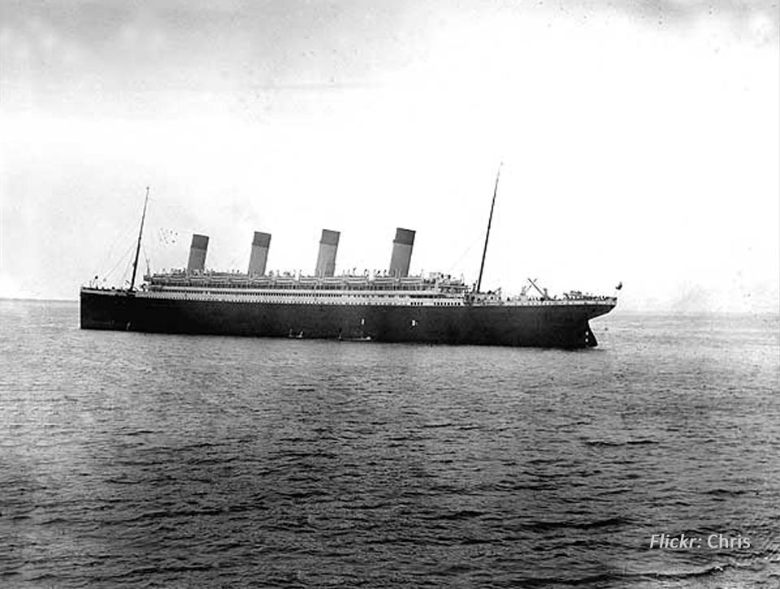
A small change can
make a big difference

Slide 68
Looking outward

Slide 69
Looking inward

Slide 71
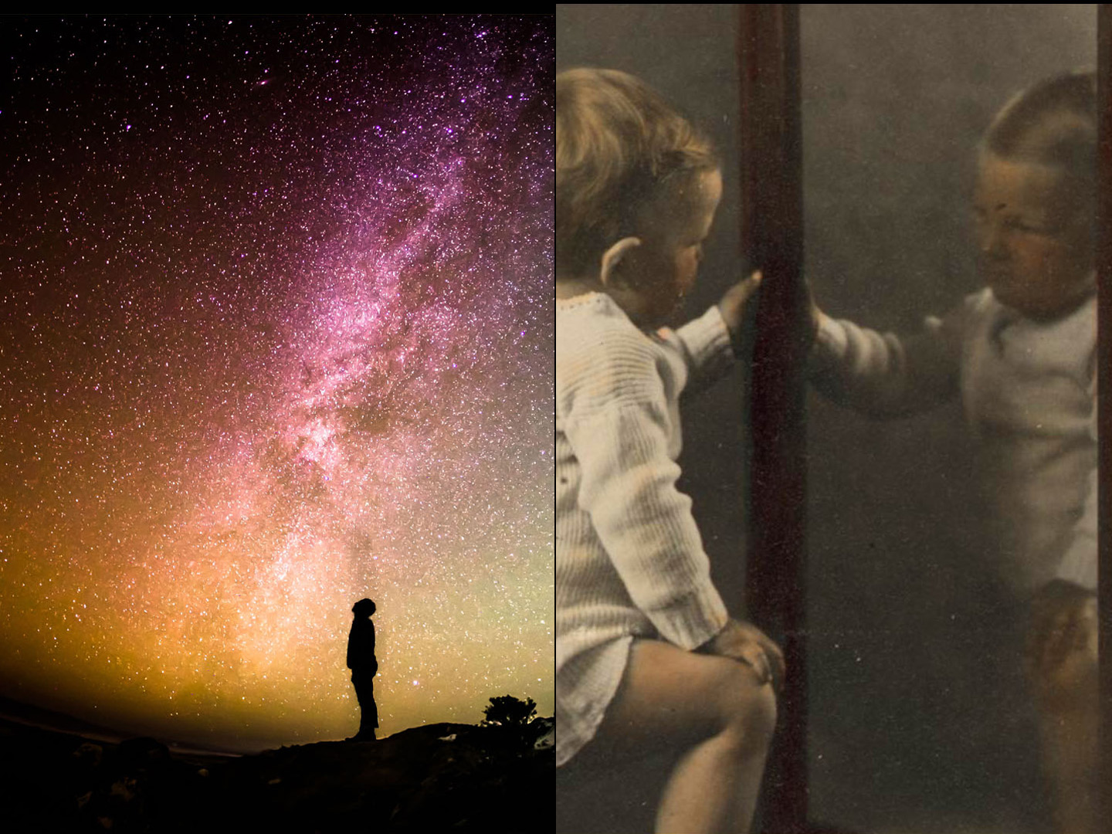

Slide 72
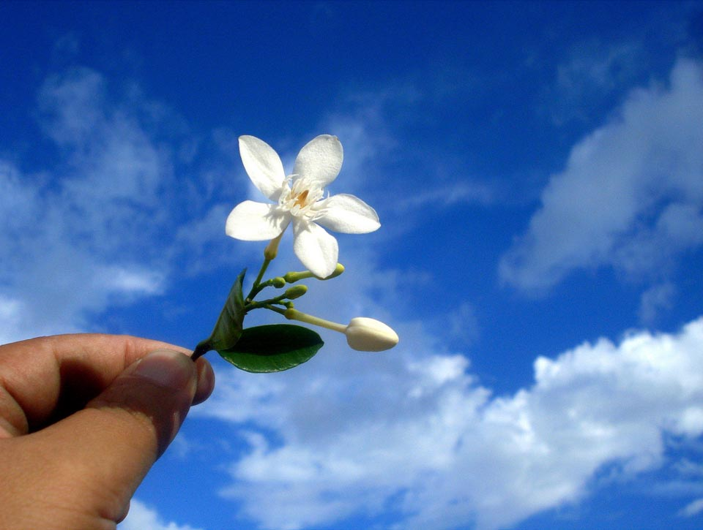
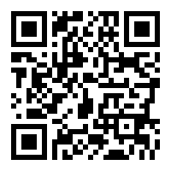
www.joemcveigh.org/resources
Thank you !
Thank you

Slide 73
www.joemcveigh.org

Slide 74
Solution focused questions
1) What are your best hopes?
2) What difference would that make?
3) What is already working in the right direction?
4) What would be the next sign of progress? What would the next step be?
Fredrike Bannink: 1001 Solution-focused questions

Slide 75
The Journey
"It's like driving at night with the headlights on. You can only see a little ways ahead of you, but you can make the whole journey that way." — E.L. Doctorow

Slide 76
Easy / Hard
“Even in a lesson that looks perfectly simple to you, the number of new things to trouble a beginner is surprising.” –Stevick

Slide 77
Unplugging
“Almost everything will work again if you unplug it for a few minutes, including you.” —Lamott, 2015

Slide 78
The most important words
The four most important words in any organization are . . .
“What do you think?” —Peters

Slide 79
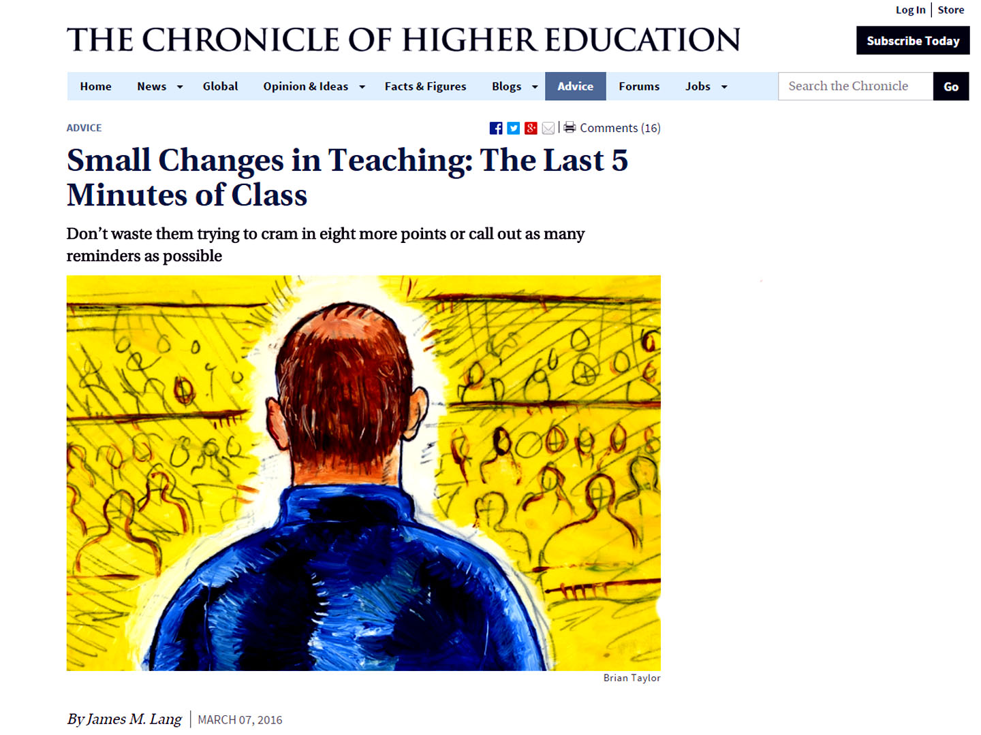

Slide 80
Advice
If you try to pull a stamp
off of an envelope
You are likely to tear it.
But if you hold the stamp,
and pull the envelope away from it,
The stamp will not tear.
This really works.
Try it sometime!
People are like that, too.
You can take a lot away from me
If you will leave me as I am,
But if you try to pull me away
From something that I have stuck
myself to,
It will be hard for you, and
very hard on me.
I hope you won’t forget this
next time.
—Stevick, 1977 Short Texts for Intermediate and Advanced Students of English as an Additional Language

Slide 81
Looking outward

Slide 82
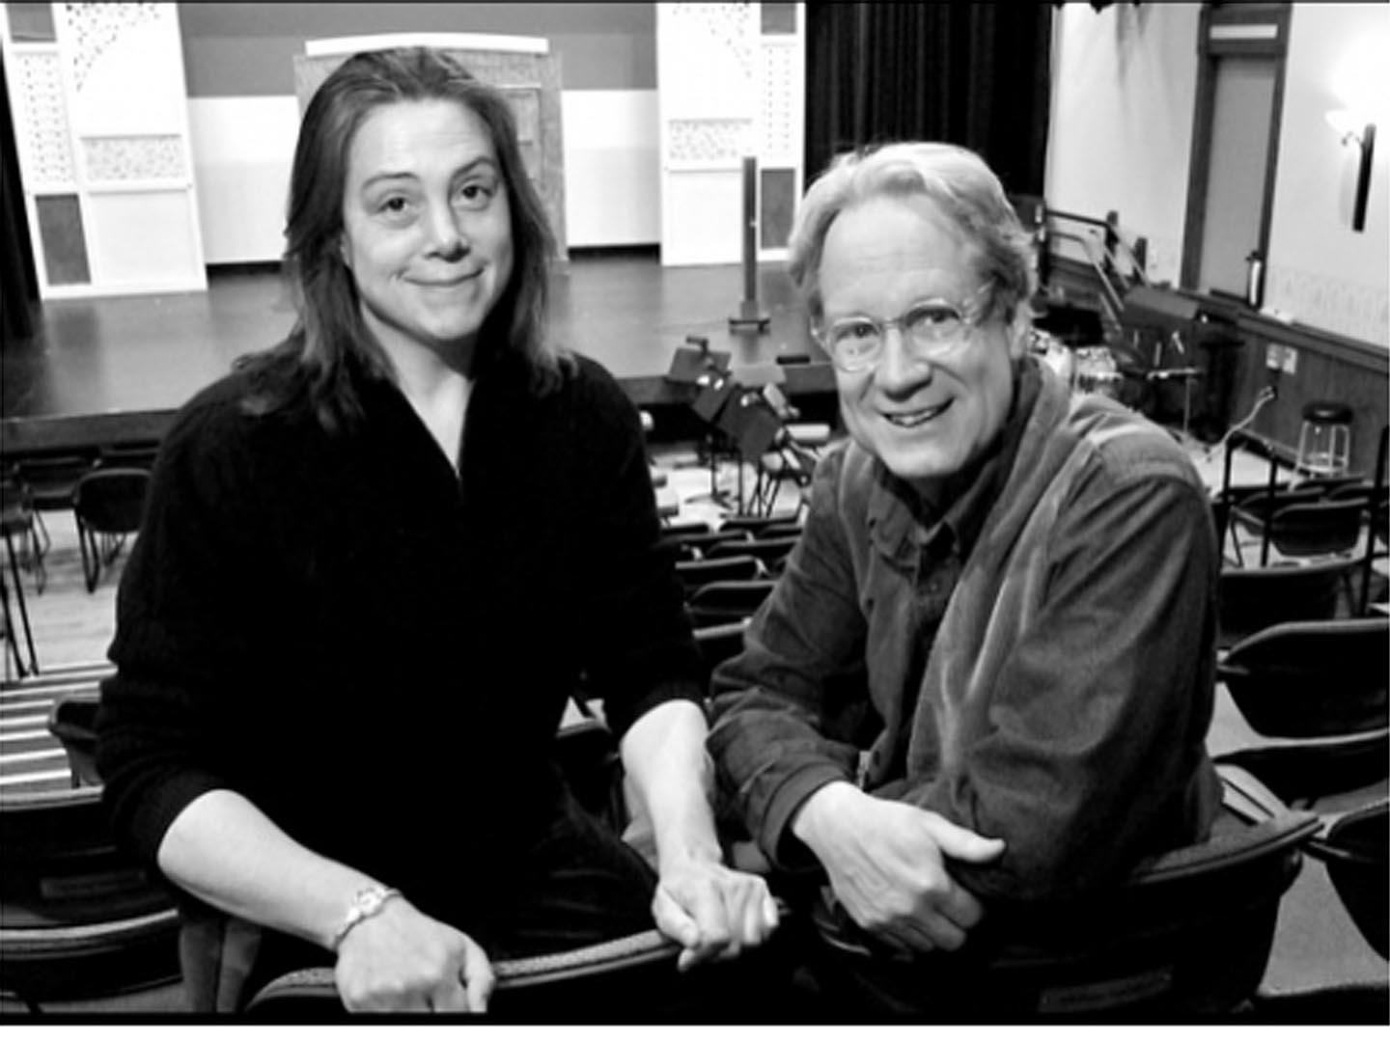
Create anticipation
Doug Anderson

Slide 83
Listen

Slide 84
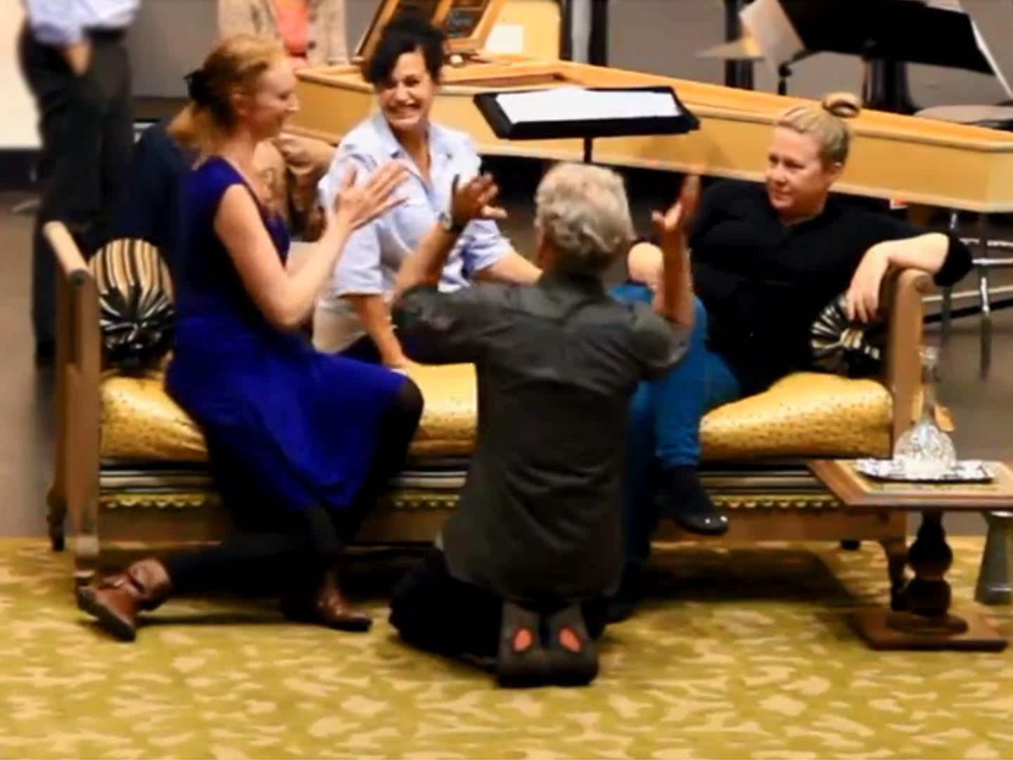
Keep things moving

Slide 85
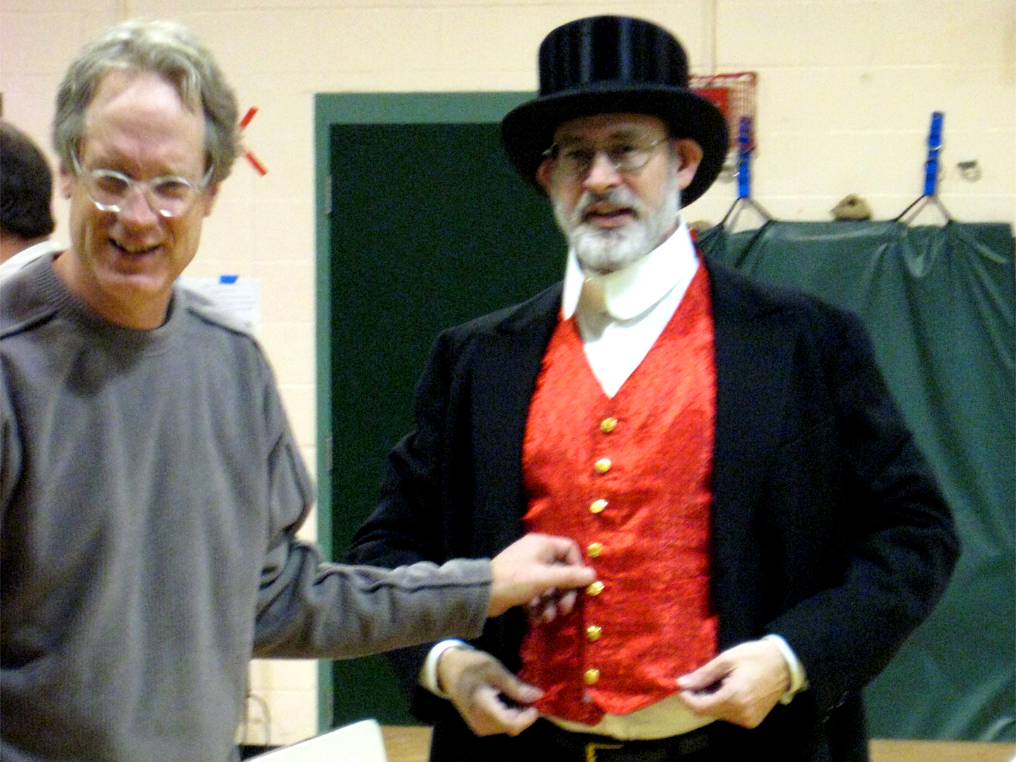
Pay attention to details

Slide 86
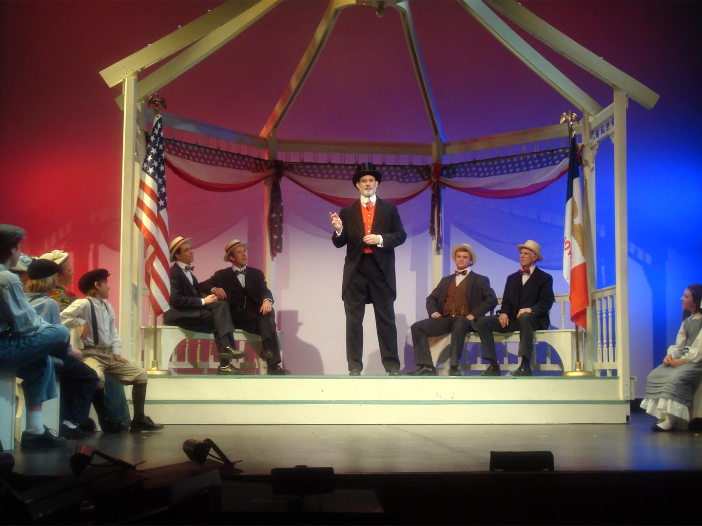

Slide 87
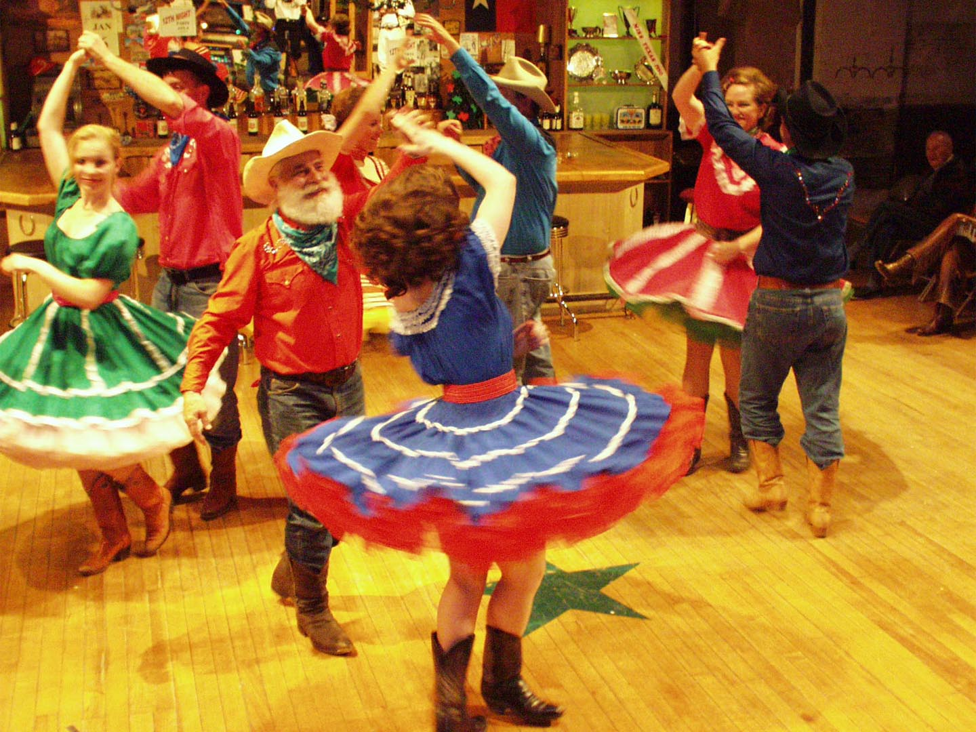
Have a clear vision

Slide 88
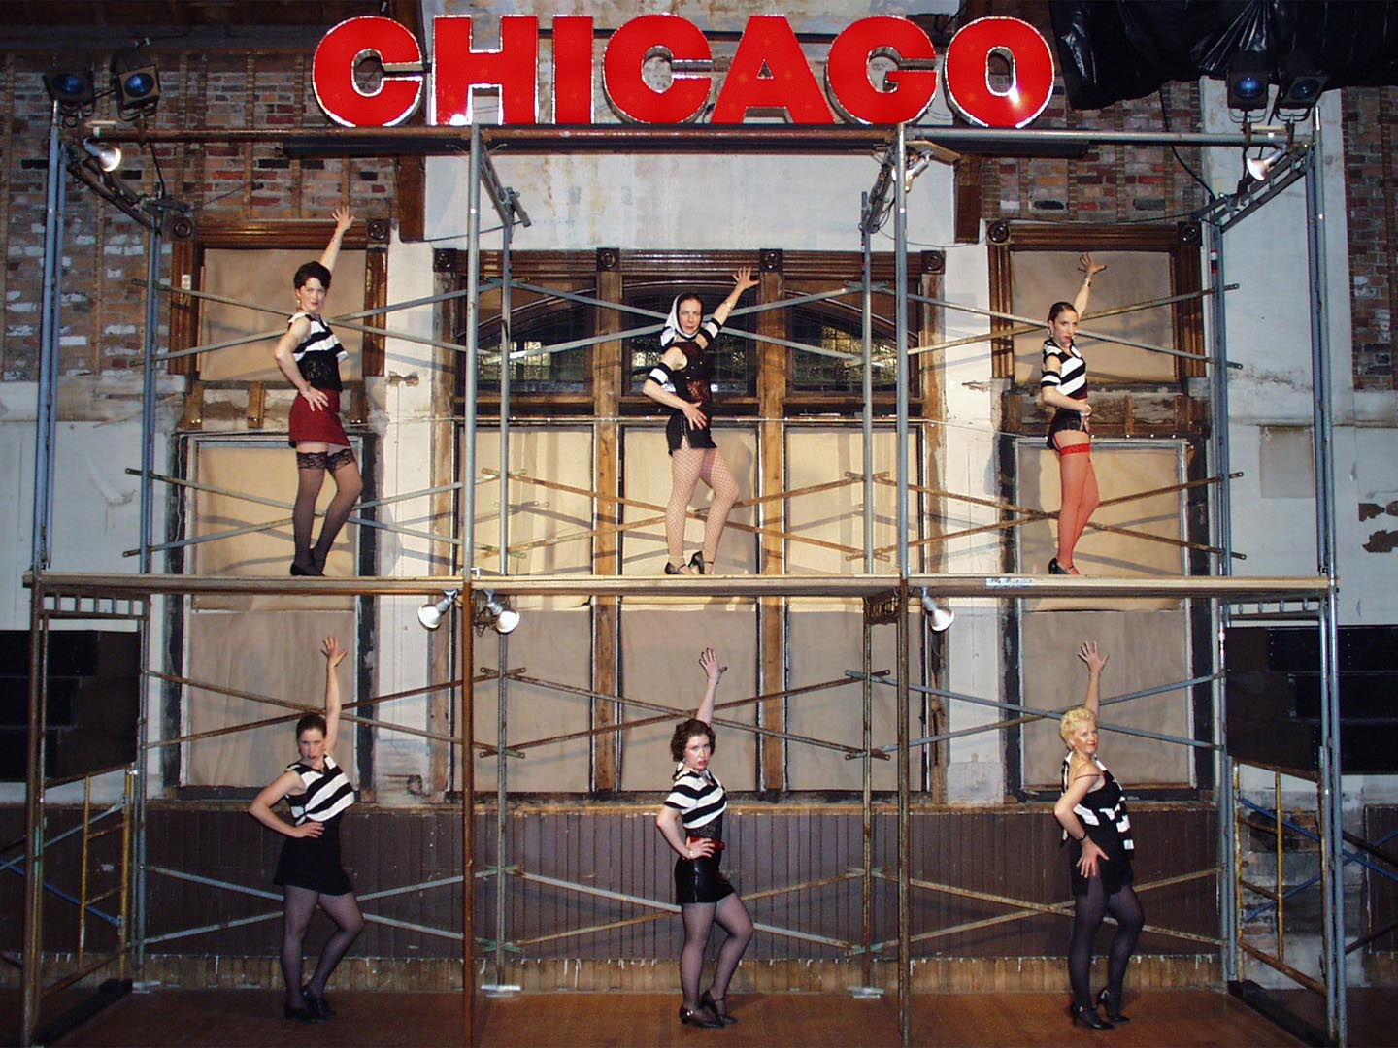
Make use of what you have

Slide 89
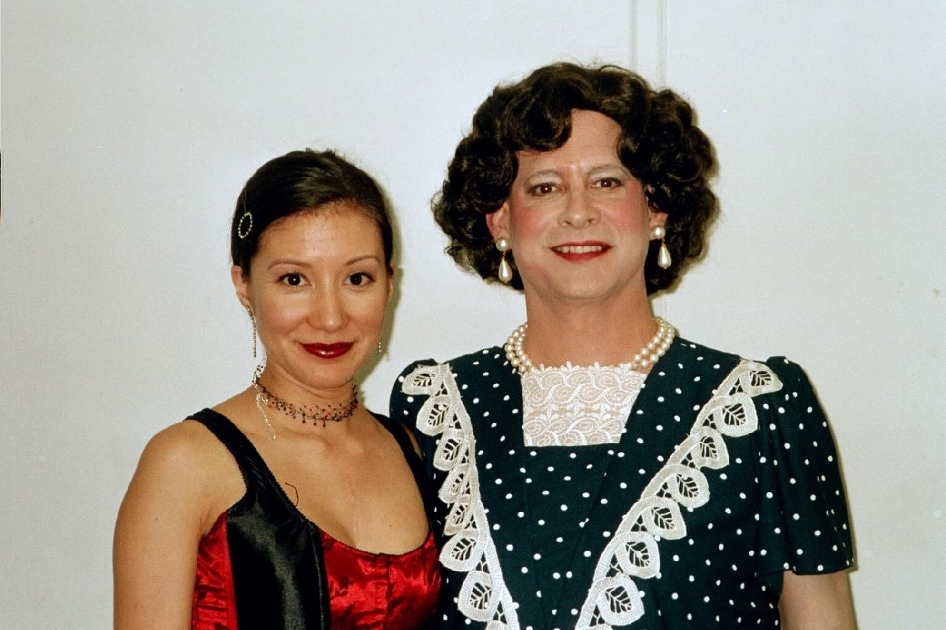
Be willing to do the unorthodox

Slide 91
You can do
anything
for 15 minutes

Slide 92
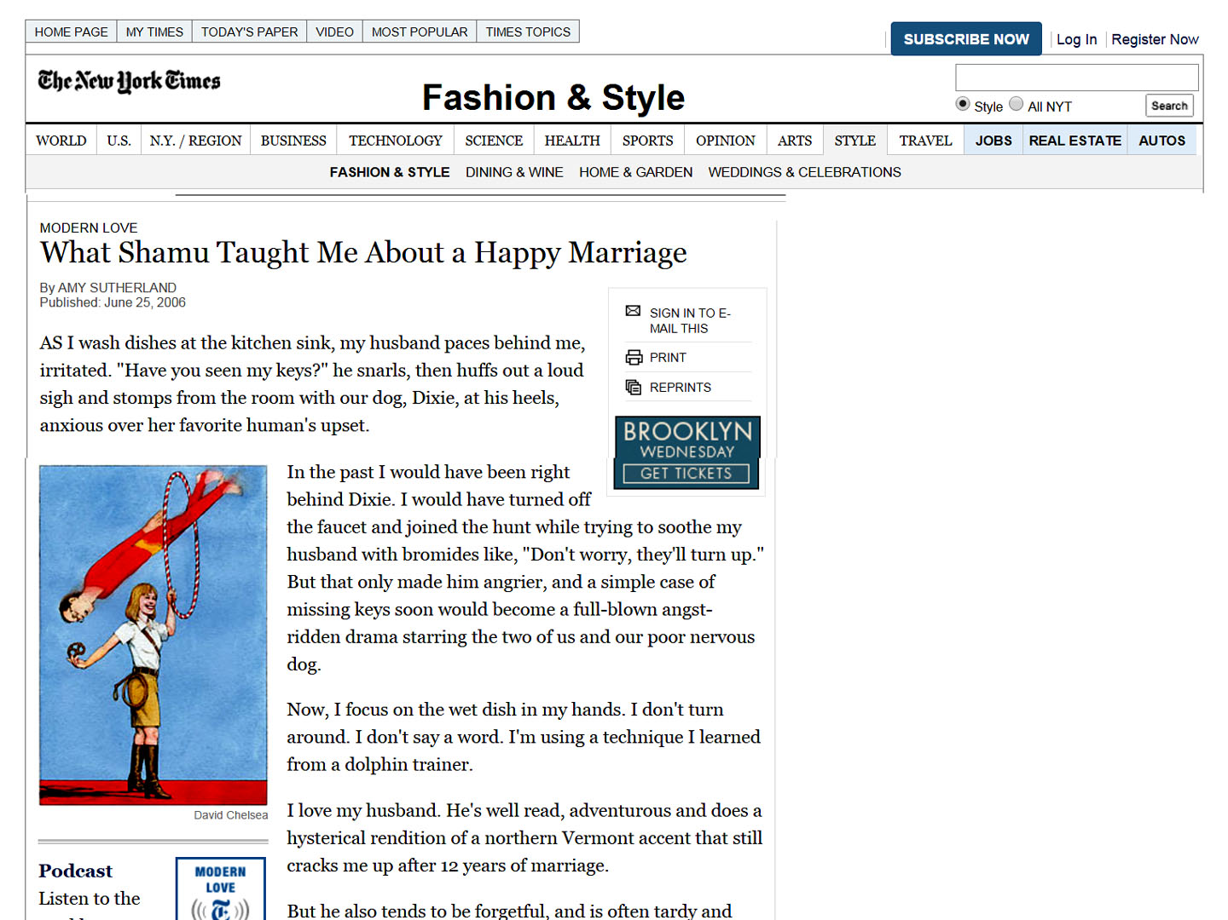

Slide 93
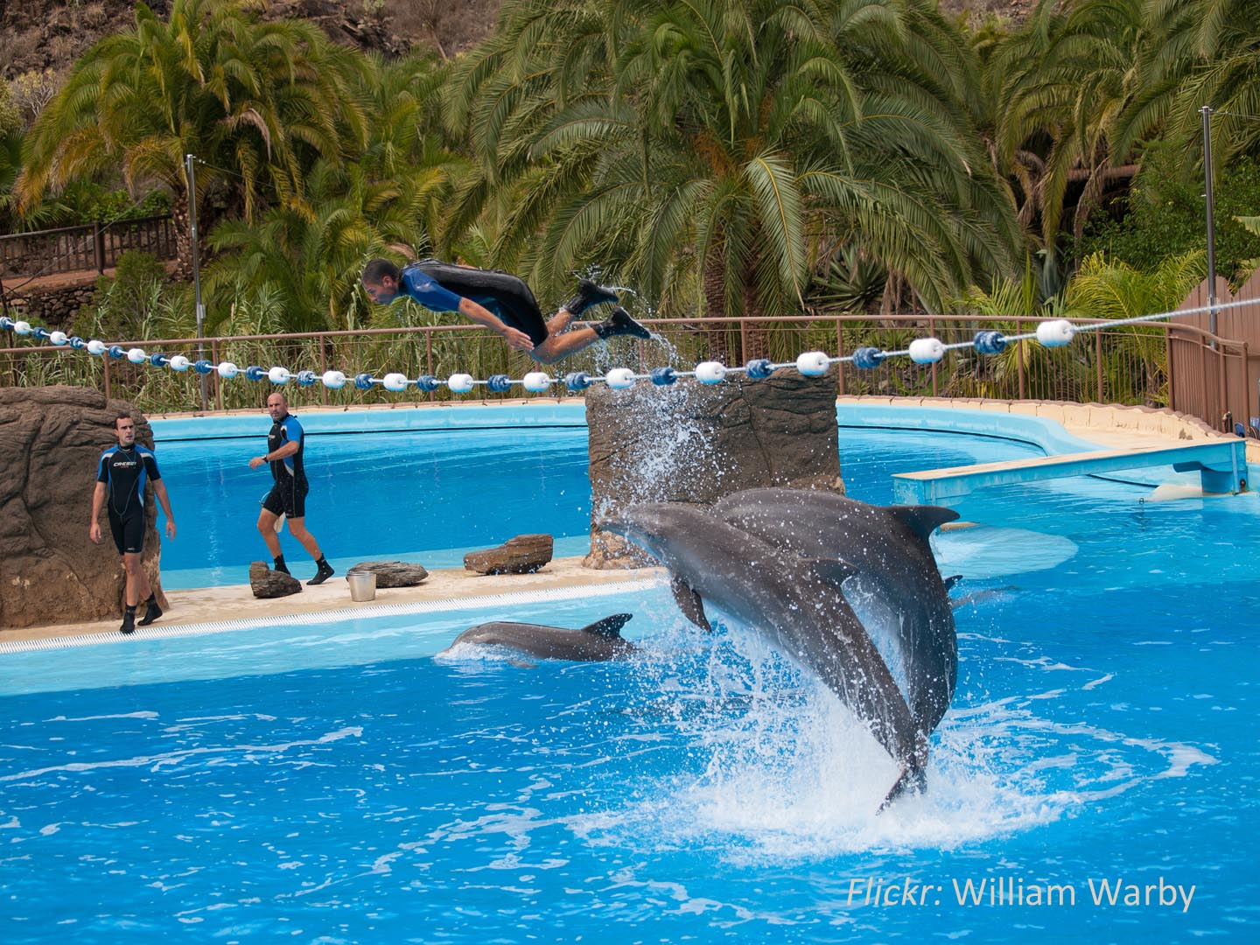
Reinforce positive behavior

Slide 94
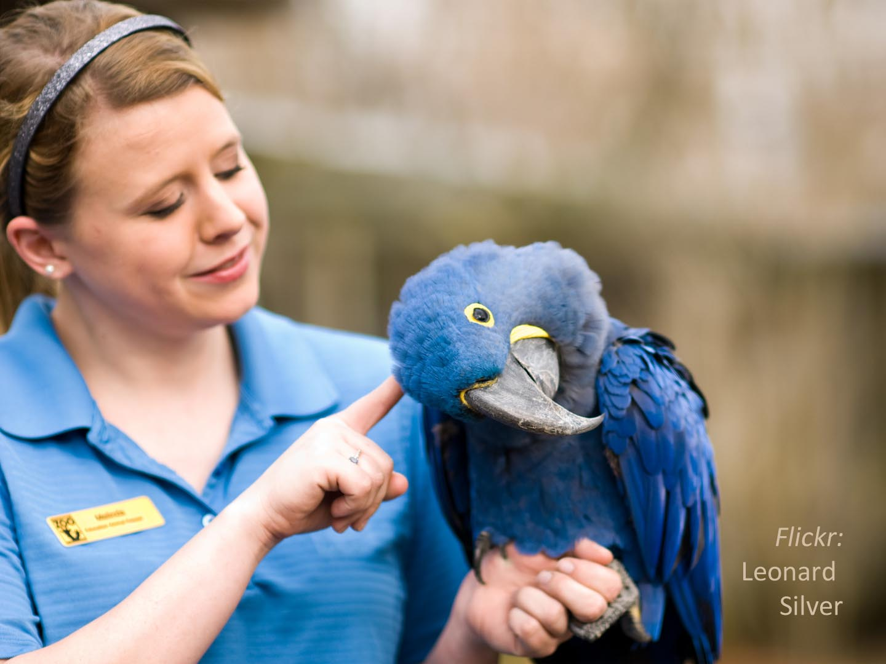
Ignore undesirable behaviors

Slide 96
Small things matter
The small things matter. Being balanced doesn’t mean dramatic upheaval in your life. With the smallest investment in the right places, you can radically transform the quality of your life.
-- Nigel March

Slide 97
Teacher as psychologist
“Every teacher is in his own way, a psychologist. Everything he does, says, or teacher has . . . a pychological impact. What he offers helps children to discover their resources and their limitations He is the central figure in countless situations which can help the learner to realize and accept himself or which may bring humiliation, shame rejection, or self-disparagement.” —Jersild, 1955

Slide 98
A larger purpose
Somewhere in those deep recesses of your mind and emotion you are guided by a sense of mission, of purpose, and of dedication to a profession in which you believe you can make a difference. Your sense of social responsibility directs you to be an agent for change. You’re driven by convictions about what this world should look like, how its people should behave, how its governments should control that behavior, and how its inhabitants should be partners in the stewardship of the planet.
--Brown 2007

Slide 100
A “living contradiction”
“It is one thing to see and articulate one's values as they develop and move in and out of view, and another to connect them with one's practice in life. Whitehead (2005) writes of the moment when we find that our practice contradicts our values, and of the consequent experiencing of our selves as a ‘living contradiction’, a potentially creative state and an impetus for inquiry.” —Underhill in Arnold & Murphy, 2015

Slide 101
Resistance to change
“There is really only one riddle – why do we resist change? Or perhaps we should say, ‘How do we manage to resist changing even when we are currently engaged in promoting change?’ In spite of the fact that we are sincere in our resolve to change, we nevertheless sabotage our own efforts and frustrate ourselves and others as we fall short of proclaimed goals.” —Clarke in Arnold & Murphy, 2015

Slide 102
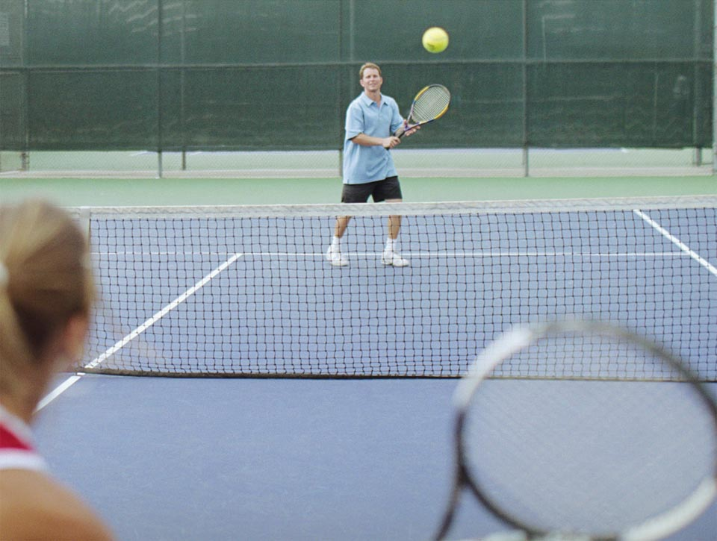
Timothy Gallway
The Inner Game of Tennis

Slide 103
Gallway – Inner Game of Tennis
Watch it change; don’t do the changing.
Self 1: the critic
Self 2: the do-er
Self 2 doesn’t actually listen very well to self 1

Slide 104
Gallway – Inner Game of Tennis
The Usual Way of Learning | The Inner Game Way of Learning
Criticize or judge past behavior | Observe existing behavior nonjudgmentally
Tell yourself to change, instructing with word commands repeatedly | Picture desired outcome
Try hard; Make yourself do it right | Let it happen! Trust yourself!
Critical judgment about result leads to a vicious cycle | Nonjudgmental, calm observation of the results leading to continued observation and learning

Slide 105
The riddle of mixed methods
“Stevick put forth a riddle, which I can summarize as follows: you can have two quite different methods, Method A and method B, based on different assumptions about how people learn, yet one teacher gets excellent results with A and another gets comfortable results with B. How is this possible?” —Underhill paraphrasing Stevick, 1976 in Arnold & Murphy, 2015

Slide 106
Atmosphere
Two approaches . . . same outcome but . . .
Same lesson . . . different outcomes
--- Adrian Underhill

